Slide 1
iMeta SSI for SCB
Technical Training
Day 1

Slide 2

Introduction to Trainer
James Watson
Support Manager
iMeta Technologies
E-mail: jwatson@imeta.co.uk
Telephone: +44 2380 763975

Slide 3

Introduction to iMeta
Privately owned UK based business
Formed in 2000, specialising in bespoke back-office software for the finance industry
First version of Assassin created in 2005 for Nomura Securities
Assassin v2 created in 2007 and delivered to Barclays Capital in 2008
Assassin v2 delivered to SCB in early in 2011
Assassin v3 created in late 2011 and delivered to Lloyds
SCB upgraded to Assassin v3 in 2012
iMeta CLM suite created in 2015
First CLM component delivered to HSBC in 2016
In addition to SCB, iMeta Software is used by Barclays, Credit-Suisse, BMO, ITG Europe, TDS & HSBC
Projects underway with RBC & Mitsui Bussan

Slide 4

Introduction to Attendees
Name
Role
Experience with iMeta SSI

Slide 5
Aim and objectives
The objective of the training is to provide the attendees with sufficient technical knowledge and understanding to allow them to complete the following tasks with iMeta SSI:
To understand the capabilities of iMeta SSI sufficiently to determine how future SCB business requirements could be implemented
Implement new requirements when this is achievable using iMeta SSI’s system administration toolset and/or configuration, or database. This would include data import, validation, workflow and permissions
Investigation of any issues encountered, establish the source of the issue and take steps to resolve that issue
Monitor the application and take proactive steps should issues occur
To understand the resources that are available to assist with the above

Slide 6

Course format

Slide 7
Agenda – Day 1
Start Time | Topic | Duration
10:00am | Introduction | 30 minutes
10:30am | Introduction to iMeta SSI | 30 minutes
11:00am | Tour of iMeta SSI Overview of UI, Introduction to Omgeo Alert, Import / Export in Client, System Administration | 90 minutes
12:30pm | Lunch | 60 minutes
1:30pm | System Architecture | 60 minutes
2:30pm | Database part 1 | 60 minutes
3:30pm | Review & Questions | 30 minutes

Slide 8
Agenda – Day 2
Start Time | Topic | Duration
9:30am | Recap & Questions | 30 minutes
10:00am | Database part 2 | 60 minutes
11:00am | Validation | 90 minutes
12:30pm | Lunch | 60 minutes
1:30pm | Workflow | 120 minutes
3:30pm | Review & Questions | 30 minutes

Slide 9
Agenda – Day 3
Start Time | Topic | Duration
9:30am | Recap & Questions | 30 minutes
10:00am | Logging | 45 minutes
10:45am | Monitoring | 30 minutes
11:15am | Documentation | 15 minutes
11:30am | Environment & Deployment | 60 minutes
12:30pm | Lunch | 60 minutes
1:30pm | Past / Common Issues | 60 minutes
2:30pm | SCB Customisations | 20 minutes
2:50pm | What’s new in iMeta SSI v3.6 | 20 minutes
3:10pm | Review & Questions | 30 minutes
3:40pm | Closing | 20 minutes

Slide 10
Introduction to iMeta SSI
10:30am

Slide 11
What is iMeta SSI?
iMeta SSI is a client - server application for the management of SSIs.
Initially developed in 2008 now in use several major multinational banks
Core functionality encapsulated in Base product common to all
Customer specific functionality in Custom version
iMeta SSI can receive data from a number of sources. These include:
Manual Input
Omgeo Alert (via Alert Direct)
Custom Data Feeds (Upstream)
Bulk upload (typically from spreadsheet) using Imports capability
iMeta SSI Enriches and manages this reference data
Automated Trading Account and SSI data distribution to (Downstream) settlement systems

Slide 12
iMeta SSI Capabilities
Automatic management of Alert source reference data
Comprehensive data validation across all sources of SSI data
Auto-repair of invalid data using validation and workflow rules
Can provide a strict 4 eyes approval requirement for manual changes
Maintains an audit trail of changes and actions

Slide 13
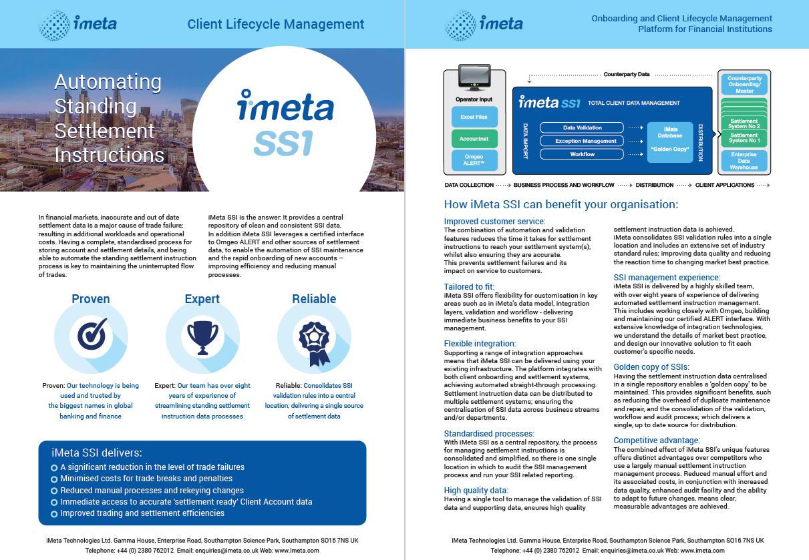

Slide 14
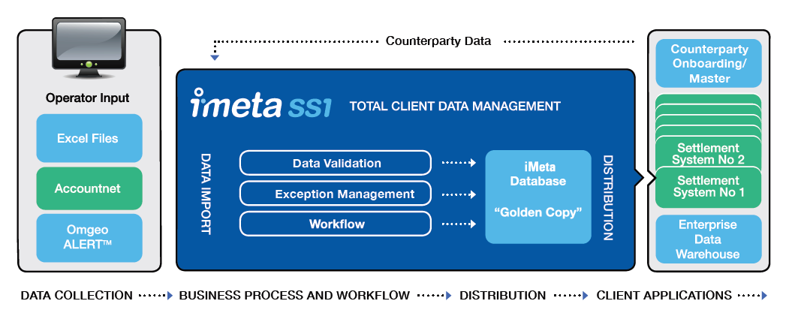
iMeta SSI

Slide 15
iMeta CLM Platform

Slide 16
Tour of iMeta SSI
Overview of User Interface
Look at key screens
Cover key concepts

Slide 17
Data Hierarchy
Counterparty
Trading Account
SSI
Contact
Trade Confirm
Contact
Settlement Chain Entries
Document
Document
Document

Slide 18
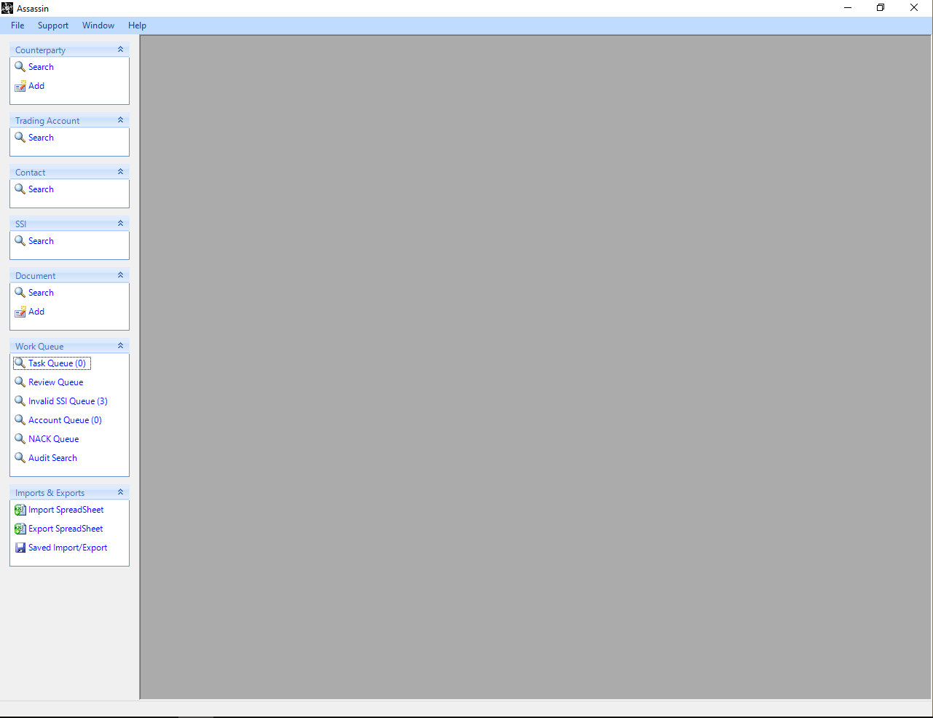
Desktop Client
Notes:
- On successful login the iMeta SSI Main Form will be displayed to the user as shown in the screenshot below.
- The iMeta SSI Main Form is used to access all the iMeta SSI functions needed for managing settlement data.
- These functions are accessed via the Main Form Sidebar which is shown on the left hand side of the Main Form.
- The Sidebar provides access to the main types of iMeta SSI functionality which are listed below.
Searches
Queues
Audit Search
Imports & Exports
Creation of Counterparties/TA
- The Main Form also has a standard windows menu at the top where System Administration functions and other options are available
- Permissions can be assigned to users that Grant access to the items on the sidebar

Slide 19
Desktop Client
On successful login the iMeta SSI Main Form will be displayed to the user
The iMeta SSI Main Form is used to access all the iMeta SSI functions needed for managing settlement data
These functions are accessed via the Main Form Sidebar which is shown on the left hand side of the Main Form
The Sidebar provides access to the main types of iMeta SSI functionality which are listed below.
Searches
Queues
Audit Search
Imports & Exports
Creation of Counterparties
The Main Form also has a standard windows menu at the top where System Administration functions and other options are available

Slide 20
Counterparties
Top level iMeta SSI record
Can be created via:
Manual Input
Import
Upstream message from SCI
Parent iMeta SSI record of a Trading Account

Slide 21
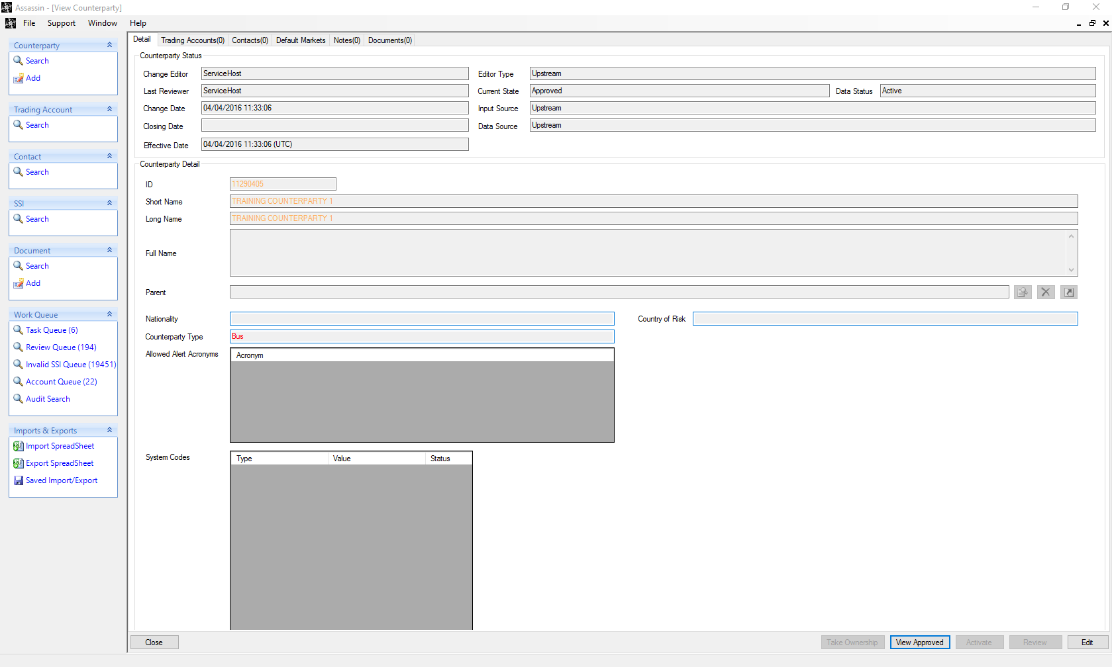
Counterparty View Screen

Slide 22
Trading Accounts
Trading Accounts can be created using the following methods:
Manually
Import
Downloaded from ALERT
Upstream via SCI
Certain fields are required for a Trading Account
Address
City
Country
Many Trading Accounts can exist under a Counterparty

Slide 23
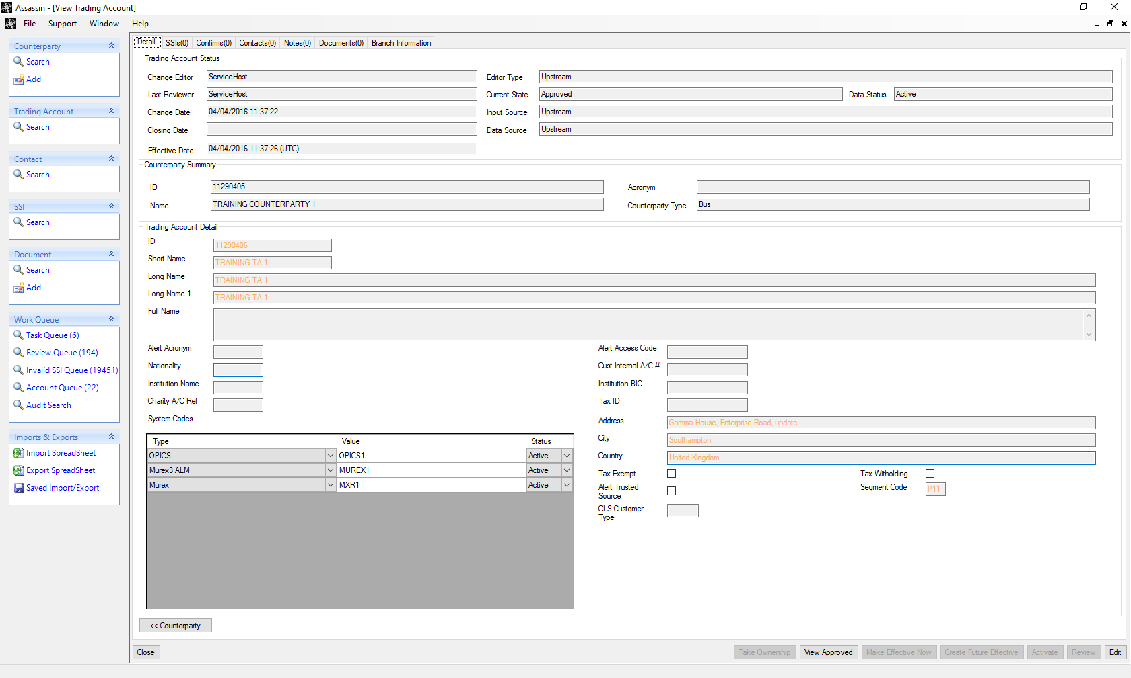
Trading Account View Screen

Slide 24
SSIs
Reside under an iMeta SSI Trading Account
2 Types of SSI
Each SSI type has different steps
Cash (based on a cash Trade e.g. Foreign Exchange)
Non-Cash (based on a non-cash Trade e.g. Equities)
Can be sourced in the following ways
ALERT
Manual
Import
Notes:
- Mention the types of SSIs are linked to the data in sys admin.

Slide 25
Cash SSI steps in the real world
Shown with examples of different levels of clearing

Slide 26
Non Cash SSI steps in the real world
Shown with examples of different levels of clearing
Note: It is common for the DEAG/REAG and DECU/RECU to be the same

Slide 27
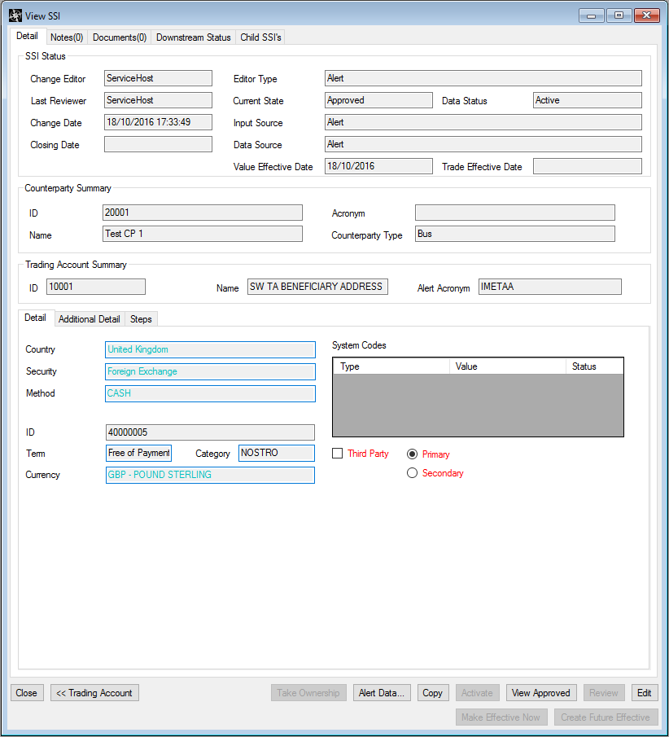
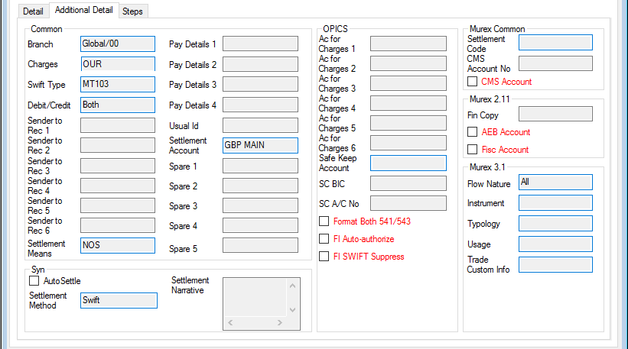
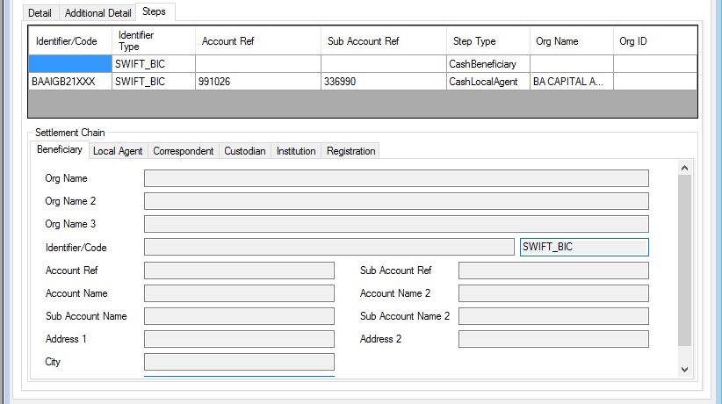
SSI View Screen

Slide 28
SSI Business Key
From a business point of view, SSIs are uniquely identified by their ‘Business Key’
Business key contains a selection of fields which identify the SSI
Used to define when two SSIs are considered to be duplicates, under the same Trading Account
Business key uniqueness is enforced by the use of a Validation Rule
The SCB business key fields are:
Country, Security, Settlement Method, Currency, Branch Id, Settlement Code, Debit/Credit, Usual Id, Safe Keep Account, Settlement Means, Settlement Account, Term, Category, Flow Nature, Instrument, Typology, Usage, Trade Custom Info
Parent Trading Account is also intrinsically part of this key

Slide 29
ALERT SSIs
SSIs are downloaded from ALERT based upon the Market Filter sets in system Administration
Market filters specify what SSIs should be downloaded
If there are no validation Failures when an SSI is downloaded the SSI does not need approval (based on configuration)
Updates to ALERT SSIs are automatically downloaded from ALERT via the iMeta SSI ALERT Poller and Downloader services
SSIs can be automatically downloaded or manually downloaded. This depends on their ‘effect’ setting in Market Filters.
ALERT SSIs can only be downloaded when the Trading Account is an ‘ALERT trusted Source’

Slide 30
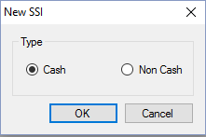
Manual SSIs
User can specify which SSI type to create
Can only be created by users with correct permissions
Need to be approved before they can be sent downstream
Certain fields must be populated before the SSI can be saved.

Slide 31
Copy/Import SSIs
Copy
SSIs can be copied via the Trading Account SSI screen
Copied SSIs need business key fields changing
Only SSIs that have a previously approved version can be copied
Import
Can use the iMeta SSI import tool to create SSIs via an Excel spreadsheet
Will cover this in a later session

Slide 32
Object Change State
iMeta SSI has the concept of states and a series of state transition rules
The following states are present in iMeta SSI:
Pending: Assassin Object has be changed/created but needs approval
Approved: Assassin Object has been approved by a reviewer and if it is an SSI it my/may not be sent downstream
Draft: Assassin object has had some manual changes and these have been saved in draft
Invalid: Assassin object has failed Assassin validation
PendingParentApproval: Parent object is not in the approved state but the object has been approved
Rejected: Assassin object was rejected by a reviewer
Closed: Assassin object has been closed
Editing: Assassin object is currently being edited
Reviewing: Assassin object is currently being reviewed by another user

Slide 33
State Transition Rules and Actions

Slide 34
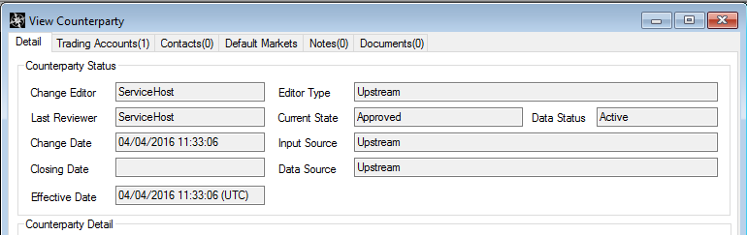
Status Panel
Status panel shows the status of an iMeta SSI Record
All iMeta SSI records have a Status Panel

Slide 35
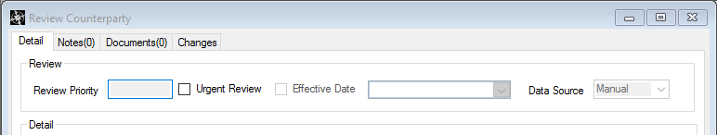
Review Panel
Review panel is displayed when the iMeta SSI Record is being reviewed by a user.
All iMeta SSI records have a Review Panel

Slide 36
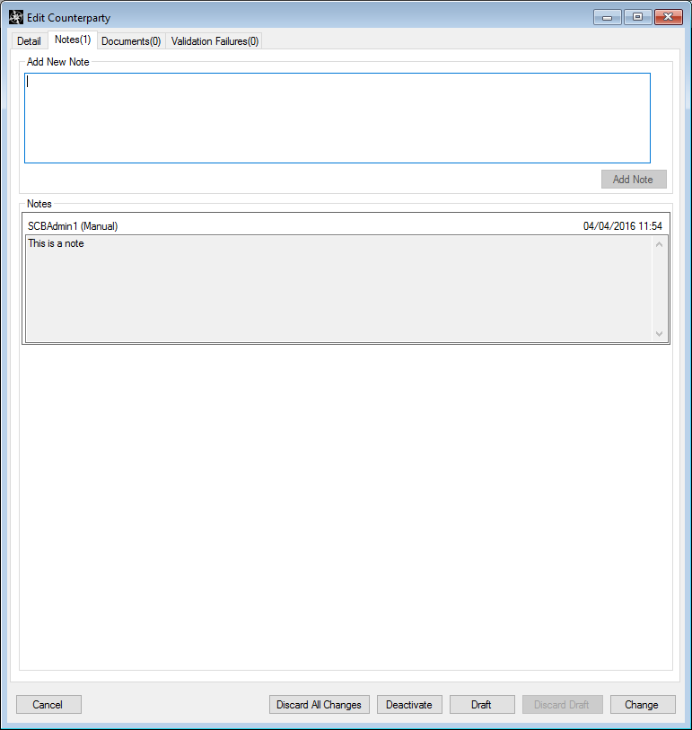
Notes
Notes are available on all iMeta SSI Records.

Slide 37
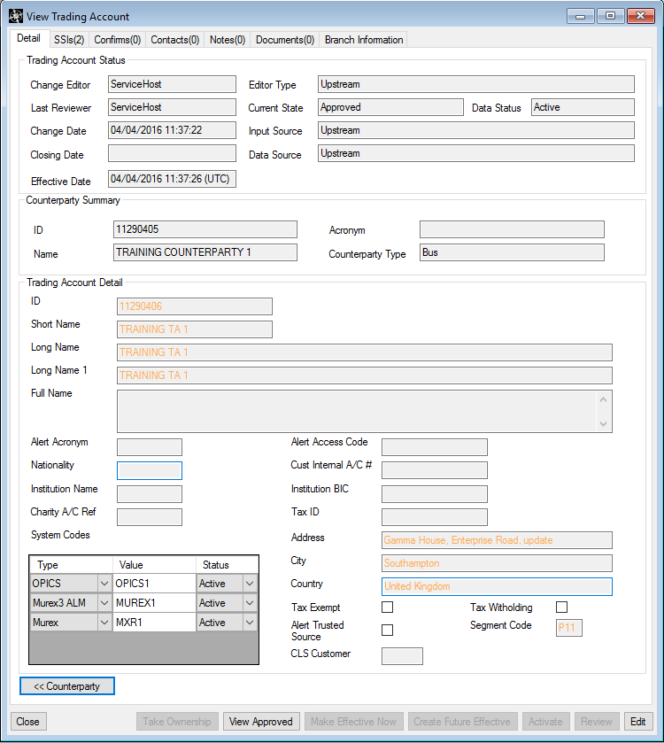
View Mode
View mode is used when iMeta SSI objects are being viewed but no user interaction is taking place.

Slide 38
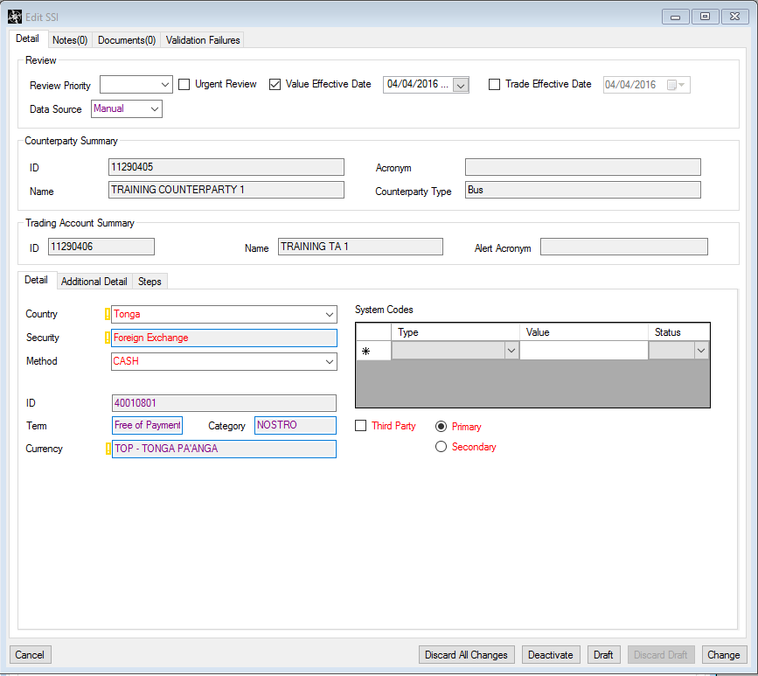
Edit Mode
Edit mode is used when a user selects the Edit button on an iMeta SSI Record
Edit mode shows mandatory fields as well an any validation failures
Records that are being edited can be saved as a draft
If a record has been edited and is invalid then it cannot be saved

Slide 39
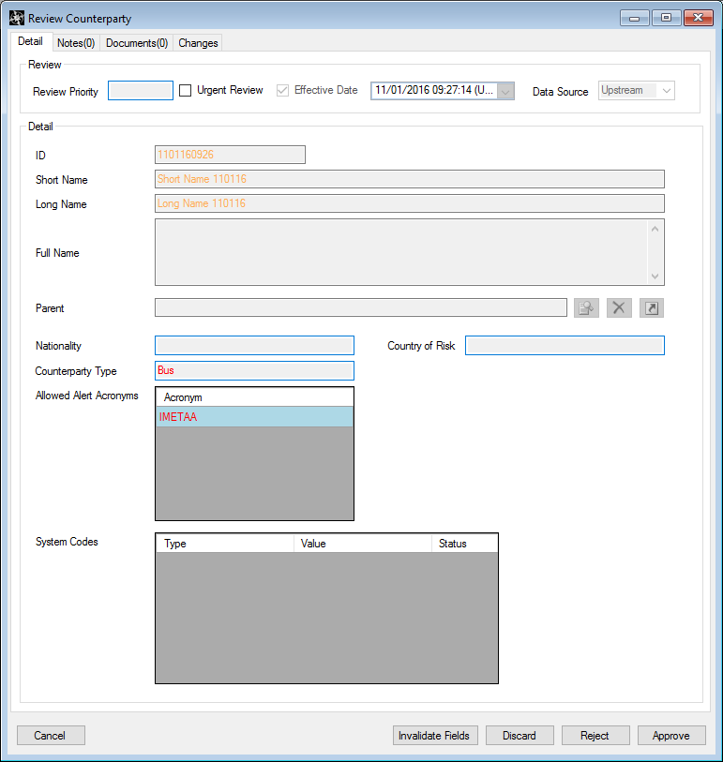
Review Mode
Review mode is used when a user is reviewing a record.
Changed fields are highlighted in blue

Slide 40
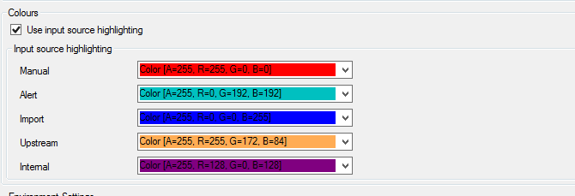
Field Source
Data in iMeta SSI in colour coded based upon its source
This colour configuration can be configured in System Administration
The input sources are as follows:
Manual
Changes made by a user via the iMeta SSI interface
ALERT
Changes made by ALERT i.e. SSI data downloaded from ALERT
Import
Changes made when an iMeta SSI Record is imported
Upstream
Changes made via an upstream message
Internal
Changes made by iMeta SSI directly, most likely source is workflow, but could be other

Slide 41
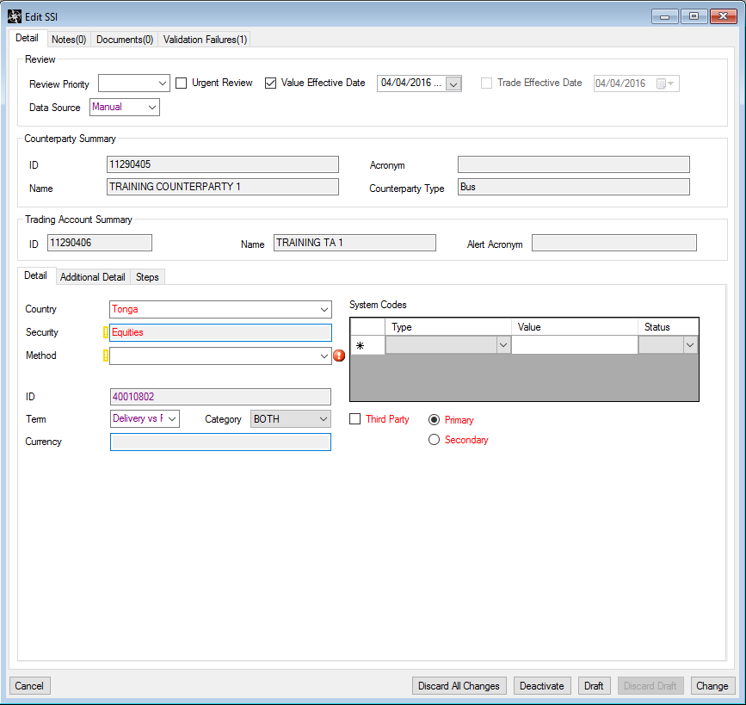
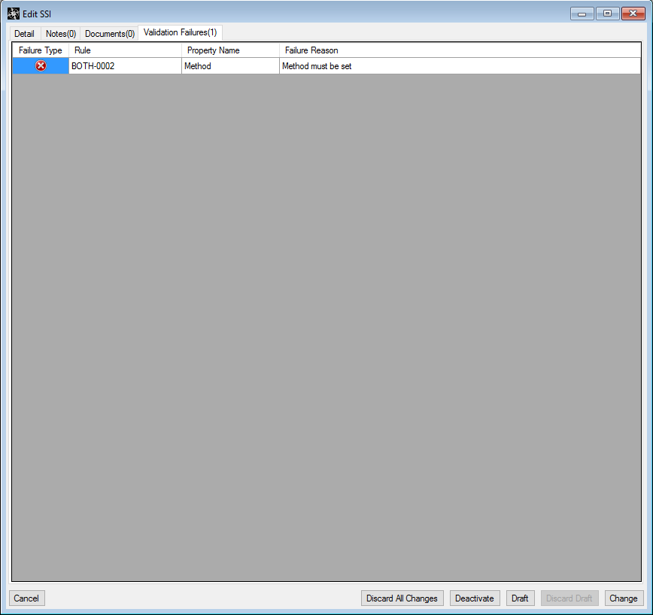
Validation Rules
Data entered into iMeta SSI is validated by Validation Rules
iMeta SSI records cannot be Approved until there are no Validation Failures
This icon will be displayed when an iMeta SSI field fails validation
Lots more on this later

Slide 42
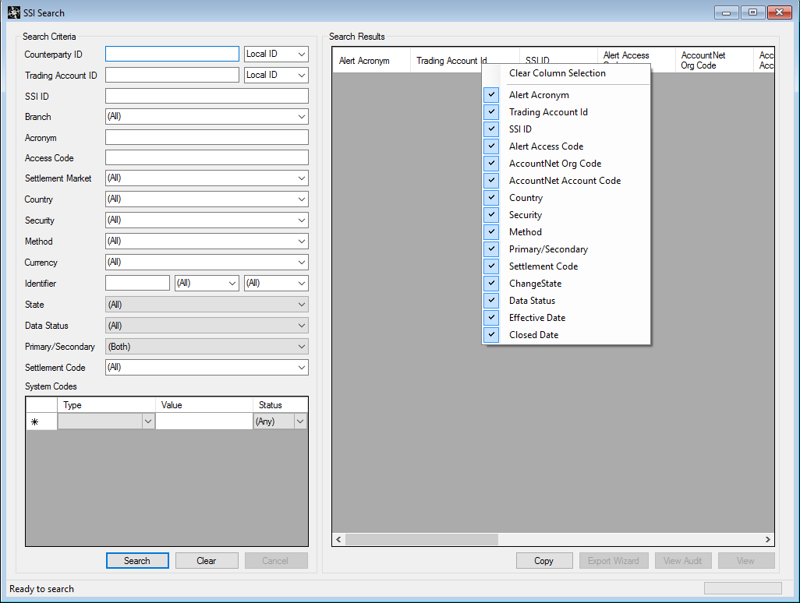
Searching
iMeta SSI provides search forms for each record type
Each search form contains a standard set of functions
In order to maintain system performance the default maximum number of records returned is configured to be up to 2000 records
Chosen search criteria are chained together using a logical ‘AND’ operator
Records which are returned by the search will match all the criteria entered.
Searches can be saved and shared
Search functionality is used within iMeta SSI’s Export feature

Slide 43
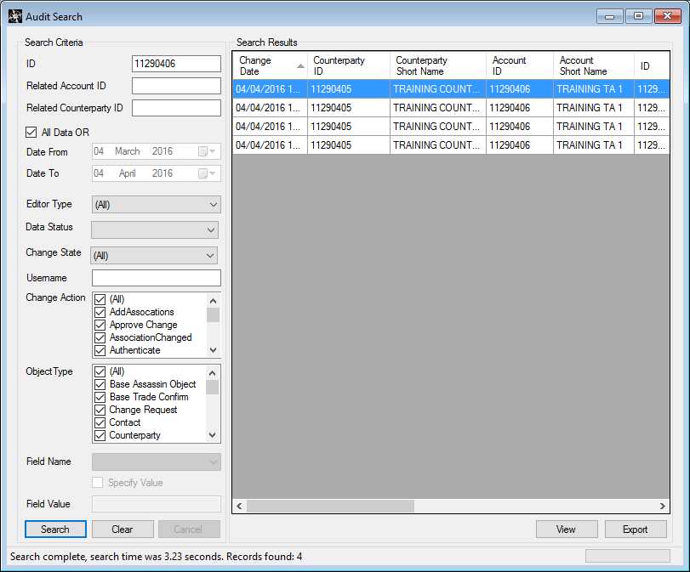
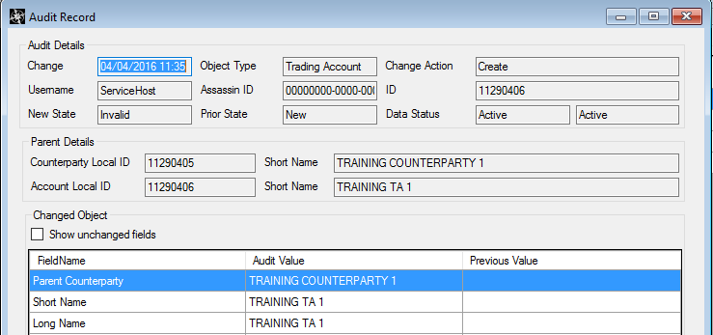
Audit
iMeta SSI maintains a complete version history of Records, detailing changes
Useful to help Identify what changes were made by whom and when
Can search for any iMeta SSI Record
Can export Audit details as a pdf
Search returns all versions of an iMeta SSI Record
Can drill down in to an iMeta SSI Record specific version to show what fields changed compared to the previous version

Slide 44
Notes about GUIDs & OIDs
This screen is the only way to locate and view the object identifier of a record from the iMeta SSI Client
See The Assassin ID field.
It contains a value of the C# GUID data type that is unique across iMeta SSI.
In the iMeta SSI database this is stored as a RAW(16) and there are database functions to convert between this ID and its oracle format.
To find the object in the iMeta SSI database use:
Select GetRawFromGuid('c3f1414f-f3ed-462f-8b1b-703249c63f27') from dual;
To check the Assassin ID in this dialog from the value in the database:
Select GetGuidFromRaw('4F41F1C3EDF32F468B1B703249C63F27') from dual;

Slide 45
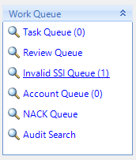
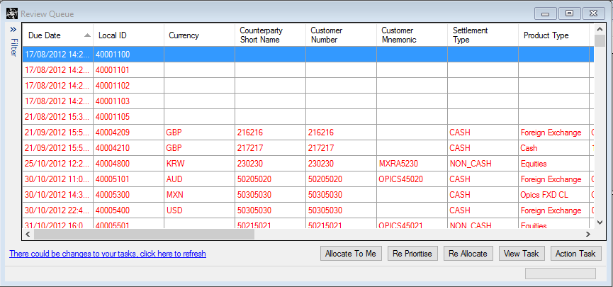
Task/Notification Queues
Queues contain Tasks that relate to data managed in iMeta SSI
Queues can be used for work prioritisation and can help define a process
SCB has 5 Queues
Each queue displays a count of the number of tasks in the queue
Tasks can be assigned to users and notification to users of Tasks assigned to them can be configured
Tasks within a queue can be filtered

Slide 46
Task/Notification Queues
Account Queue
Account Queue contains Counterparties and Accounts that are in the Invalid or Pending state
Tasks leave the Account Queue when they leave the Invalid or Pending state
Invalid SSI Queue
Invalid queue contains Tasks for SSIs that are in the ‘Invalid’ state
Tasks leave the invalid queue when the underlying Assassin object is no longer in the Invalid state
Review Queue
Review queue contains Tasks for SSIs that are in the ‘Pending’ state
Tasks leave the pending queue when the underlying Assassin object is no longer in the Pending state
Nack Notification Queue
Nack queue contains SSIs that have not successfully been accepted by downstream
Tasks leave the Account Queue when an ACK is received
Task Queue
Tasks queue has a different column layout to the other queues
Shows all Tasks assigned to the logged in user
‘Allocate To Me’ button not visible

Slide 47
Difference between Task and Notification Queues
Notification Queue
SSI Nack Queues
Tasks enter the queue when SSI Nack messages arrive
Tasks leave the queue when SSI Ack message arrive
Task Queues
Account Queue / Invalid SSI Queue / Review Queue
Tasks enter and leave the queues when associated record changes state
E.g. A task leaves the Review queue when:
SSI transitions from ‘reviewing’ to ‘approved’ state
SSI transitions from ‘reviewing’ to ‘rejected’ state
E.g. A task leaves the Invalid SSI queue when
SSI transitions from ‘invalid’ to pending
SSI transitions from ‘editing’ to pending
SSI transitions from ‘editing’ to draft
SSI is deactivated

Slide 48
Tour of iMeta SSI
Omgeo ALERT

Slide 49
What is ALERT?
Omgeo ALERT is the industry’s largest and most compliant online global database for the maintenance and communication of account and standing settlement instruction (SSI) data
iMeta SSI can download Trading Accounts and SSIs from ALERT
Trading Accounts and SSIs can be downloaded manually or automatically in iMeta SSI

Slide 50
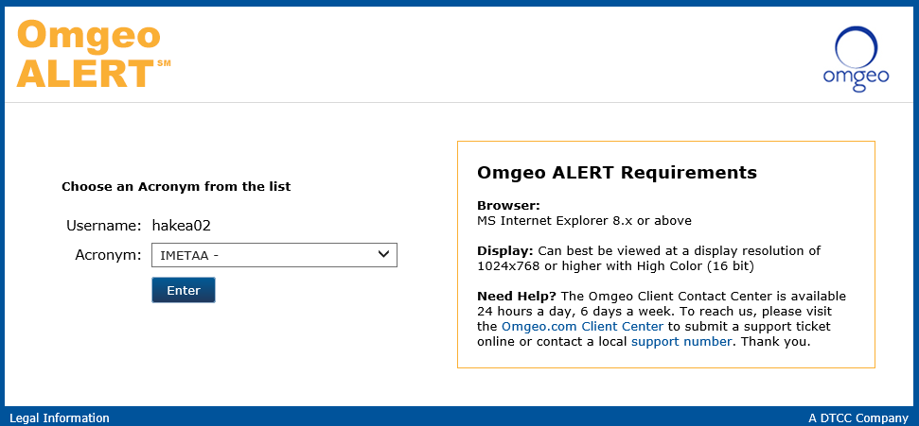
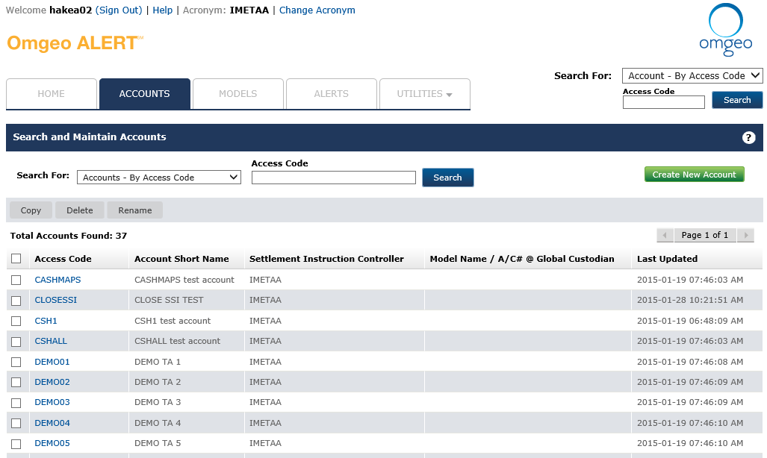
Alert On the Web
https://alertct.omgeo.net/cleartrust/ct_logon.jsp
Broker Acronym Chooser Screen:
Trading Account Screen:

Slide 51
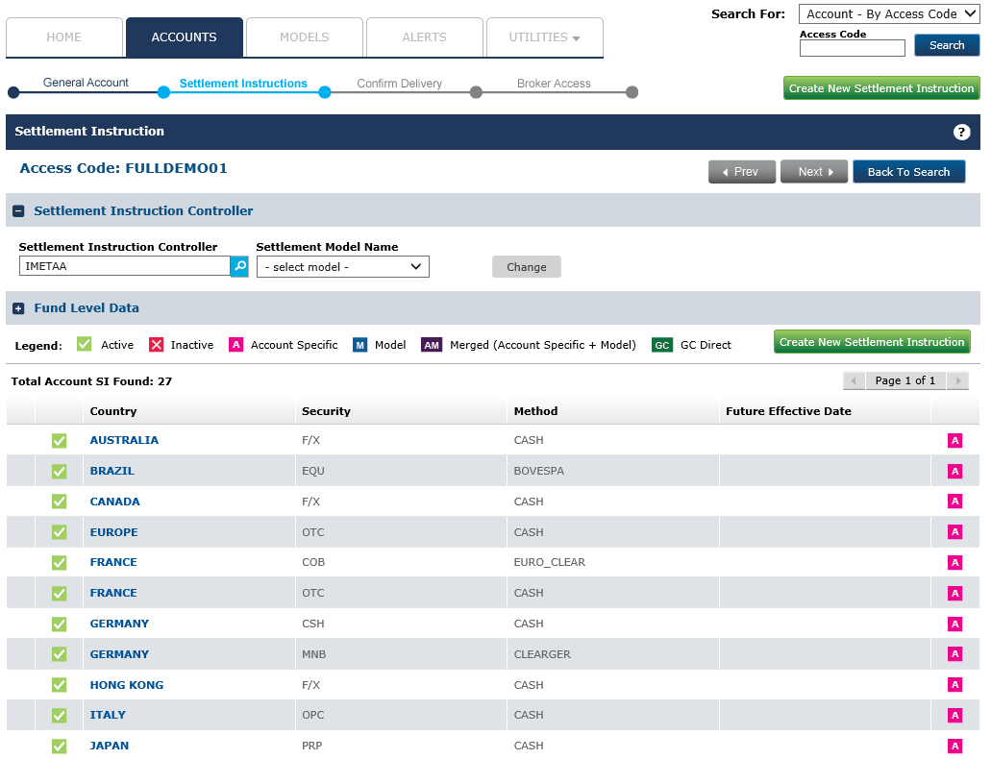

Slide 52
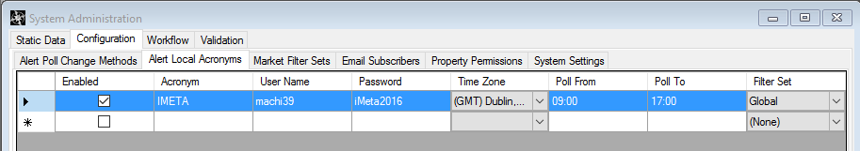
Integration with ALERT
iMeta SSI can only download Trading Accounts that the Broker Acronym has been permissioned for. The Investment Manager will permission Broker Acronyms to have access to Trading Accounts.
The broker Acronym that SCB use is configured in the ALERT Acronyms tab in System Administration
iMeta SSI uses the ALERT Direct API to download Trading Accounts and SSIs.
iMeta SSI ALERT Poller and Downloader are used to monitor and download updated Trading Accounts and SSIs
Records source from ALERT have an Input source of ALERT

Slide 53
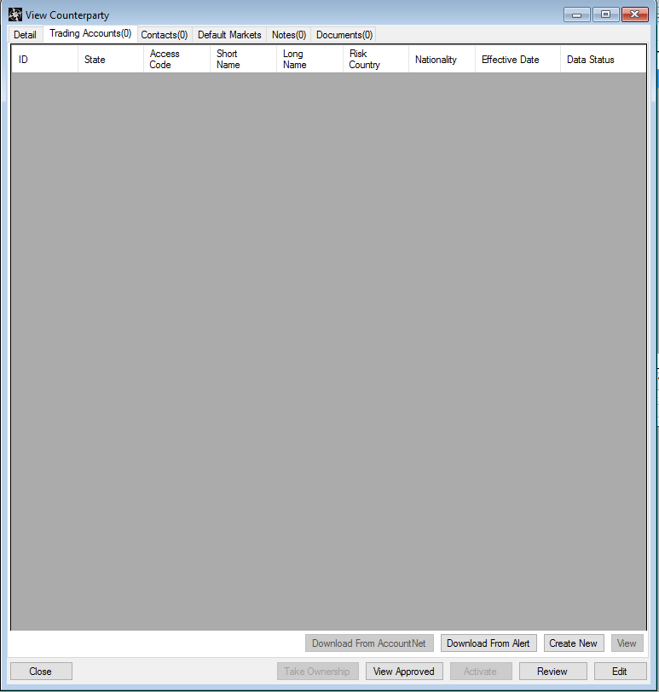
Manually download ALERT Trading Account
You can manually download a Trading Account from ALERT via the Trading Account Tab under a Counterparty using the ‘Download From ALERT’ button

Slide 54
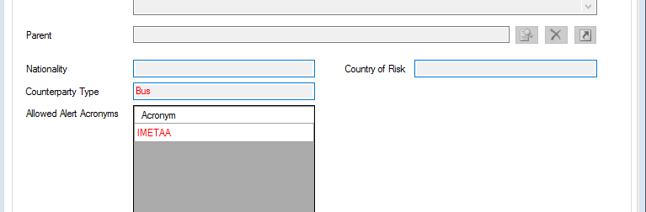
Manually download ALERT Trading Account
To download a Trading Account from ALERT the Counterparty should have the Acronym field populated with a valid Acronym and the Counterparty should be Approved

Slide 55
ALERT Trading Accounts from SCI
Upstream Trading Account Messages from SCI can contain an ALERT Acronym and Access Code
An Acronym and Access Code are required to download the Trading Account and SSIs from ALERT
No extra Trading Account data and SSIs will be downloaded until the Account has its ALERT trusted source flag set

Slide 56
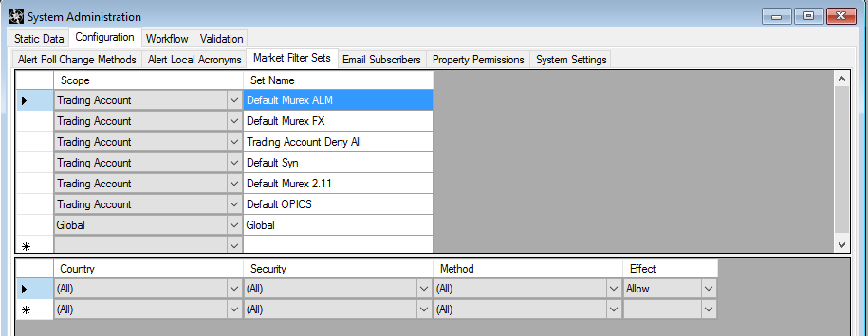
Download SSIs from ALERT
SSIs are automatically downloaded based upon Market Filter sets
Market Filters are defined in the Market Filter Sets tab in System Administration

Slide 57
Market Filter sets
SSIs are downloaded if they are included in a Market Filter Set
Market Filter Sets have ‘effects’ which determine whether the SSI is downloaded, allowed to be downloaded or prevented from being downloaded
The effects are:
IncludeIfAllow
Automatically downloads SSI
iMeta SSI will ‘maintain’ this SSI
Deny
Do not download these SSIs
Allow
SSI can be downloaded by selecting the SSI checkbox under the Market Filters tab, but this is not done automatically
Market filter sets are composite – they can exist at all layers in the data hierarchy

Slide 58
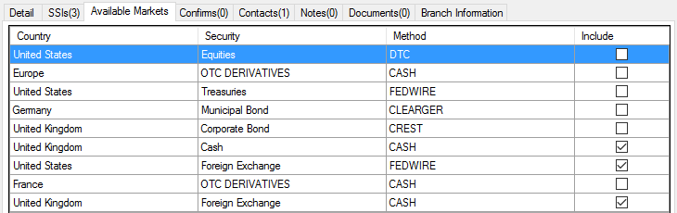
Market Filter sets
If the SSI has an effect of Allow it has to be downloaded by selecting the checkbox under the available markets tab in a Trading Account
If the SSI has an effect of IncludeIfAllow it will be automatically downloaded and maintained and the include flag will be ticked automatically

Slide 59
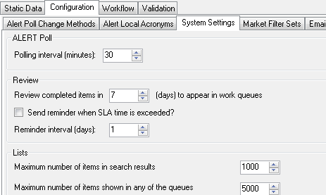
ALERT Updates
Trading Account and SSI updates are monitored and downloaded by the following iMeta SSI services:
ALERT Downloader
ALERT Poller
The Poller interval can be set in System Administration
The Alert Poller connects periodically to Alert and retrieves any pending Alert Messages
The Alert Downloader then evaluates each Alert Message and acts on the message if required (more on this later)

Slide 60
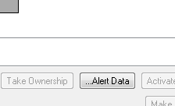
View ALERT Data
Unmapped ALERT data can be viewed in iMeta SSI
This can be done for Trading Accounts and SSIs
Select the …….ALERT Data button
If you double click on an ALERT data field iMeta SSI will display the corresponding field

Slide 61
Billable Calls & the Data Cache
Data from Omgeo Alert Direct is cached upon arrival
When iMeta SSI retrieves SSI data from Alert it performs a “billable call” which opens up a limited window of time to retrieve data from Omgeo for a fixed cost
To minimise these calls, iMeta SSI will download all SSIs under a trading account into the cache within the window of time available
This feature is designed to save money by iMeta SSI needing to perform less ‘billable calls’ to Alert
iMeta SSI will get data from Alert automatically when:
A user performs the update markets action from a trading account
A user performs the change filters and data is not in the cache or is expired in the cache
The Alert Downloader is informed of an update to an SSI or Account that is Active within iMeta SSI.
An update comes in from SCI that changes Alert Acronym or Access Code
Billable calls are logged in the database and could be reported on

Slide 62
Tour of iMeta SSI
Client Import / Export

Slide 63
Exporting Data
Export Wizard
Accessible from the Search UI after performing a search
Accessible from the side bar
Export can be saved and scheduled
Can Export SSIs only

Slide 64
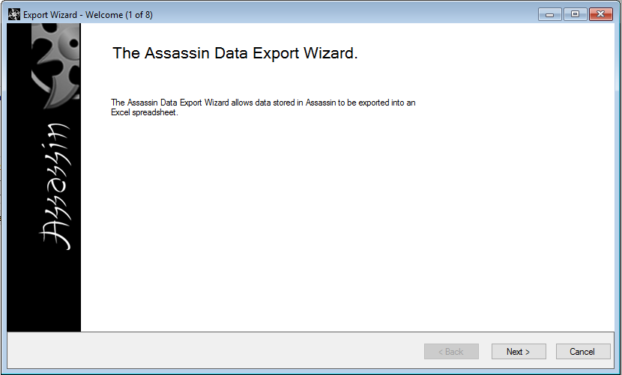
Export Wizard Step 1

Slide 65
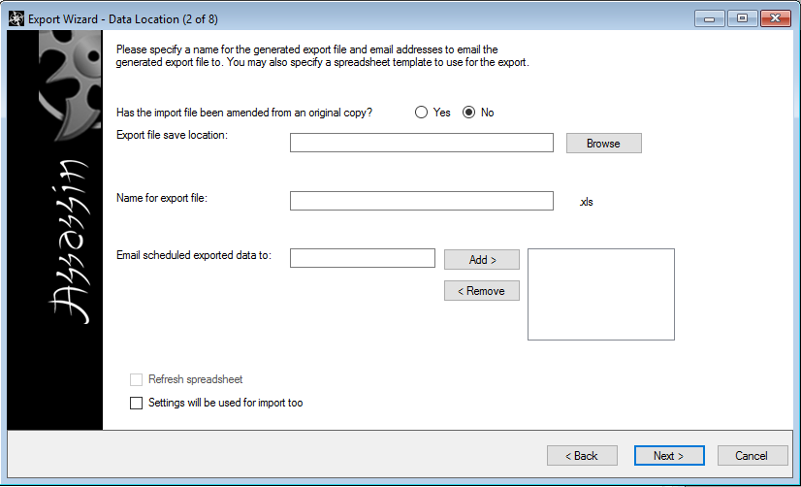
Export Wizard Step 2
Export file Save Location – Location where the export file will be saved
Name for Export File – Name of the export file
Email schedule exported data to – List of e-mail addresses where export can be sent

Slide 66
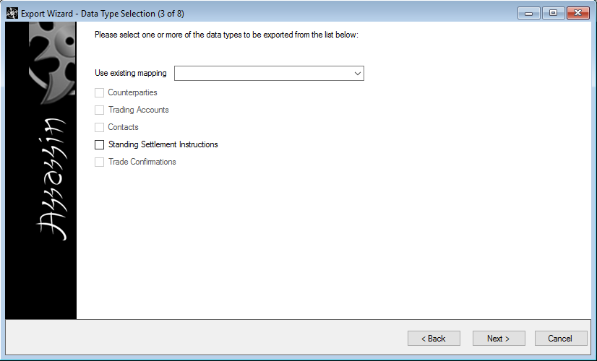
Export Wizard Step 3
Specify the type of record to be exported
Can use an existing mapping that has been saved (this will be explained on a later slide)

Slide 67
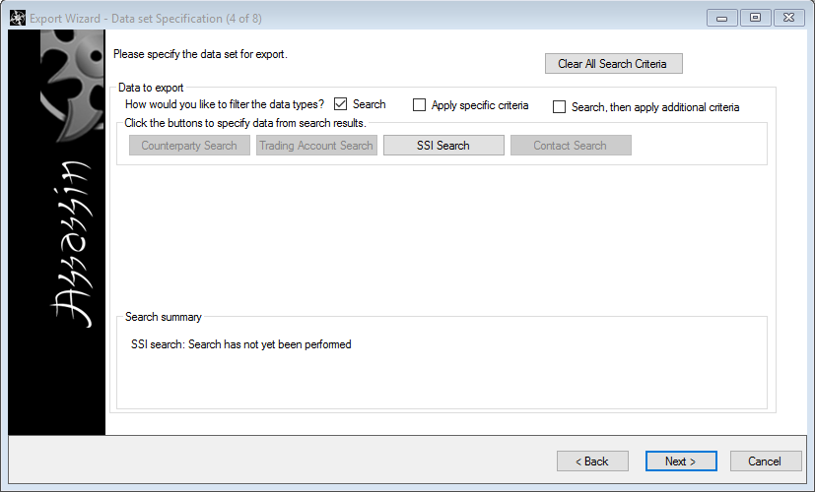
Export Wizard Step 4
Select the SSI Search button to search for an SSI to export. If you are exporting a Counterparty or Trading Account this search button will change accordingly.
The standard record search screen will be displayed based upon which record is to be exported

Slide 68
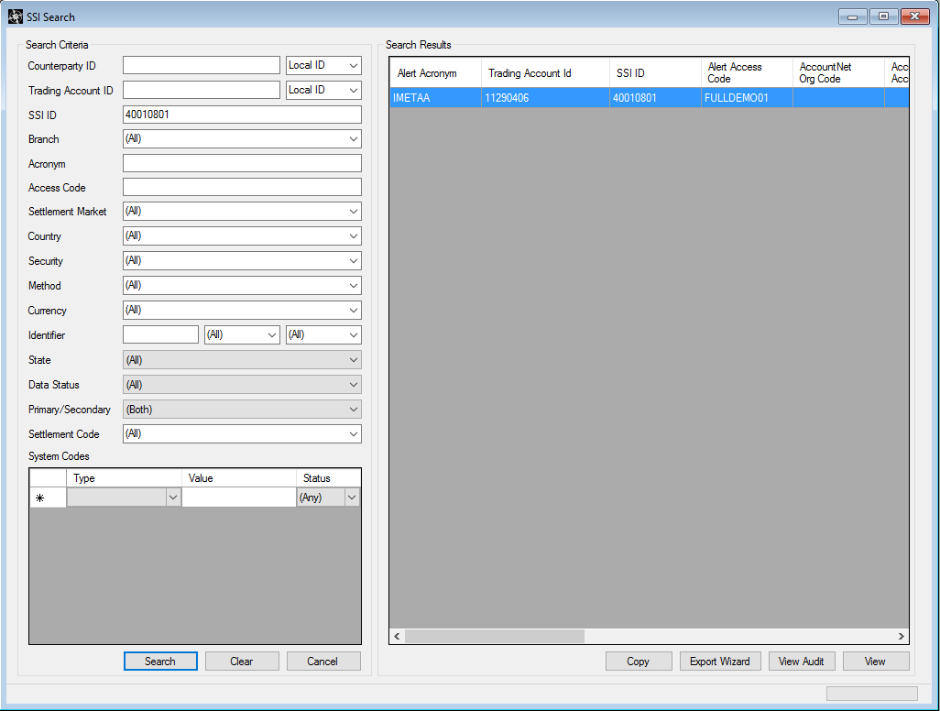
Export Wizard Searching
Once the search is completed, select the export wizard button to be take back to the Export Wizard

Slide 69
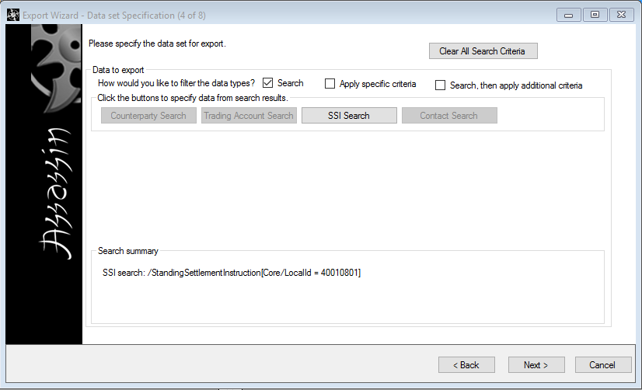
Export Wizard Step 4
The search criteria is displayed in the search summary section

Slide 70
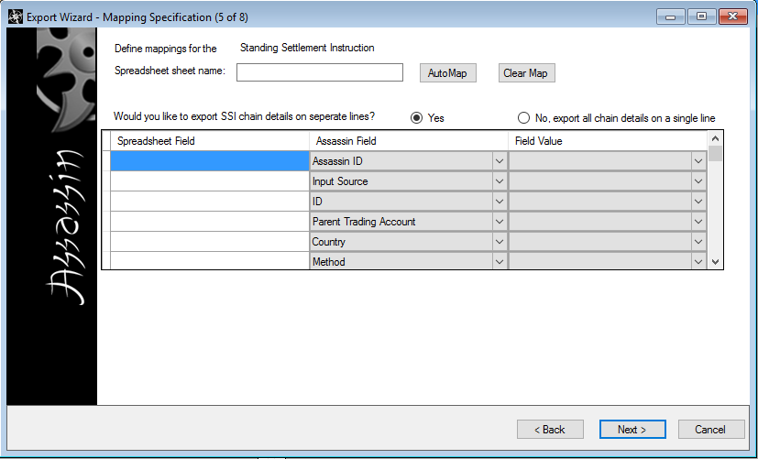
Export Wizard Step 5
Can select the name of the tab that the data will be exported to
Can specify what spreadsheet column names maps to iMeta SSI fields (Usually users will select the auto map option)

Slide 71
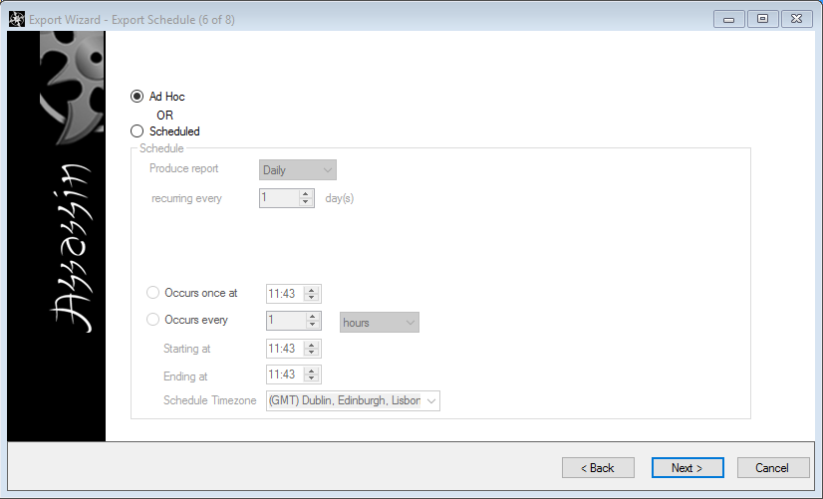
Export Wizard Step 6
Can schedule the export to be run at particular times or intervals

Slide 72
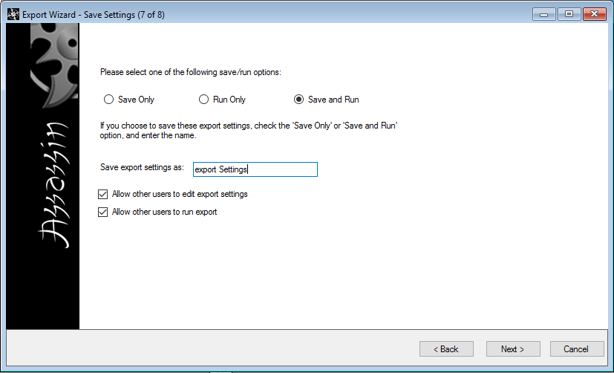
Export Wizard Step 7
Export can be saved, run or saved and run. If the Export is saved it can be selected as an existing mapping in step 3
Allows others permission to edit these settings if they require

Slide 73
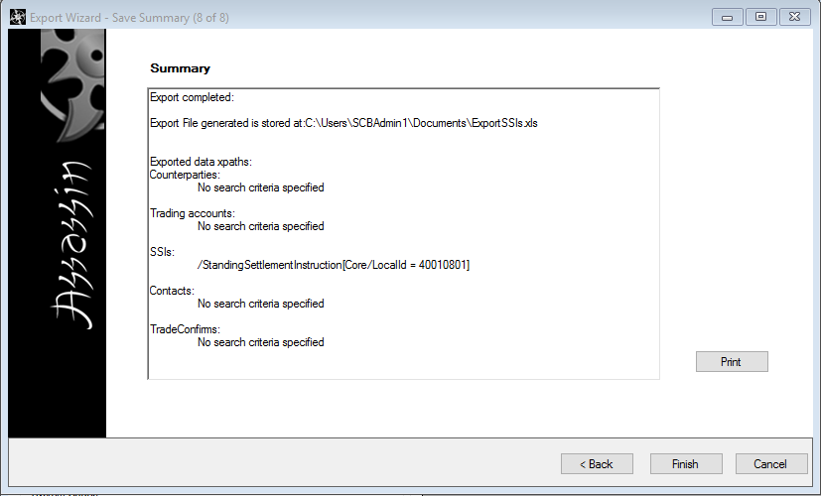
Export Wizard Step 8
Summary of the Export
Any validation failures can be viewed on the Validation Failures Tab

Slide 74
Importing Data
Import Wizard available via the side bar
Can Import SSIs only
Import can be used to:
Create new SSIs
Update existing SSIs
Close SSIs
Reopen SSIs
Revalidate SSIs
A mixture of the above
Can be very powerful and useful for a technical user…

Slide 75
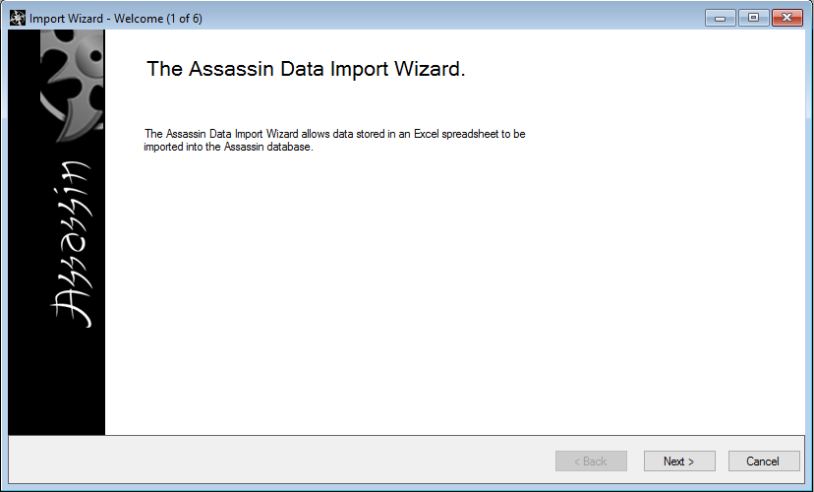
Import Wizard Step 1

Slide 76
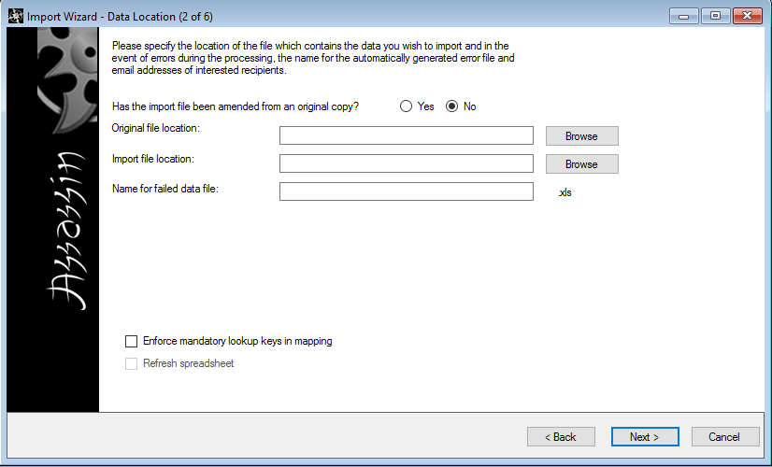
Import Wizard Step 2
Original File Location – Location of the file on which the import is based (e.g. Spreadsheet from Client)
Import File Location – Location of the Excel file that contains the imported data
Name for Failed data File – Name of the file containing the errors if the import fails
Enforce Mandatory lookup Keys in mapping
Import settings may be configured specifically to update existing data within iMeta SSI
The mappings specified in the next step are validated so that they are appropriate mappings to ensure existing data is found & data integrity can be enforced
For example, there are mandatory fields enforced on the mapping definition such as the trading account local ID (unique identifier in iMeta SSI)
A mapping and imported spreadsheet data in these fields must be present in order for iMeta SSI to find existing records in its data base to be updated
If the mapping is missing a user gets an error message on import wizard step4 and would not be able to proceed
Invalid file locations or read-only/locked files will cause Errors
Errors are highlighted should for any reason the import cannot be performed
Refresh Spreadsheet – Only available when the spreadsheet being imported has been read previously
Notes:
- Refresh Spreadsheet- The ‘Refresh spreadsheet’ check box is only activated when a spreadsheet exists and if it has been read at least once. By default, the spread sheet is not read more than once. This means that if the user navigates away from this window, then navigates back and then navigates away, the spreadsheet is not read again each time. This check box option allows the user to force the Export wizard to read the spreadsheet again. For example, in cases where the spreadsheet has changed when it has previously been read.

Slide 77

Import Wizard Step 3
A saved mapping can be selected, or a new mapping can be defined on the next page
SSI must be selected

Slide 78
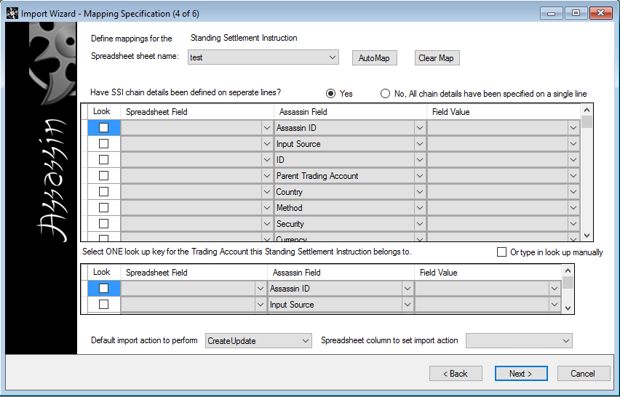
Import Wizard Step 4
Notes:
‘Look Up Key’
Check boxes indicate whether a property would serve as a property to use to locate a record within iMeta SSI.
When new data is imported and the import action is defined as create, these look up keys will not be required and can be ignored.
They are essential when data is an update to existing data, when there is a mix of new and updates and when the default action is set to CreateUpdate.
If they are not set, the underlying logic will not be able to determine what to do and will just overwrite any existing SSIs regardless of whether they match.
‘Spreadsheet Field’ contains the dropdowns.
The dropdowns are populated with the names of columns on the selected spreadsheet.
‘Assassin Field’
Contains drop downs of all the fields present on the Assassin object type concerned.
‘Field Value’
Only applies to Assassin fields like backed by static data e.g. countries, currencies and settlement methods.
These need to be mapped more precisely e.g. using Id, ISO Code, ALERT Abbreviation etc… These fields are highlighted in grey.

Slide 79
Import Wizard Step 4 (Mapping)
AutoMap
Spreadsheet fields are automatically mapped into the table provided that the spreadsheet field is the same name as the iMeta SSI field
ClearMap
The ‘Clear Map’ button clears the grid of all mappings
Lookup
Spreadsheet fields that are mapped to iMeta SSI field is used to identify the imported Counterparty/Trading Account/SSI
If a record is imported and the lookup matches against an existing record then the existing record in iMeta SSI will be updated. If it does not match a new record is created
Parent Look-up
Specify what field in the imported spreadsheet contains the parent iMeta SSI Record of the imported data. E.g. If you are importing SSIs this field would contain the Trading Account that the SSIs are to be imported under
For SSI imports, the spreadsheet can have the data on one line or multiple lines

Slide 80
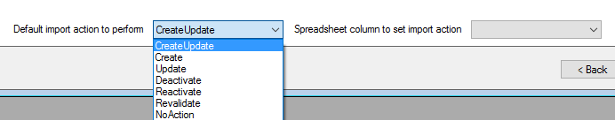
Import Wizard Default Actions
CreateUpdate Records that are imported will either create or update records in iMeta SSI, depending if a matching record can be found based on the defined lookup
Create Record that is imported will create a new record in iMeta SSI
Update Record that is imported will update a record in iMeta SSI
Deactivate Record that is imported will deactivate a matching record in iMeta SSI
Reactivate Record that is imported will reactivate a matching record in iMeta SSI
Revalidate Record that is imported will revalidate a matching record in iMeta SSI

Slide 81
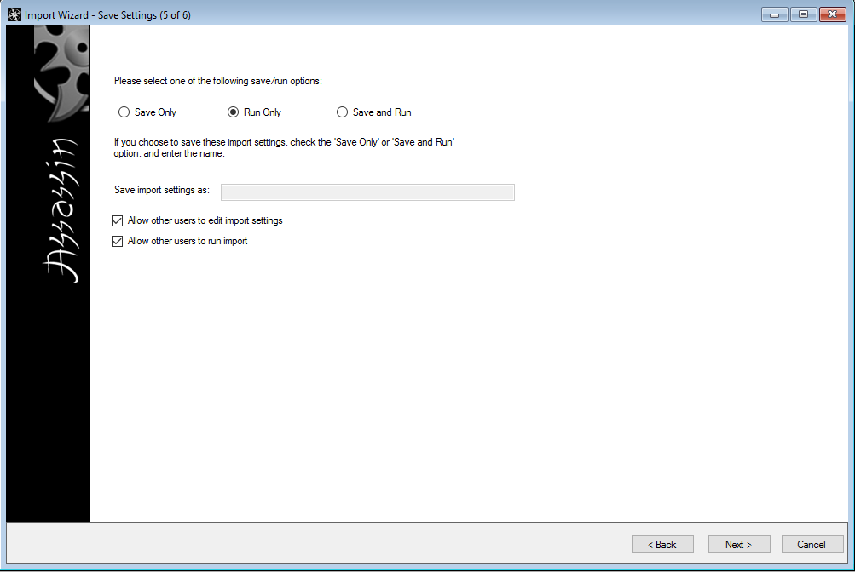
Import Wizard Step 5
Import can be saved, run or saved and run. If the import is saved it can be selected as an existing mapping in step 3
Allows others permission to edit these settings if they require

Slide 82
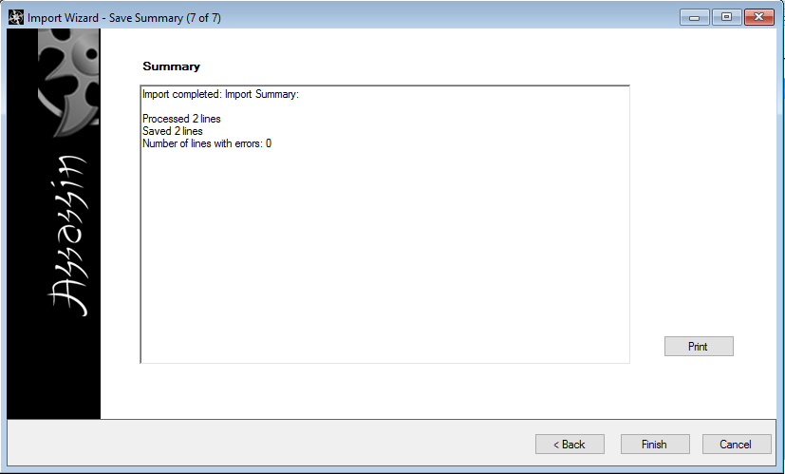
Import Wizard Step 6
Displays the number of lines processed from the Imported spreadsheet
If the import has any lines with errors these are outputted to a file which takes the format of <import spreadsheet name> _ errors.xsl
Notes:
At least one spreadsheet field to Assassin field mapping must be specified
Mandatory fields must have mappings
If the import action is update then Assassin ID or Object Identifier mapping is compulsory
If the data object type being mapped has a parent
A parent object look up must be specified
Unless a mapping has been provided for the Assassin ID or unique local Id field
If a look up key has been specified and the parent mappings have been specified,
The parent mapping must contain a mapping definition for the lookup key specified
If the object is an SSI and imported data has been specified on multiple lines, mapping for either the SSI's local ID OR the country+security+method must be specified
The spreadsheet name must be provided
It must be less than 31 characters
It cannot be a duplicate of sheet name used in another mapping
Duplicates in the list column of Assassin fields (for imports) are not allowed
Duplicates in the list column of spreadsheet fields are not be allowed
If the Assassin data type property being mapped is an object,
A field value is mandatory. E.g. a static data type
If the Assassin data type property being mapped is an SSI chain the following are mandatory
The step type
And step index

Slide 83
Import Wizard Mapping Tips
Do not use import feature if your data set is near to or in excess of 1000 records
Match updates to SSIs on Local Id or Object Identifier
Avoid matching updates to SSIs on multiple fields e.g Country, Security, Method, Currency
Use imports as a quick & efficient way of re-validating small to medium sized data sets

Slide 84
Import/Export for Technical Users
The Search and Import/Export features are exceedingly useful for:
Finding sets of Invalid SSIs
Revalidating invalid SSIs if a rule has been changed
Updating small to medium sized sets of SSIs in bulk
Repairing small to medium sized sets of SSIs in a spreadsheet
Copying a set of SSIs onto new Trading Accounts
Support – exporting problematic SSIs and importing into another environment, to facilitate investigation

Slide 85
Tour of iMeta SSI
System Administration
User Permissions

Slide 86
System Administration Overview
Broken up into 4 Tabs:
Static Data
Configuration
Workflow
Validation Rules
Can only be accessed If the user has the correct permissions
Usually accessed by IT department for modification
Not usually accessed by ‘normal’ users of iMeta SSI
Drives behaviour (such as auto-approve)

Slide 87
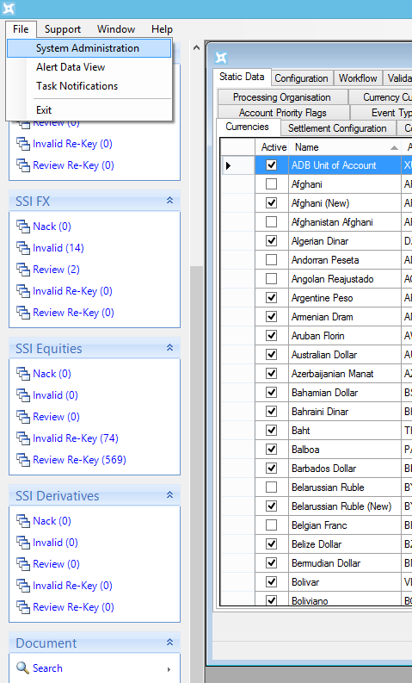
System Administration
Four main areas:-
Static Data
User interfaces for configuring lists of typed static data with Id’s and Display Names etc...
Used to populate iMeta SSI drop downs
Used within downstream messages
Configuration
Settings that affect system operation
Workflow
User interface for configuring business rules
Validation
User interface for configuring validation rules
Notes:
Where you’ll spend most of your time as a technical user

Slide 88

Settlement Method Static Data
A good example of the simplest of System Admin static data configuration screens
Id
Sent Downstream
Used in Business and Validation rules
Display Name
Used by iMeta SSI Client Combo Box Drop Downs
Active
Boolean flag indicating whether the static data is valid and active for consumption within all areas of iMeta SSI
Inactive Settlement Methods do not appear in Client Combo Box Drop Downs
Validation Rules can ensure records are invalid if they use inactive static data
Alert Abbreviation
Used when iMeta SSI receives data from Alert
Account Net Abbreviation - Not used
Country
Used for UI filtering
Notes:
The majority of screens contain:-
Active, Id, DisplayName fields
If the static data is present in Trading Accounts or SSIs coming from Omgeo Alert then static data also has Alert Abbreviation information
Account Net is another source of SSIs that Assassin can be integrated with, however it is not in use by SCB

Slide 89

System Code Type Static Data
Codes to represent SCB systems and SSI institution Identifiers
Is Identifier
Defines whether the code type is also an identifier for an institution during settlement. It drives population of SSI Step’s Identifier Type combo box
Perform Identifier validation
Used in conjunction with the ‘Is Identifier’ flag.
Defines whether identifier data in SSI Steps with the corresponding identifier type is looked up against a list of stored valid values for that identifier type

Slide 90
System Code Validation
Consider System Code Type configuration for System Code Type BIC:
Is Identifier Type: true
Perform Identifier validation: false
If an SSI Local Agent Step contains:
Identifier: GOLDUX33XXX Identifier Type: SWIFT_BIC
iMeta SSI only uses a validation rule to check the Identifier against the BIC regex pattern
Consider System Code Type configuration for System Code Type BIC:
Is Identifier Type: true
Perform Identifier validation: true
If an SSI Local Agent Step contains:
Identifier: GOLDUX33XXX Identifier Type: SWIFT_BIC
iMeta SSI uses the same validation rule to check the Identifier against the BIC regex pattern
iMeta SSI also makes an SSI invalid if GOLDUX33XXX does not exist in iMeta SSI identifier static

Slide 91


System Code Type Static Data Continued…
Concrete Type
Drop down list of iMeta SSI Object Types
Contains an option for each specific type
Contains a generic option ‘Base Assassin Object’ to apply the same behaviour to every record in iMeta SSI
Allow Multiple in Same Object
Defines whether a single record can itself have duplicates of this system code type e.g. storing multiple OPICS ids on the same Trading Account
Allow Multiple values Across Application
Defines whether across iMeta SSI there can be duplicates of this system code type with the same value e.g. 2 Trading Accounts sharing the same OPICS Id
Exclude from List
Drives population of System Code Types on relevant record type e.g. Counterparty doesn’t contain an OPICS Id

Slide 92

Settlement Configuration Static Data
List of predefined data:
Name and BIC for Place of Settlement (PSET)
Country, Security, Methods that are valid for each PSET
Used to Auto populate non-cash SSI PSET Steps
Used to filter SSI GUI’s Settlement Method combo box drop down contents based on country and security selected

Slide 93
IBAN configuration Static Data
Static data used to specify & store IBAN country formats
Drives IBAN validation on Cash SSI Steps’ Account Ref field
Validation only occurs when data in that field starts with two alphabetical characters, followed by two digits, followed by at least 10 alpha numeric values
Country
The two character ISO Code stored against the country is used as the two letters at the beginning of the IBAN.
Format
A regular expression for the IBAN
E.g. UK BIC format:
UK[0-9]{2}[A-Z]{4}[1-9]{14}
Modulus Check
Boolean indicating if the standard IBAN check digits should be used to perform a modulus check

Slide 94

Market Filter Set Static Data
The first grid enables Market Filter Sets to be created, renamed and deleted.
Market Filters are used to control what SSIs are downloaded from Alert
The scope to the filter set determines the level to which the filter can be applied
The second gird shows the market filters associated with a selected Filter Set
Each filter is defined by a Country, Security and Method or ‘All’
Effect determines the effect of the filter (Default is ‘Allow’)
Allow
Deny
Include If Allowed

Slide 95
Market Filter Effects
Deny
SSIs with the given venue cannot be downloaded and any existing SSIs with the C/S/M combination will not be updated from Alert.
A ‘Deny’ effect always overrides any matching filters marked as ‘Allow’ or ‘Include if Allowed’.
Allow
SSIs with the given C/S/M combination are allowed to be manually downloaded by a user and once downloaded, be automatically updated from Alert.
Note this filter only allows the download, an ‘Include If Allowed’ filter is also required in order to download the SSI.
Include If Allowed
SSIs with the given C/S/M combination are treated as ‘Default SSIs’ and will be automatically downloaded from Alert where they have a corresponding Allow filter.
They will also subsequently be updated from Alert.

Slide 96

SSI Verification Static Data
Prevent SSI from auto approving when they match the criteria

Slide 97
User Permissions
SCBs version of iMeta SSI has the following sets of User Groups:
Read Only
Editor Reviewers
Trading Account Reviewers
Administrators
FM PDCs
Each User Group is associated with an SCB Active Directory Group
The permissions that are assigned to each group are part of the Assassin configuration
There is no screen to manage permissions – any changes need to be made via data load
Be cautious with permission changes – the permissions drive much iMeta SSI behaviour

Slide 98
User Permissions
Read Only
Users part of the Read Only group can perform the following:
Search and View all Data
Perform audit searches
View all System Administration configuration
Editor Reviewer
Users part of the Editor Reviewer group can perform the following:
Can edit and review all SSI’s
Can edit any SSI that is pending review or invalid
Cannot review own changes
Import SSI Data
Export SSI Data
View all System Administration configuration
View a Queue of Invalid items
View a Queue of items for Review
Manually entered or Imported SSI’s will require an approval from another user. A user cannot approve their own changes
Downloaded ALERT SSI’s will be automatically approved unless manually altered.

Slide 99
User Permissions
Trading Account Reviewers
Users part of the Trading Account Reviewers group can perform the following:
Search and view all data
Review Trading Accounts, to open the review form
Approve Trading Account, the review form will have cancel, and approve options only to Perform audit searches
View all System Administration configuration Standard Chartered (SCB)
View a Queue of Invalid Account items
Administrators
Users part of the Administrators group can perform the following:
The same permissions as for the Editor Reviewer
Create, Edit and Review Counterparties, Trading Accounts, Contacts and Trade Confirms
Create, Edit, Delete all System Administration configuration for all configuration under the Config, Workflow and Validation tabs
All manually entered or imported data will require an approval from another user. A user cannot approve their own changes
All downloaded ALERT data will be automatically approved unless manually altered

Slide 100
User Permissions
FM PDCs
Users part of the PM PDCs group can perform the following:
The same permissions as for the Administrator apart from the System Administration permissions
Create, Edit, Delete only in the Static Data tab

Slide 101

Property Permissions
iMeta SSI also allows various fields to have permissions applied
Permissions applied via the Property Permissions tab in System Administration

Slide 102
Lunch
Resume at 1:30pm
12:30pm

Slide 103
System Architecture
1:30pm

Slide 104
SCB iMeta SSI Solution

Slide 105
iMeta SSI System Architecture
Notes:
Server Log Files
C:\Program Files\Assassin\Services\Log\ServiceHost.txt
StateMachine & ObjectChange processing, Upstream & Downstream Integration ++
C:\Program Files\Assassin\Services\Log\WebService.txt
WebService call processing from the Client at the Server
C:\Program Files\Assassin\Services\Log\AlertPoll.txt
Poll request and Alert Summary Response messages
C:\Program Files\Assassin\Services\Log\AlertDownload.txt
Alert data Download request messages and responses, specifically in response to AlertPoller messages, Relevance processing
Client Log File (typical location)
C:\Users\<Username>\AppData\Local\Temp\AssassinLogs\Log.txt (Client Log)
Client Interaction calls to the Server and Client Side validation logging

Slide 106
Key Components
Service Host
State Machine queue – queued background actions
Upstream – Interface to SCI (MQ) for Counterparty/Agent messages
Downstream – Interface to BPMS (MQ) for SSI messages to publish to Settlement systems
Other object change
Ack/Nack processing from BPMS
Daily sproc runner
Delete closed objects
Others
Web Services
Interface providing Client functionality
Client
Managing objects, task queues and system management
Alert Poller
Polls for Alert messages
Alert Downloader
Downloads Raw Alert SSIs and Trading Accounts data in response to relevant Alert messages from AlertPoller
Alert Cache
Optimises performance by caching raw Alert Data
Reduces cost by downloading additional data in paid-for window
State Machine
‘Glue’
State transition rules
Permissions
Validation
Workflow

Slide 107
Proposed change to Service Host
At the time of writing, a plan to split up Service Host is being discussed between iMeta and SCB
If this proceeds, Service Host would remain, however it would do less
In addition, several new services would be created, which would take on the roles that are removed from Service Host
They are likely to be:
Upstream Service
State Machine Service
Object Change Service
Ack/Nack Receiving Service

Slide 108
Data flow illustration – new Cpty/TA from SCI
XML message received from SCI by Upstream processor
Record created in iMeta SSI via SM
Call made to Alert to retrieve Alert TA data
Calls made to Alert to retrieve SSIs
SSIs published downstream if Approved

Slide 109
Data flow illustration – Alert update to SSI
Alert Poller polls and receives a summery of acronyms for which SSIs have changed
For each acronym, Alert Messages are downloaded and stored in DB
Alert Downloader processes each Alert Message, downloading the changed SSI and updating the iMeta SSI version via the SM
If approved, the SSI is published downstream

Slide 110
Data flow illustration – Manual change to SSI
User A makes change to SSI
SSI updated via SM and moved to Pending state
Task added to Review Queue
User B actions task and reviews change
SSI is approved and published downstream

Slide 111
Logging Overview
Each component of iMeta SSI will create a log file
When investigating issues it will often be helpful to look at the logs to establish what has happened
In addition to the logs, we also have the object dump
Rules run on the client will be logged in the client log on the users profile:
%tmp%\AssassinLogs\Log.txt
Rules run on the server will be logged to the service logs:
[Assassin Installation Location]\Services\Log\Webservice.txt
[Assassin Installation Location]\Services\Log\serviceHost.txt
[Assassin Installation Location]\Services\Log\AlertPoll.txt
[Assassin Installation Location]\Services\Log\AlertDownloader.txt
[Assassin Installation Location]\Services\Log\DataLoad.txt
More on both logging and object dump later on

Slide 112
Database (part 1)
2:30pm

Slide 113
Database Introduction
iMeta SSI can connect to either Oracle or SQL Server
The database holds:
Managed reference data (SSI, TA, Cpty etc.)
Transient data (User action queues, Alert Message queue, State Machine queue etc.)
Static data (country list, currency list etc.)
Configuration (validation, workflow, Alert credentials)
Audit
Other than small amounts of configuration (held in runtime.config and app/web.config files), database holds everything

Slide 114
iMeta SSI Data Model
iMeta SSI uses a bespoke ORM called metaCore to convert between c# application code and Oracle database based on an XML data model
(ORM - Object Relational Mapping)
Auditing and Archiving are built into the ORM & occur automatically when records are written to the database by application code
The Archive is important in iMeta SSI, it is used for Rollback and as part of approval process / change cycle
Database tables & columns are case sensitive (in Oracle)
Components of records in the database are related to one another by Object Identifier “oid” – this is the primary key for an object

Slide 115
iMeta SSI Data Model
When querying the database for a record, general rule: join on “oid”
oid, eid and pid are used to manage child lists
docOrder is used to maintain order in lists
__version and __action are used in archive tables
The base classes of the majority of iMeta SSI records are:
Assassin Object
Counterparty / Trading Account / SSI
Admin Object
Static Data e.g. Country, Security, Currency etc…
Look at database

Slide 116
Database Table Mapping overview
“SSI” – Standing Settlement Instruction
“TradAcc” – Trading Account
“Cpty” – Counterparty
“AssObj” – Assassin Object
“AssObj#__i” – Assassin Object Info metadata
“AssObj#Core” – Assassin Object Core metadata
“AssObj#Change” – Assassin Object Change metadata
“AssObj#ValFail” – Assassin Object validation failures
“AssObj#Notes” - Notes
“AssObj#Docs” - Documents
“AssObj#SystemCodes” – System Codes
“AssObj#LatestEditors”, “AssObj#LatestReviewers”
Tables ending #__a are for Archive Records
Tables ending #__acl are used for security – out of scope
Audit records are found here:
“AssassinAudit” and “AssassinAudit#Changes”

Slide 117
Breakdown of SSI Structure
SSI#SetChain – SSI Steps aka Settlement Chain Entries are here
For example:
To get the details of an SSI, which is an Assassin Object and has a number of steps:
select *
from "SSI" ssi -- Main SSI data
join "SSI#SetChain" ssisc on ssi."oid" = ssisc."oid" -- Step
join "AssObj" ao on ssi."oid" = ao."oid" -- Parent
join "AssObj#SystemCodes" aosc on ssi."oid" = aosc."oid" -- System codes
join "AssObj#Core" aoc on ssi."oid" = aoc."oid" -- Core
join "AssObj#__i" aoi on ssi."oid" = aoi."oid" -- Info
join "AssObj#Change" aoch on ssi."oid" = aoch."oid" -- Change
left join "AssObj#LatestEditors" aole on ssi."oid" = aole."oid" -- Editors
left join "AssObj#LatestReviewers" aolr on ssi."oid" = aolr."oid"-- Editors
left join "AssObj#Notes" aon on ssi."oid" = aon."oid" -- Notes
left join "AssObj#Docs" aod on ssi."oid" = aod."oid" -- Docs
left join "AssObj#ValFail" aov on ssi."oid" = aov."oid" -- Validation Failures
Note: There are left joins because these tables may not contain any data

Slide 118
SSI Structure in pseudo code form
public class StandingSettlementInstruction extends AssassinObject {
- TradingAccount
- Country
- Security
- Method
- Currency
- IsDefault
- SettlementChainEntries
….
- SubSettlementMethod
- AdditionalInfo-1
}
public class AssassinObject {
- oid
- ChangeState
- StableChangeState
- StableChangeVersion
….
Core
- Local Id
- Data Source
…
Change
- LastApprovedVersion
…
Info
- CreationDate
- Version
…
Notes
SystemCodes
ValidationFailures
…
}
Base SSI class properties
Custom properties
Base Assassin Object class properties
& nested ones

Slide 119
Deeper Dive into SSI Structure
To obtain human readable Country, Security, Method & Currency:
select * from "SSI" ssi
join "Country" co on ssi."Country" = co."oid"
join "Security" se on ssi."Security" = se."oid"
join "Method" sm on ssi."SettlementMethod" = sm."oid"
join "Currency" cur on ssi."Currency" = cur."oid"
To obtain the SSI and its Trading Account:
select * from "SSI" ssi
Join "TradingAccount" ta on ssi."TradingAccount" = ta."oid"

Slide 120
Deeper Dive into Archive Records
select * from "SSI#__a" ssi
join "AssObj#__a" ao on ssi."oid" = ao."oid"
and ssi."__version" = ao."__version"
join "AssObj#ValFail#__a" aovf on ssi."oid" = aovf."oid"
and ssi."__version" = aovf."__version"

Slide 121
Alert Database tables of interest
Alert Message queue
AlertMsg
Trading Account Cached Data
CacheTA
CacheTA#AccInf#GenFld
SSI Cached Data
CacheSSI
CacheSSI#SSI#Meth
Billable Call Log
AlertBillableCall

Slide 122
Enumerated Static Data Types
Can’t be modified
All contained within “EnumLookup” database table
Useful to know when diagnosing issues and debugging
Really good idea to print out list and keep it as a reference
The majority of record fields contain a ‘source’ field
E.g. SSI.Currency has SSI.CurrencySource
These hold a reference to the ‘Editor’ that set the value into this field
The ‘Editor’ is an enumerated static data type:
Select * from "EnumLookup" where "TypeName" = 'Editor';

Slide 123
Example database query using Enumerated Data
select SSI.*, ao.*, aoc.*,
cs."EnumText", scs."EnumText",
ac."EnumText", ds."EnumText"
from "SSI" ssi
join "AssObj" ao on ssi."oid" = ao."oid"
join "AssObj#Core" aoc on ssi."oid" = aoc."oid"
join "EnumLookup" cs on ao."ChangeState" = cs."EnumValue"
and cs."TypeName" = 'ChangeState'
join "EnumLookup" scs on ao."StableChangeState" = scs."EnumValue"
and scs."TypeName" = 'ChangeState'
join "EnumLookup" ac on ao."Action" = ac."EnumValue"
and ac."TypeName" = 'ChangeAction'
join "EnumLookup" ds on aoc."DataSource" = ds."EnumValue"
and ds."TypeName" = 'Editor';

Slide 124
Database Table Mapping for Static Data
Many Types of non-enumerated static data
All Extend the base type “AdminObject”
All have similar archive records using #__a database query syntax
Audit history if made via System Admininstration GUI can be seen in Audit
select * from "Method" i
join "AdminObject" ao on ao."oid" = i."oid";
select * from "SubSettlementMethod" i
join "AdminObject" ao on ao."oid" = i."oid";
select * from "Identifier" i
join "AdminObject" ao on ao."oid" = i."oid";

Slide 125

Caching & Auto Updating Static Data
Each iMeta SSI module maintains its own cache of static data
iMeta SSI uses Oracle’s Change Notification feature. Each database connected module is alerted of changes to cached static data
Requires Sysdba to have run: GRANT CHANGE NOTIFICATION TO ASSASSIN;
This setting enables changes to be made to static data without restarting IIS, ServiceHost or the Alert Services
BUT…
Any clients other than the used to add
the new static requires restarting or
execute ‘Refresh Local Cache’

Slide 126
Review & Questions
3:30pm

Slide 127
Review – Day 1
Introduction
Introduction to iMeta SSI
Tour of iMeta SSI
Overview of UI
Introduction to Omgeo Alert
Import / Export in Client
System Administration & Permissions
System Architecture
Database part 1

Slide 128

Questions

Slide 129
Agenda – Day 2
Start Time | Topic | Duration
9:30am | Recap & Questions | 30 minutes
10:00am | Database part 2 | 60 minutes
11:00am | Validation | 90 minutes
12:30pm | Lunch | 60 minutes
1:30pm | Workflow | 120 minutes
3:30pm | Review & Questions | 30 minutes

Slide 130
iMeta SSI for SCB
Technical Training
Day 2
9:30am

Slide 131
Agenda – Day 2
Start Time | Topic | Duration
9:30am | Recap & Questions | 30 minutes
10:00am | Database part 2 | 60 minutes
11:00am | Validation | 90 minutes
12:30pm | Lunch | 60 minutes
1:30pm | Workflow | 120 minutes
3:30pm | Review & Questions | 30 minutes

Slide 132
Recap - Day 1
Introduction
Introduction to iMeta SSI
Tour of iMeta SSI
Overview of UI
Introduction to Omgeo Alert
Import / Export in Client
System Administration & Permissions
System Architecture
Database part 1

Slide 133
Questions

Slide 134
Database (part 2)
10:00am

Slide 135
Database Queries
Quick recap from yesterday
We’re going to write some queries now
Any suggestions?
List of SSIs that have specific PSET Bic
List of SSIs that have been changed within given timeframe
List of Trading Accounts with specific available market
List of SSIs that are invalid against a specified rule
List of Countries that have been added in a specified time

Slide 136
Data Loader
Used by iMeta to deliver static data and configuration to SCB
Can be used to move configuration from environment to environment
Can be used to bulk import data (usually only used when commissioning new connected systems)

Slide 137
Importing Static Using the Static Data Loader
Create your static data package directory structure & name it:
SCB-Assassin-<version>-<Date/PatchId>
E.g. SCB-Assassin-3.0.6.0-Patch-1
Copy iMeta bat file
Adjust the relative paths for your static import, data and header files
Copy header files for static from iMeta release
Create data files for your static
E.g. One for Workflow rules, one for Validation rules
Create your static import xml file
Create an <import> section for each type of static

Slide 138


Using the Static Data Loader
Directory Structure StaticImport.xml

Slide 139

The static loader batch file
You may need to adjust
this path accordingly

Slide 140

Header file
Defines the layout of the data to be imported
Truncate
@ defines the lookup / key

Slide 141
Data file
Contains the data that you intend to import
Comma separated
Conforms to the header
Example:
0~2~3,0,True,False,14~7,"Set IdentifierType Default Value for Step","",com.iMeta.Assassin.Model.Core.StandingSettlementInstruction,com.iMeta.Assassin.Model.Core,"<RuleSet Name=\"1821724a-1d65-4072-8405-7adb2e4368f2\" ChainingBehavior=\"Full\" Description=\"{p1:Null}\" xmlns:p1=\"http://schemas.microsoft.com/winfx/2006/xaml\" xmlns=\"http://schemas.microsoft.com/winfx/2006/xaml/workflow\" />","<RuleSet Name=\"1821724a-1d65-4072-8405-7adb2e4368f2\" ChainingBehavior=\"Full\" Description=\"{p1:Null}\" xmlns:p1=\"http://schemas.microsoft.com/winfx/2006/xaml\" xmlns=\"http://schemas.microsoft.com/winfx/2006/xaml/workflow\">……</RuleSet>",True

Slide 142

Object Analysis Tool
Tool for assisting Support
Extremely useful when analysing your own technical issues
Gives complete view of iMeta SSI record’s composite parts and history in verbose format
Supply:
Local Id
Object Identifier
Raw Object Identifier
Export output to HTML

Slide 143
Validation
11:00am

Slide 144
Validation in iMeta SSI
iMeta SSI provides a framework for validation
Rules can be edited and created without requiring a code change to the system
Rules can evolve as business requirements and best practice change
Validation occurs against all relevant record types e.g. SSI, Trading Account
Validation occurs as an integrated part of the record “change” process
The validation process evaluates a record against all relevant validation rules
Complex cross-field validation is supported

Slide 145
Validation in iMeta SSI
iMeta SSI’s validation framework supports 5 types of validation rule:
Regex Validation rules
XPath rules
Coded validation rules
Database lookup business key rule
Account number format validation
Regex validation rules were used in early versions of iMeta SSI, using them is no longer recommended as more powerful regular expression checking can be achieve via XPath rules
Coded validation rules and database lookup validation rules are supplied to SCB from iMeta and perform more complex validation operations than can be achieved in the XPath rule framework
Validation rules contain Base and customer specific rules

Slide 146

System Administration - Validation

Slide 147
System Administration - Validation
The configurability of all validation rules or all rule types occurs on this screen
Rule ID
The rule Id of existing rules should not be modified
The rule Id shows in a comma separated list inside iMeta SSI task queues
Display name
Used in grid of validation failures on individual iMeta SSI records e.g. SSIs
Enabled
Whether the rule is enabled or disabled
Disabling or enabling a rule and applying the change will not retrospectively update related SSIs
Server Side Only
Some rules only run inside iMeta SSI server modules because they require complex database interaction
XPath rules can always be run client and server side
Locked
Some rules that are fundamental to the day to day operation of iMeta SSI have been intentionally locked
E.g. rules that are used to display exception/error messages to a user that occur during processing of SSIs
E.g. Alert sends a country that isn’t in your static data yet
E.g. One of the Workflow (business) rules had a problem running against a specific SSI
Data Type
The iMeta SSI record type the rule will be executed against
Rule Type
The type of validation rule

Slide 148
Validation Rules in Database
select * from "ValRule" vr --Validation rule core data as shown in GUI
left join "ValRule#CtorProp" vrc on vr."oid" = vrc."oid"
left join "ValRule#ErrDispProp" vre on vr."oid" = vre."oid" -- Error display properties
left join "ValRule#ValProp" vrp on vr."oid" = vrp."oid" --Validation Properties
left join "DBLookupValRule" db on vr."oid" = db."oid" -- For DataBase Validation Rules
left join "XPathValidationRuleData" xp on vr."oid" = xp."oid" --XPath rule data as shown in xPath rule editor
where vr."Id" like '%ParentIsNotClosedValidationRule%';
--XPath rule outcomes
select * from "EnumLookup" where "TypeName" like '%Outcome%';

Slide 149

XPath Validation
XPath validation rules are applied by converting reference data records in iMeta SSI into an XML representation of the data
XPath expressions can be written using iMeta SSI’s framework to verify the content of this XML data
<Counterparty>
<ShortName>GLOBAL INVESTORS<ShortName/>
<LongName/>
<FullName/>
</Counterparty>
{
Display
Names
Data model Names

Slide 150
Locating display Names
Query:
PropDispMap
PropDispMap#Mapping
select pdm."TypeName", pdmm."PropertyName", pdmm."DisplayName" from "PropDispMap#Mapping" pdmm
join "PropDispMap" pdm on pdm."oid" = pdmm."oid"
where pdmm."DisplayName" like '%Alert Trusted Source%';

Slide 151

System Administration XPath Validation
Create new XPath validation rules and configure existing XPath validation rules
Create
Creates a new empty XPath rule
Edit
Populates and enables the UI for the selected rule
Export All
Covered later
Export Selected
Covered later

Slide 152
Creating a New XPath Validation Rule 1
Give your rule an Id and a Name
Follow standard rule naming conventions e.g.
SCB-<DataType>-<property/operation>-<number>
SCB-Counterparty-GridSystemCode
SCB-Account-IsPrimaryReadonly
SCB-SSI-OursTheirs
SCB-SSI-InternalOursTheirs-2
Select a record Data Type e.g. SSI
This causes various fields in the UI to populate
Cancel Edit – To cancel and loose your changes
Update – To save your changes into memory
Note you must press ‘Apply’ or ‘OK’ to apply your rule to the system - Changes will not be applied unless this is done

Slide 153

Creating a New XPath Validation Rule 2
Select a ‘Validation Property’
When a record fails validation, this property will appear in the record’s failures grid see:
The iMeta SSI record will also contain a failure icon adjacent to the property's field indicating there is something ‘erroneous’ about it.
For an SSI record, all properties of an SSI are available
Specify a ‘Failure Reason’
Some concise human readable text explaining what’s wrong

Slide 154
Creating a New XPath Validation Rule 3
Failure Reason continued…
A validation failure reason displayed to the user when a record is invalid against the rule.
Token replacement is used to substitute tokens for the field names as they appear in the iMeta SSI client
Use {0} for the Validation Property
Use {1},{2},{3},... to substitute the Dependent Properties where the number relates to their position in the Dependent Properties list.
E.g. ‘When method is CRYL, DEAG/REAG step must be populated, DEAG/REAG {0} is mandatory if DEAG/REAG {1} and DEAG/REAG {2} are empty’

Slide 155
Creating a New XPath Validation Rule 4
Dependent Properties
When defining complex business validation rules where multiple field values effect the validation these fields should be specified as dependent properties
When editing an iMeta SSI record and a dependent properties value is changed the rule will automatically be re-evaluated
This allows the user to see immediately if a dependent fields value has caused/cleared a validation failure against the record
E.g.: If a Market specific rule is defined for against the Account Ref field which is only applied where the Method is CREST, the Settlement Method field should be marked as a Dependent property
Though specifying dependent values enables a better user experience they are not strictly required as all validation rules are run on the server side when a user attempts to apply a change to a record
Display Properties
By default an error provider icon is displayed against the Validation Property when the record is invalid against a rule
Setting the Display Properties enables you to change which one or more fields the error provider icon is displayed against
Group – Covered later in rule overriding
Group Rule Priority – Covered later in rule overriding

Slide 156
Creating a New XPath Validation Rule 5
Rule Outcome – The effect of validation rule:
Invalid
Matching fields will be marked as Invalid against the rule
InvalidAndMandatory
Matching fields will be marked as Mandatory and the record will be Invalid against the rule if a value is not specified for the field
Read Only
Matching fields will be made read-only
ReadOnlyWhenEmpty
Matching fields will be read only when they are empty or their contents has been deleted
Warning
Where the rule applies the user will be presented with a warning when they attempt to apply their changes
The change can still be applied if the user chooses to ignore the warning

Slide 157

XPath Tab
From the XPath tab the user is able to define the XPath expressions to a node to evaluate on the XML representation of the iMeta SSI record
XML is only generated when using the ‘Test Rule’ feature
The XML of the reference data record is in the text area at the bottom

Slide 158
XPath Tab
Matches XPath
Where an element matches the XPath specified in the Matches XPath the rule outcome will be applied
The Matches XPath is also used to define which repeating group of complex content is being validated
Invalid XPath
Where the rule cannot be written in one XPath the Invalid XPath can be used to define the rule
The Invalid XPath is evaluated from the Matches XPath element, but can evaluate any node in the document by using ‘/’ to match the root
Regex Pattern
Where a Regex has been specified this will be applied to any matched fields based on the Matches XPath
Where the matching fields value does not conform to the Regex pattern the data is invalid against the rule
This can be used to define constraints such as mandatory fields and field lengths

Slide 159
Matches XPath Example:
To match the Account Ref of the PSET Agent (as opposed to the Account Ref code of any other agent):
/StandingSettlementInstruction/SettlementChainEntries[StepType='NonCashPset']/AccountNumber
Conditions can be added to the Regex, for example a market specific rule will apply based on the Settlement Method of the instruction:
/StandingSettlementInstruction[SettlementMethod='CRYL']/SettlementChainEntries[StepType='NonCashDeagReag']/Bic
Commonly Used Regular Expressions:
Example Failure Reason Text: Make a field mandatory
Regex: ^.+$
Meaning: Match any character 1 or more times
Example Failure Reason Text: Limit a fields length
Regex: ^.{0,35}$
Meaning: Match data between 0 and 35 characters

Slide 160


Testing XPath rules

Slide 161
XPath Rule Testing Notes
Pressing on the Test Rule button will open a Test Edit Window for the relevant Data Type allowing a user to test the rule being edited
The Test Edit Window will apply the current rule being edited to the data allowing the user to test the rule
(An SSI’s edit form with Settlement Chain tab visible)
Pressing the Change button from this screen will load the XML representation of the test record into the XPath tab of the XPath Validation Rule Editor
The Xml view dynamically shows a visual representation of the elements in the XML which match the XPath, Invalid XPath and Regex patterns in order to aid with the definition of these expressions
If the rule is updated the Test Edit Window must be re-opened to pick up the changes

Slide 162
Worked Examples 1
Create new XPath validation rule for Counterparty records
Use the name: SCB-Counterparty-ShortNameMandatory
Set all properties, XPath and regex to make ShortName mandatory
Test XPath rule in XPath validation rule tester
Create a new Counterparty and see your rule in action
Modify the XPath validation rule you created
Use the name: SCB-Counterparty-ShortNameMandatory
Relax the XPath rule so that its an outcome is warning
Create a new Counterparty and see the effect of your change
Create new XPath validation rule for Counterparty records
Use the name: SCB-Counterparty-FullNameReadOnly
Make the Counterparty ‘Full Name' field read only
Test XPath rule in XPath validation rule tester
Create a new Counterparty and see your rule in action

Slide 163


Worked Examples 1 Answers - A
“SCB-Counterparty-ShortNameMandatory",,,,,,,,,,,,,,,,"com.iMeta.Assassin.Model.Core.Counterparty","com.iMeta.Assassin.Model.Core","com.iMeta.Assassin.Validation.XPathValidationRule","com.iMeta.Assassin.Validation","ShortName",,,"SCB-Counterparty-ShortNameMandatory","{0} is required
","True","False","False","^.+$","InvalidAndMandatory","","","Low","/Counterparty/ShortName"

Slide 164

Worked Examples 1 Answers - B
"SCB-Counterparty-ShortNameMandatory",,,,,,,,,,,,,,,,"com.iMeta.Assassin.Model.Core.Counterparty","com.iMeta.Assassin.Model.Core","com.iMeta.Assassin.Validation.XPathValidationRule","com.iMeta.Assassin.Validation","ShortName",,,"SCB-Counterparty-ShortNameMandatory","{0} is required
","True","False","False","^.+$","Warning","","","Low","/Counterparty/ShortName"

Slide 165


Worked Examples 1 Answers - C
"SCB-Counterparty-FullNameReadOnly",,,,,,,,,,,,,,,,"com.iMeta.Assassin.Model.Core.Counterparty","com.iMeta.Assassin.Model.Core","com.iMeta.Assassin.Validation.XPathValidationRule","com.iMeta.Assassin.Validation","FullName",,,"SCB-Counterparty-FullNameReadOnly","Full name is read only","True","False","False","","Readonly","","","Low","/Counterparty/FullName"

Slide 166

XPath rule overriding
Rule priorities can be configured to allow rules to override each other
A common example is where an SCB or market specific SSI rule should override a general SSI rule
From the General tab of the Editor a Group must be defined for the rule in order to support overriding
The Group Rule Priority of the rule can be set from (High, Medium and Low)
When rules are executed any matching rules (rules applicable to the data) in the same group will override rules with a lower priority

Slide 167
XPath rule overriding
Examples of XPath rule overriding a general SSI rule:
SCB-BOTH-0020
(A simple example covered next)
SCB-BOTH-0020-OVR
(A more complex example covered later)
Use this SQL to determine rules captured by a group:
select "Id", "Group", "GroupMatchPriority" from "ValRule" where "Group" like '%';

Slide 168


XPath rule overriding example
This rule defines a valid SWIFT BIC format for a field called SenderToReceiver2 on an SSI

Slide 169


XPath rule groups & overriding example
This rule defines an alternative for the same field when the SecurityTypeGroup is set to SYNEQU

Slide 170
Worked Examples 2
To validate your understanding of XPath rules that check string properties, create a new XPath validation rule to enforce the SCB full name field as a mandatory field on trading accounts and only contains upper case characters
Suggested rule name: SCB-TradingAccount-FullName-MandatoryAndUppercase
To validate your understanding of XPath rules that check static data backed properties, create a new XPath validation rule to make a trading accounts invalid if their nationality is Russia
Suggested rule name: SCB-TradingAccount-Russia
To validate your understanding of XPath rules that check nested properties, create a new XPath validation rule to enforce SWIFT BIC system code values have 11 characters on trading accounts
Suggested rule name: SCB-TradingAccount-SwiftBicSystemCode

Slide 171


Worked Examples 2 Answers - A
"SCB-TradingAccount-FullName-MandatoryAndUppercase",,,,,,,,,,,,,,,,"com.iMeta.Assassin.Model.Core.TradingAccount","com.iMeta.Assassin.Model.Core","com.iMeta.Assassin.Validation.XPathValidationRule","com.iMeta.Assassin.Validation","FullName",,,"SCB-TradingAccount-FullName-MandatoryAndUppercase","Full name is mandatory and must only contain uppercase characters","True","False","False","^[A-Z]+$","InvalidAndMandatory","","","Low","/TradingAccount/FullName"

Slide 172


Worked Examples 2 Answers - B
"SCB-TradingAccount-Russia",,,,,,,,,,,,,,,,"com.iMeta.Assassin.Model.Core.TradingAccount","com.iMeta.Assassin.Model.Core","com.iMeta.Assassin.Validation.XPathValidationRule","com.iMeta.Assassin.Validation","Nationality",,,"SCB-TradingAccount-Russia","Russia is not allowed","True","False","False","","Invalid","","","Low","/TradingAccount[Nationality='RU']"

Slide 173


Worked Examples 2 Answers - C
"SCB-TradingAccount-SwiftBicSystemCode",,,,,,,,,,,,,,,,"com.iMeta.Assassin.Model.Core.TradingAccount","com.iMeta.Assassin.Model.Core","com.iMeta.Assassin.Validation.XPathValidationRule","com.iMeta.Assassin.Validation","SystemCodes",,,"SCB-TradingAccount-SwiftBicSystemCode","A SWIFT_BIC system code on a Trading Account must contain exactly 11 characters","True","False","False","^.{11}$","Invalid","","","Low","/TradingAccount/SystemCodes[SystemCodeType = 'SWIFT_BIC']/Value"

Slide 174
Validation Rules on SSIs
SSI validation rule walkthrough
Rules that evaluate properties on SSI records directly
Rules that act on SSI steps
Rules checking if fields have any data set at all e.g. internalCategory2
XPath Rules making fields read-only
XPath Rules making fields mandatory
SSI rules checking the SSI’s parent trading account
SWIFT character validation

Slide 175
Rules that evaluate properties SSI records directly
E.g.
SCB-BOTH-0134
Failure Reason: Third Party flag is Read Only when SSI is from Alert
Matches XPath: /StandingSettlementInstruction[Core/DataSource = 'Alert']
Validation Property: Third Party
Rule Outcome: Readonly

Slide 176
SSI Validation Rules that act on SSI steps
E.g.
SCB-CASH-0067
Failure Reason: Stop Account Ref validation being mandatory for Cash Local Agent step Non Alert SSI
Matches XPath: /*[Core/DataSource != 'Alert' ] /SettlementChainEntries[StepType='CashLocalAgent' ] /AccountNumber
Validation Property: AccountRef
Rule Outcome: Invalid
/*/SettlementChainEntries[string-length(Bic)>0 and IdentifierType='HKRTGS']/Bic

Slide 177
Rules checking if fields contain data
E.g.
SCB-BOTH-0017
Failure Reason: A Branch Id is a mandatory field unless the SSI is an equity
Validation Property: Branch Id
Matches XPath: /StandingSettlementInstruction[SecurityTypeGroup != 'SYNEQU']
Invalid XPath: ../*[not(BranchId)]
Rule Outcome: InvalidAndMandatory

Slide 178
ReadOnly XPath SSI Validation Rules
E.g.
HSBC-SSI-OursTheirs
ValidationProperty: ‘Ours/Theirs’
Rule Outcome: Readonly
Matches XPath: /*
A more typical use of this might be to set a custom id field to be readonly, allowing a value to be entered, but not changed once entered

Slide 179
Making SSI fields mandatory
E.g.
SCB-SSI-NonCashCurrencyMandatory
Rule Outcome: InvalidAndMandatory
Failure reason: Currency is required
Matches XPath:
/*[SettlementType='NON_CASH']
Invalid XPath:
../*[not(Currency)]

Slide 180
Example SSI XPath rule syntax for checking SSI’s parent trading account
HSBC-SSI-CLS
A SSI's parent account must be marked as a CLS Member if the Method is CLS
Matches: /*[SettlementMethod = 'CLS']
Invalid XPath: /*/TradingAccount[ClsMember != 'true']
HSBC-SSI-InternalOursTheirs-1
Make the Ours Theirs field read-only when SSI’s trading account is internal and OursTheirs is set to Ours
Matches:
/*[OursTheirs = 'Ours']/TradingAccount[InternalAccount='true']

Slide 181
Example XPath syntax for SWIFT character validation
BANK-SSI-SwiftField1
Matches XPath:
/*/SwiftField1
Regex Pattern:
^[ a-zA-Z0-9,.:'\+\(\)\?'\-/]*$
This regex is used in the majority of SWIFT special character validation XPath rules

Slide 182
Example XPath syntax for 2 fields
HSBC-SSI-CASH-0123-Override
Override for Base rule: CASH-0123
CASH-0123 makes LocalAgent Bic Mandatory
We needed to ensure a BIC or a SubAccountRef is mandatory
Match group: SettlementChainEntries.Bic
Match priority: Medium
Matches XPath:
/*/SettlementChainEntries[StepType='CashLocalAgent' ]
Invalid XPath:
/*/SettlementChainEntries[StepType='CashLocalAgent' and SubAccountNumber[not(text())] and Bic[not(text())]]
Notice Bic and SubAccountNumber have their own label names so the {0} {1} syntax is used with display properties

Slide 183
Worked Examples 3
Create the following XPath validation rules. Check each rule works by creating new trading account and SSI records
Create a new validation rule ‘SCB-SSI-Currency-ReadOnly’ to:
Make Currency read-only once its been set into an SSI
Create a new validation rule ‘SCB-TradingAccount-FullName-SwiftCharacters’ to:
Make trading account invalid if its Full Name contains invalid SWIFT characters
Use the regex: ^[ a-zA-Z0-9,.:'\+\(\)\?'\-/]*$
The business have requested BIC format checking be relaxed on Cash SSI beneficiary step
Create a new SCB-SSI-… XPath rule giving it a logical name
The rule needs to override BIC checking rule ID BOTH-0004
To achieve this set the group and priority fields
The rule needs to ensure that BIC checking is not performed on the Beneficiary step but is performed on all other steps of SSIs
To achieve this copy an extend the XPath from BOTH-0004
Your rule will need the same regex as the BOTH-0004
Set the rule outcome to warning
Create a new cash and non cash SSI to test your rule works outside of the sys admin rule tester

Slide 184


Worked Examples 3 Answers - A
"SCB-SSI-Currency-ReadOnly",,,,,,,,,,,,,,,,"com.iMeta.Assassin.Model.Core.StandingSettlementInstruction","com.iMeta.Assassin.Model.Core","com.iMeta.Assassin.Validation.XPathValidationRule","com.iMeta.Assassin.Validation","Currency",,,"SCB-SSI-Currency-ReadOnly","{0} is read only once it has been set","True","False","False","","Readonly","","","Low","/StandingSettlementInstruction/Currency"

Slide 185


Worked Examples 3 Answers - B
"SCB-TradingAccount-FullName-SwiftCharacters",,,,,,,,,,,,,,,,"com.iMeta.Assassin.Model.Core.TradingAccount","com.iMeta.Assassin.Model.Core","com.iMeta.Assassin.Validation.XPathValidationRule","com.iMeta.Assassin.Validation","FullName",,,"SCB-TradingAccount-FullName-SwiftCharacters","Full name must contain only valid SWIFT characters","True","False","False","^[ a-zA-Z0-9,.:'\+\(\)\?'\-/]*$","Invalid","","","Low","/TradingAccount/FullName"

Slide 186


Worked Examples 3 Answers - C
"SCB-SSI-CashBene-BOTH-0004-Override",,,,,,,,,,,,,,,,"com.iMeta.Assassin.Model.Core.StandingSettlementInstruction","com.iMeta.Assassin.Model.Core","com.iMeta.Assassin.Validation.XPathValidationRule","com.iMeta.Assassin.Validation","SettlementChainEntries.Bic",,,"SCB-SSI-CashBene-BOTH-0004-Override","Identifier/Code is not a valid BIC code format","True","False","False","^[A-Z]{4}[A-Z]{2}[A-Za-z0-9]{2}[A-Za-z0-9]{3}$","Warning","","SettlementChainEntries.Bic","High","/*/SettlementChainEntries[string-length(Bic)>0 and IdentifierType='SWIFT_BIC' and StepType = 'CashBeneficiary']/Bic“
When you test this, there is a problem… SCB-BOTH-0111

Slide 187
XPath rule development advice 1
Give your rules logical names and Ids
They are visible to the business,
They should be distinct from iMeta created rules
Keep it simple
Avoid trying to make a rule check too many fields
Use rule override to layer complex field checking
Make use of the TestRule client
To generate XML
To highlight XML matching your XPaths and regexes
Ensure your failure reasons are human readable, they can contain {0}, but check these work before deploying to test
If seeing rules on your client that are out of sync with those on the server: Close Sys Admin, use the ‘Support’ menu’s ‘refresh local cache’

Slide 188
XPath rule development advice 2
XPath rules can’t query static data directly
E.g. Return the asset class of an SSI
XPath rules can’t access alternative properties of static data
E.g. /StandingSettlementInstruction/Country[Currency=‘USD’]
Xpath rules can only act upon what is included in the validation XML. iMeta have the option of extending what is included in this, if required
Be aware the TestRule client doesn’t allow you to test XPaths that require certain values are present in parent properties
E.g. /StandingSettlementInstruction/TradingAccount/InternalAccount
(Suggest developing using SSI XML from WebService.Log and notepad++ XML XPath feature)
After changing a rule remember to press ‘Update’ then ‘Apply’ to avoid loosing changes

Slide 189
Post rule deployment advise
Changes validation rules are not applied to records retrospectively
To queue a revalidation of a population of Records use the SQL script called RevalidateSSIsByValidationRule.sql
This script MUST be configured as required
It can be setup to act on any AssassinObject record type: SSI, TA, CP
Change the SQL query at the top that returns OIDs
It can be setup to queue any iMeta SSI state machine action on the AssassinObject record, common ChangeActions are:
To re-evaluate validation rules use:
23 = ‘Revalidate’
Could be used after changing, adding or deactivating a validation rule
Plan when these scripts are run because they affect downstream. (SSIs becoming valid enter the approved state & will flow downstream)

Slide 190

Extracting XPath rules
Export All
Exports all XPath rules in iMeta SSI
Use to send iMeta a copy of all rules
Use to store a copy in your source code repository
Export Selected
Exports the currently selected XPath rule to the clipboard
Use when wanting to analyse a rule in development
Use when wanting to save a rule for promotion to SIT->UAT->Prod

Slide 191

Importing XPath rules
Automatically import exported rules
Achieved using iMeta SSI’s static data file loader
Ensure the batch files references the StaticImport.xml
Ensure the StaticImport.xml file contains the header and rule file
See Example files provided:
Note:
There is a header line at the top of the csv file
This header file & line format format should match the exported rule format
Rules are updated when loaded in iMeta SSI if they contain a matching a rule ID
Loader batch file
Static import xml file
Validation rules csv file
Header xml file

Slide 192
A quick look at the XPath rule loader header file
<import-format>
<line-formats> <!-- Process rules which have an implementation, based on match xpath existing -->
<line-format header-ref="ImplementedRules" match=",[^,]+$"/> <!-- Ignore rules that dont have an implementation -->
<line-format ignore="true" match=",$"/>
</line-formats>
<headers>
<header reference="ImplementedRules">
<object-type>com.iMeta.Assassin.Model.Core.XPathValidationRuleData</object-type>
<assembly>com.iMeta.Assassin.Model.Core</assembly>
<columns>
<!-- This object inherits from the ValidationRule so needs the following data -->
<!-- Id --><column>@Id</column><!-- Document --><column/><!-- Section --><column/><!-- Page --><column/>
<!-- Table --><column/><!-- Country --><column/><!-- Security Type Group --><column/><!-- Method --><column/>
<!-- Field --><column/><!-- Rule --><column/><!-- Notes --><column/><!-- Instruction --><column/><!-- Source --><column/>
<!-- Mapped --><column/><!-- Status --><column/><!-- Original Id --><column/>
<column>DataObjectTypeName</column>
<column>DataObjectAssemblyName</column>
<column>RuleImplTypeName</column>
<column>RuleImplAssemblyName</column>
<column>ValidationProperties</column>
<column>ErrorDisplayProperties</column>
<column>ImplConstructProperties</column>
<column>DisplayName</column>
<column>DisplayFailReason</column>
<column>Enabled</column>
<column>ServerSide</column>
<column>Locked</column>
<!-- XPathValidationRuleData object specifics -->
<column>RegularExpression</column>
<column>Outcome</column>
<column>ValidationXPath</column>
<column>Group</column>
<column>GroupMatchPriority</column
><column>XPath</column>
</columns>
</header>
</headers>
<docdef><!-- Don't process the first row --><skipLines>1</skipLines></docdef>
</import-format>
Update based on ID
To Enable or Disable a rule
Regex
Invalid XPath
Matches XPath
Skip First Line of the import file

Slide 193
Lunch
Resume at 1:30pm
12:30pm

Slide 194
Workflow
1:30pm

Slide 195
Introduction to Workflow rules
iMeta SSI provides a workflow to facilitate the management of reference data records
Customers can configure aspects of the workflow to meet changing business requirements without requiring a code change
Configuration is achieved by defining Workflow Rule sets
Workflow rule sets are configured against a particular reference data type (e.g. SSI/Trading Account) and state within the iMeta SSI workflow
Workflow Rules may contain one or more rule sets
Workflow Rule Sets define an Action to apply and a Condition defining whether the Action should be applied
Notes:
The next side details some examples of what workflow rules can be used to achieve

Slide 196
Examples of workflow rule use
Automatically repair reference data records retrieved from a data source such as Omgeo Alert
Assigning tasks to a particular user and define when the user should complete the task
Automatically adding Notes to a reference data record

Slide 197
More examples of workflow rule use
Defaulting & Auto Population scenarios
Setting a value into a field / set of fields based on criteria
Setting field editors e.g. internal / object editor
Concatenating data into additional info fields
Auto correction scenarios
Correcting records failing specific validation rules
Removing special characters
Applying formatting e.g. padding fields to specific lengths
Copying values from trading account to SSI
E.g. TA system code
Raising Tasks

Slide 198
Workflow and the State Machine
The workflow process is enforced using the state machine and happens as part of the state transition logic
The state machine handles the transition of Reference Data records from state to state
Whenever a manual or system process acts upon a Reference Data record the record undergoes an audited state transition
In simple terms:
Editing a record causes it to transition into the editing state
Reviewing a record causes it to transition into the reviewing state

Slide 199
State Transitions
Notes:
The diagram describes the set of states for Reference Data items and actions which are allowed to be performed between those states.

Slide 200
Edit-Review- Approve Example
An approved record is edited
This edit is saved as a ‘draft’
The draft record is re-edited
The edit is applied to the record by performing ‘change’
Whilst awaiting a review, the same record is edited again
This additional edit is applied to the record by performing ‘change’
The record is reviewed (including all previous changes)
The reviewer approves all of the changes to the record
The record enters the Approved state
Notes:
The diagram describes the set of state transitions as part of a standard change and review process in iMeta SSI.
In this case the record is modified as a draft before being changed and approved.
The diagram shows that a user can draft an item in between making edits allowing the user to save changes to the database without those changes going to review.
In addition it illustrates that a user can also make a change whilst the item is awaiting review allowing the modifier to make amendments.

Slide 201
Use of states in workflow rules
As a general principle, when writing workflow rules only use stable states.
These are the states that you would expect a record to rest in for any length of time
Stable States
Approved
Closed
Pending
Invalid
Draft
Current State: AssObj.ChangeState
Current StableState: AssObj.StableChangeState
Unstable States
Editing
DraftEditing
Reviewing

Slide 202
State Machine Related Development Hints
Some state are stable and some aren't
A record’s current state is represented by a value from the ChangeState enum
Check a record has ever been approved by evaluating LastApprovedVersion !=null
A record’s transition is audited and represented by a value from the ChangeAction enum
iMeta SSI reference data record’s GUI form buttons have labels that correspond to their respective ChangeAction

Slide 203
Checking Approved Data in workflow rules
Last Approved version of a record
this.Approved
Will be null if a record has no previously approved version
Last Approved Version Number in the data model
AssObj#Change.LastApprovedVersion
Will be null if a record has no previously approved version
When doing analysis you can see if an object is being changed in some way when:
AssObj.StableChangeVersion != AssObj#Change.LastApprovedVersion

Slide 204
Transitioning to the Deleted State
Only records that never reach the approved state can enter the deleted state
This is achieved by performing actions:
DiscardEdits or DiscardDraft
Audit and archive records are generated for deleted records
Deleted records can be found using Audit search and Object Analysis tools
Deleted records are removed from the data type database table e.g. “SSI” and the “AssObj”, “AssObj#...” related set of database tables

Slide 205
Data Status
iMeta SSI records have a State and a DataStatus
Found here:
AssassinObject#Core.DataStatus
Populated by values from the DataStatus enum
Active
All records in active use Approved and awaiting approval
Closed
De-activated records in the Closed State or awaiting closure
Awaiting EffectiveDate – see next slide
Do not use:
New – Only applied to records undergoing initial creation and is never persisted to the database
Update – Only applied to records via downstream enrichment and is never persisted to the database

Slide 206
Future Effective SSIs
SSIs can have a special data status called ‘FutureEffective’
‘FutureEffective’ SSIs represent SSIs that contain changes that a broker has been advised will happen on a specific date in the future e.g. a change of address
An existing SSI can have 0 or multiple ‘FutureEffective’ SSIs
A ‘FutureEffective’ SSI may have no existing SSI
The Make Effective Change Action
FutureEffective SSIs automatically undergo the ‘MakeEffective’ ChangeAction on their “effective date”
The ‘MakeEffective’ process copies the FutureEffective data onto the existing SSI, revalidates the existing SSI and closes the FutureEffective SSI
If there is no existing SSI the ‘MakeEffective’ process transitions the FutureEffective SSI into an ‘Active’ one
Notes:
Future effective SSIs are covered here because they represent one of the most complex state machine transition cycles for SSIs

Slide 207
Example Future Effective SSIs
The currently Active ‘parent’ SSI
SSI
Active
FE SSI
1/1/2016
The MakeEffective ChangeAction
Converts this to the active SSI on 1/1/2016
FE SSI
1/1/2017
The MakeEffective ChangeAction
Converts this to the active SSI on 1/1/2017
FE SSI
7/7/2017
The MakeEffective ChangeAction
Makes this parent less future effective SSI Active on 7/7/2017

Slide 208

Workflow Rules
Accessed via the System Administration Screens

Slide 209
Field | Condition | Description
Enabled |  | Enables/Disables the rule set from being executed
For Type | Mandatory | Type of reference data record that this workflow rule is applied to for example Standing Settlement Instruction or Trading Account In addition to the specific record types, rules can also be applied at a base level: Base Assassin Object: Rule will apply to all reference data records Base Trade Confirm: Rule will apply to all trade confirm records (Email, Telex etc.) The actions that can be performed at a base level will be less specialised than those available on a specific record type. Each type supports a workflow domain which defines what can be performed by the workflow rules for the given type. These domains are discussed in more detail in following sections.

Slide 210
Field | Condition | Description
For State | Mandatory | State in the workflow that this rule is applied to for example Pending, Approved, Invalid. You can choose 1 or more states that the rule applies to. Useful for example where the rule should apply regardless of whether the data is auto-approved or not in iMeta SSI. For more information on the various states of the iMeta SSI workflow please refer to the Functional Specification.
Application Type | Mandatory | Determines at what point the rule is executed in the workflow when processing the state transition. Available options are one or more of the following: Change Update State Entry Post State Entry

Slide 211
Field | Condition | Description
Run Order | Mandatory | Allows rules to be executed in a specific order. Rules are run from a lower to a higher run order (0 are run before 1)
Display Name | Mandatory, Unique | A display name for the rule
Edit Server Rules |  | Opens the Rule Set Editor to configure the rules that are run on the Server
Edit Client Rules |  | Opens the Rule Set Editor to configure the rules that are run on the Client
Run Client Side Rule Server Side |  | Indicates if the Client side rules should also be executed on the Server side. Any configured Server side rule set will not be executed.

Slide 212
Types of Workflow Rules
Client Side
Only run on records when a user is editing them in the user interface
Applicable rules are re-evaluated when user tabs off each field, field by field
Can be configured to run both client and server side
Server Side
Rules run by all processes
Rules run when records transition between states
See next slide for further details

Slide 213
Types of Workflow Rules in depth
Client side rules
Always run when a user changes focus within an edit form e.g. tabbing between fields
Their operation is limited to setting or correcting values and performing basic static data queries
Queuing or triggering actions is not possible and associated action utilities are unavailable
Revalidation is not performed as part of rule execution
Server side rules
Run only on a rule’s specified state and when the rule’s designated application type is reached
Can perform actions via the action util
Changing market filters
Revalidating or changing child records e.g. when a GRID changes
Can perform lookups requiring database access e.g.
Querying a trading account’s SSI population
Query a settlement institution’s related SSI population

Slide 214
Application Type
Change() or Update() Rules
Post State Entry Logic
State Entry Logic
State Entry Rules
Persist Data
Post State Entry Rules
Both Change and Update come before anything else happens
If you wanted to block a change, this is where you would do it
State Entry is where most rules would run
If you wanted to define a default value, this is where you would do that
Post State Entry is where you would manipulate the object after the current operation has been applied and other rules have run
This is where you would repair incorrect data

Slide 215
Application Type - Change vs Update
Change
Allows rules to be executed when a ‘Change’ action is performed on a record
Use this for rules that change data in non-stable states such as Editing
Use this rather than writing a rule against resulting stable states such as Approved, Invalid or Pending
Update
Update actions are only performed when data is updated from a vendor source such as Alert.
Use this for rules that should only apply to updates from a vendor source (Alert) as opposed to manual updates

Slide 216
‘Change’ vs ‘Update’ Examples
Change Example:
A user makes an edit to an SSI
Updates an Account Ref in the Local Agent Step
The user has to press the ‘Change’ button in the iMeta SSI UI
This initiates execution of the ‘ChangeAction’ on the record.
Upon initiation of the ‘ChangeAction’
iMeta SSI runs all workflow rules with the ‘Change’ Application Type
The ‘Change’ ChangeAction can be run from the majority of states
Update Example:
Alert Poller informs the Alert Downloader new data needs to be retrieved from Alert
Alert Downloader performs the download
Alert Downloader updates the SSI Cache
Alert Downloader locates the matching SSI record
The updated Alert SSI data is written into the SSI record
The Update ‘ChangeAction’ is then initiated
Upon initiation of the ‘ChangeAction’
iMeta SSI runs all workflow rules with the ‘Update’ Application Type

Slide 217
Application Type - State Entry vs Post State Entry
State Entry
Use this for rules that make changes to records, when you require that the change be triggered by the state changing on the record (to one of the selected states), by any available means
E.g. Revalidation, Closure
Different to Change in that Change will only occur when a Change Action is performed against the data
Changes will be persisted, saved to the database, in one operation
Post State Entry
Use this for repair rules
iMeta SSI will generate an explicit audit record for the repair
If your workflow rule changes a record…
The changes will only be persisted, saved to the database, if your rule explicitly calls a function
E.g. ValidaitonUtil.SetToRevalidate()
This function revalidates the record and persists the record as Approved or Invalid based on the result of the validation

Slide 218



Application Type - State Entry vs Post State Entry
A rule moves Settlement Agent Name 2 to Settlement Agent Name where the Settlement Agent Name was empty
Repairing data on State Entry
Generates 1 audit record
Repairing data on
Post State Entry
Generates 2 audit records
1 for the invalid data
1 for the repair operation
Invalid
Repaired

Slide 219
Application Type continued…
Do not use State Entry/Post State Entry if you need your workflow rule to evaluate data added or removed from records in non-stable states – use ‘Change’
States are entered before records are modified
E.g.
A user clicks the ‘edit’ button
The state machine pushes the record through state entry and post state entry processing
A record enters the ‘editing’ state
A user then changes some data e.g. BIC or Account Ref
A user presses the ‘change’ button
The state machine pushes the record through the ChangeAction process
The state machine pushes the record through state entry and post state entry processing of the appropriate state for the record (invalid or pending)

Slide 220

The Workflow Rule Set Editor
The rule set editor is displayed when the users clicks to ‘Edit Server Rules’ or ‘Edit Client Rules’
Rules can be added or deleted using the buttons at the top
Each Rule Set can contain many rules identified by a name
Higher Priority Rules are run before lower ones e.g. 1 before 0
Each rule has a condition
If the condition evaluates true
‘Then Actions’ are run
If the condition evaluates false
‘Else actions’ are run
Rules can be active or deactivated using the active checkbox
Notes:
The Rule Set Editor dialogue window is a standard control which is part of the Microsoft .NET Windows Workflow library. More information to compliment this section can be found online at http://msdn.microsoft.com/en-us/library/bb483171.aspx.

Slide 221
Workflow rule set chaining
Determines whether the rule conditions are revaluated when data within the context changes based on an action:
Full Chaining
Each workflow rule in the rule set is re-evaluated when data on the context changes i.e. if a rule action changes data evaluated by another rule the other rule is re-evaluated
Sequential
Each workflow rule in the rule set is evaluated in order and will not be re-evaluated if data on the context changes
Explicit Update Only
Each workflow rule in the rule set is re-evaluated when a specific call is made to update data on the context
Recommend

Slide 222
Workflow rule re-evaluation
Determines whether the condition and resulting action of this specific rule within this workflow rule set should be re-evaluated
Re-evaluation occurs following the action of the rule itself and other rules within this rule set
Useful where actions effect data that is within the scope of other rules’ conditions
If used incorrectly this will cause iMeta SSI to enter a recursive loop and crash the related processing area

Slide 223


Testing Client Side Workflow Rules
System Administration workflow rule set editor
‘Test Client Rule’ button
This opens a test edit window for the data type of the rule
The user can enter data suitable for testing the rule
Client side rules run against the real client side rule domains
The result of the rule will be displayed in real-time in the test edit window

Slide 224

Testing Server Side Workflow Rules
System Administration workflow rule set editor
‘Test Server Rule’ button
This opens a test edit window for the data type of the rule
The user can enter data suitable for testing the rule
Pressing the ‘Change’ button will run the rule configuration against a test domain implementation
A ‘Workflow Results’ dialog window is then displayed
It identifies failures occurred running the rule against the test domain
It lists some outcomes which didn’t affect the record directly (e.g. creating a work item)

Slide 225

Server Side Workflow Rule Test Results
Workflow marked to revalidate
Checked when the rule caused the record to be revalidated
Workflow failed to run
Checked if an error occurred executing the workflow rule
Failure Information
More details on any errors which occurred executing the workflow
Workflow description
Name of the workflow rule which was executed
Not Currently in use by SCB
User Group
The user group assigned any task created by the rule
User
The specific user assigned a task created by the rule or [Auto Assigned] where a specific user has not been defined
Due Date
The due date of any task created by the workflow rule
Honour Availability
Set as appropriate when the workflow rule raises a task

Slide 226
More on testing server side workflow rules
Where the rule effected the records data this can be verified by closing the ‘Workflow Results’ dialog and inspecting the test window
Word of warning…
The server test domain is a limited implementation
Its appropriate for testing simple implementations of the following rule types:
Rules which evaluate the record
Simple auto repair rules
Simple task allocation
Note: currently the work queue a rule targets is not exposed
Testing rules which utilise utility methods and data access utilities is not currently supported.
These types of rules will need to be functionally tested as part of a real workflow execution.
E.g. Creating an actual SSI in iMeta SSI

Slide 227
Testing rules using real execution
iMeta recommend workflow rules be tested in iMeta SSI’s real workflow even if the test UI has been used during initial implementation
Ensure changes / corrections occur perform on the data and during the state transitions expected
Ensure system performance is not adversely affected
All workflow domains contain extensions on Log4net
Workflow rules can write output information to iMeta SSI’s log files:
Standard categories: Debug, Warn, Info, Error
Note: Logging to Warn and Error should be avoided These indicate system level failure and are logged to Windows Event Log
Example usage:
this.Logger.Debug(“Hello World”)
or
this.Logger.DebugFormat(“{0}{1}”, “Hello”, “World”)

Slide 228
Quick Reference for Accessing Data Types in Workflow Rules
Primitives
Bool / int / string
This.Ssi.DefaultSSi = true
This.Ssi.AddtitionalInfo1 = “abc”
Enums
Access via the model: com.iMeta.Model.Core.<EnumType>
This.Ssi.SettlementType =com.iMeta.Model.Core.SettlementType.CASH
Nested Objects or Static
This.Ssi.TradingAccount.Oid - check for null before using
This.Ssi.TradingAccount.Reference
This.Ssi.Country.Oid - check for null before using
This.Ssi.Country.Reference
This.Static. and this.CustomStatic. helpers for accessing Static Data
Collections
SystemCodes - use the this.SystemCodes. helpers
SSI Settlement Chain Entries
Use this.ChainExists(…), this.CurrentChain this.GetChain(…) etc… helpers
Note:
null checking
and static, system code & chain helpers
are covered in more detail later

Slide 229
Null checking inside workflow rules
Nulls are most common cause of workflow rule failure
Its highly recommended that before checking record property values and references check for null
If a reference is null it is safer and more efficient to check the oid for null rather than the reference
For example:
If you are writing a rule to run on USD SSIs
Use the condition:
this.SSI.Currency.Oid != null &&
this.SSI.Currency.Reference.Id = ‘USD’

Slide 230
Hints on Writing Code in Workflow rule editor
Be aware in normal code you might write:
String s = this.Ssi.AdditionalInfo1
s = s.SubString(10);
s = s.ToUpper();
s = s.Trim();
In workflow rules both conditions or actions must be written all on one line without using a variables where possible:
this.Ssi.AdditionalInfo1.SubString(10).ToUpper().Trim();
This is why null checking early in conditions is so important

Slide 231
Worked Example 1
Create a new workflow rule for SSIs
The same run should run client and server side
The rule should only process SSIs with SettlementType = CASH
The rule should set:
Beneficiary step BIC’s into the SSI’s Spare5 field
Hint: Use the this.GetChain() method
When the SSI’s country is US & currency is USD

Slide 232

Worked Example 1 Answer
Step name | Priority | Reeval | Condition | Then | Else
Halt of not Cash | 90 | Never | this.Ssi.SettlementType != com.iMeta.Assassin.Model.Core.SettlementType.CASH | Halt
Halt if no Bene step | 80 | Never | !this.ChainExists(com.iMeta.Assassin.Model.Core.StepType.CashBeneficiary) | Halt
Halt it Country is not US | 70 | Never | this.Ssi.Country.Oid == null || this.Ssi.Country.Oid != this.Static.Countries.FindCountryByIsoCode("US").Oid | Halt
Halt if Currency is not USD | 60 | Never | this.Ssi.Currency.Oid == null || this.Ssi.Currency.Oid != this.Static.Currency.FindCurrencyByIsoCode("USD").Oid | Halt
Copy Bene Bic into Spare5 | 50 | Never | this.GetChain(com.iMeta.Assassin.Model.Core.StepType.CashBeneficiary).Bic != null | this.Ssi.Spare5 = this.GetChain(com.iMeta.Assassin.Model.Core.StepType.CashBeneficiary).Bic

Slide 233
Rule Set Priority & Halting
Higher Priority Rules are run before lower ones
e.g. 1 before 0
The ‘Halt’ command should be used to stop further processing
For example:
When criteria ‘a’ with priority 99 is met
Perform an action
And halt, preventing further processing by this rule set
When criteria ‘b’ with priority 50 is met
Compete some action
And fall through to criteria ‘c’ for further processing
When criteria ‘c’ with priority 30 is met
Perform an action

Slide 234
Workflow Rule API Methods for static data
iMeta has exposed a number of helper methods for the majority of static data types
These can be used within conditions or actions
Base Static helpers are accessed via:
this.Static.<StaticTypeName>.<method>()
Customer Specific Static helpers would be accessed via:
This.CustomStatic.<StaticTypeName>.<method>()
Use the automatically generated chm file to find more about these:
com.iMeta.Assassin.Common.Interface.WorkflowStaticDataAccess
com.iMeta.Assassin.Custom.Common.RefDataWorkflow.Interface.WorkflowStaticDataAccess
Be aware, not all of these methods are null safe
See next slides for more details…

Slide 235
Workflow Rule API Methods for safely looking up properties on static data
Because this null checking issue was common place iMeta created a means to query static reference data more safely
The following methods allow null safe string comparison
For example:
this.Static.Countries.GetCountryPropertyFromOid( this.Ssi.Country.Oid, “Id”) == “US”
this.Static.Currency.GetCurrencyPropertyFromOid( this.Ssi.Currency.Oid, ”IsoCode”) == “USD”
Other static types follow this method convention to allow null safe equality checking

Slide 236
Exploring the workflow rule API
Helpers for SSI Settlement Chains or Steps
The SSI StepType Enum is located here:
com.iMeta.Assassin.Model.Core.StepType
Raw SSI Settlement Chains can be accessed here:
this.Ssi.SettlementChainEntries[i]
Don’t use this! use the helper methods instead….
SSI Step Helper Methods:
this.ChainExists(….StepType.CashLocalAgent)
To verify a chain exists on an SSI before checking a property on that chain – e.g. not all Cash SSIs contain a custodian step
this.GetChain(….StepType.CashLocalAgent)
Gets the chain of the specified type

Slide 237
Exploring the workflow rule API
Validation Helpers
Documentation Reference: IWorkflowValidationUtil
Accessed by:
this.Validation.<method>()
Methods you may use regularly:
SetToRevalidate()
Use when writing server side rules that make a change to a record, to ensure the changed data is re-validated
ContainsValidationFailure(String ValidationRuleId)
Use when writing auto-repair rules to fix records failing a specific validation rule
IsFieldValid(String fullFieldName, Object forObject)
Use in conjunction with ContainsValidationFailure for more granular checks
Use dot separated paths within the fullFieldName e.g. Core.DataStatus
forObject should only be used when checking properties on SSI steps e.g.
IsFieldValid(“AccountNumber”,this.GetChain(com.iMeta.Assassin.Model.Core.StepType.CashLocalAgent)

Slide 238
Exploring the workflow rule API
Action Helpers
Documentation Reference: IActionUtil
Accessed by:
this.Action.<method>()
this.Action.<property>
Methods you may use regularly:
Change()
Close()
Methods to use from a trading account to act on SSIs
ChangeAllChildren()
RevalidateAllChildren()
QueueChangeFilters()
Properties you may use regularly:
ActionBeingPerformed
Returns the specific change action that your workflow rule is running in the context of as its is being performed on the iMeta SSI record
PreventAutoApproval
Allows you prevent an iMeta SSI record from being auto-approved
If valid, the record will transition to the pending state rather than the approved state

Slide 239
Current and Previous versions
It is often useful for workflow rules to check whether records have been Approved at some point in their life cycle and compare current and previous data
If a record has never been approved:
this.Approved == null
If an SSI record has been approved you can compare its specific data type properties directly like this:
this.ApprovedSsi.SwiftType == this.Ssi.SwiftType
You can compare data on SSI steps like this:
this.GetChain(this.ApprovedSsi,<StepType>).<Property> == this.GetChain(<StepType>).<Property>

Slide 240
Worked Examples 2
Improve the workflow rule you created in Worked Example 1
Enhance the rule:
In the SSI’s Spare5 field set Beneficiary step BIC’s + SPACE + Beneficiary step Account Number
Create a new client and server side workflow rule for SSIs to ensure fixed Agent Bank Accounts are used for all South African Cash Cash SSIs
Auto populate
The SSI’s LocalAgent Step’s AccountNumber with 00000 when BIC starts FIRNZAJJ
The SSI’s LocalAgent Step’s AccountNumber with 11111 when BIC starts NEDSZAJJ
The SSI’s LocalAgent Step’s AccountNumber with 22222 when BIC starts CABLZAJJ
The SSI’s LocalAgent Step’s AccountNumber with 33333 when BIC starts SBZAZAJJ
If the SSI’s Currency=USD and LocalAgent Step’s BIC starts SBZAZAJJ use AccountNumber 44444
Revalidate the SSI if the LocalAgent Account Number changes
Hints
Only work on Cash Settlement Type, security and settlement method SSIs
Ensure your step, BIC, country, security, method and currency use are null safe

Slide 241
Worked Examples 2 Answers - A
Step name | Priority | Reeval | Condition | Then | Else
Halt of not Cash | 90 | Never | this.Ssi.SettlementType != com.iMeta.Assassin.Model.Core.SettlementType.CASH | Halt
Halt if no Bene step | 80 | Never | !this.ChainExists(com.iMeta.Assassin.Model.Core.StepType.CashBeneficiary) | Halt
Halt it Country is not US | 70 | Never | this.Ssi.Country.Oid == null || this.Ssi.Country.Oid != this.Static.Countries.FindCountryByIsoCode("US").Oid | Halt
Halt if Currency is not USD | 60 | Never | this.Ssi.Currency.Oid == null || this.Ssi.Currency.Oid != this.Static.Currency.FindCurrencyByIsoCode("USD").Oid | Halt
Bic | 50 | Never | this.GetChain(com.iMeta.Assassin.Model.Core.StepType.CashBeneficiary).Bic != null | this.Ssi.Spare5 = this.GetChain(com.iMeta.Assassin.Model.Core.StepType.CashBeneficiary).Bic
Space | 40 | Never | this.GetChain(com.iMeta.Assassin.Model.Core.StepType.CashBeneficiary).Bic != null && this.GetChain(com.iMeta.Assassin.Model.Core.StepType.CashBeneficiary).AccountNumber != null | this.Ssi.Spare5 = this.Ssi.Spare5 + " "
Account Number | 30 | Never | this.GetChain(com.iMeta.Assassin.Model.Core.StepType.CashBeneficiary).AccountNumber != null | this.Ssi.Spare5 = this.Ssi.Spare5 + this.GetChain(com.iMeta.Assassin.Model.Core.StepType.CashBeneficiary).AccountNumber

Slide 242

Worked Examples 2 Answers - B
Step name | Priority | Reeval | Condition | Then
Halt if Settlement Type is not Cash | 100 | Never | this.Ssi.SettlementType != com.iMeta.Assassin.Model.Core.SettlementType.CASH | Halt
Halt if Country is not South Africa | 90 | Never | this.Ssi.Country.Oid == null || this.Ssi.Country.Oid != null && this.Ssi.Country.Reference.IsoCode != "ZA" | Halt
Halt if Security is not Cash | 80 | Never | this.Ssi.Security.Oid == null || this.Ssi.Security.Oid != null && this.Ssi.Security.Reference.Id != "CSH" | Halt
Halt if Method is not CASH | 70 | Never | this.Ssi.SettlementMethod.Oid == null || this.Ssi.SettlementMethod.Oid != null && this.Ssi.SettlementMethod.Reference.Id != "CASH" | Halt
Halt if no Local Agent | 60 | Never | this.GetChain(com.iMeta.Assassin.Model.Core.StepType.CashLocalAgent) == null | Halt
CABLZAJJ -> 22222 | 50 | Never | this.GetChain(com.iMeta.Assassin.Model.Core.StepType.CashLocalAgent).Bic != null && this.GetChain(com.iMeta.Assassin.Model.Core.StepType.CashLocalAgent).Bic.StartsWith("CABLZAJJ") | this.GetChain(com.iMeta.Assassin.Model.Core.StepType.CashLocalAgent).AccountNumber = "22222"

Slide 243
Worked Examples 2 Answers – B (continued)
Step name | Priority | Reeval | Condition | Then
FIRNZAJJ -> 00000 | 50 | Never | this.GetChain(com.iMeta.Assassin.Model.Core.StepType.CashLocalAgent).Bic != null && this.GetChain(com.iMeta.Assassin.Model.Core.StepType.CashLocalAgent).Bic.StartsWith("FIRNZAJJ") | this.GetChain(com.iMeta.Assassin.Model.Core.StepType.CashLocalAgent).AccountNumber = "00000"
NEDSZAJJ -> 11111 | 50 | Never | this.GetChain(com.iMeta.Assassin.Model.Core.StepType.CashLocalAgent).Bic != null && this.GetChain(com.iMeta.Assassin.Model.Core.StepType.CashLocalAgent).Bic.StartsWith("NEDSZAJJ") | this.GetChain(com.iMeta.Assassin.Model.Core.StepType.CashLocalAgent).AccountNumber = "11111"
SBZAZAJJ -> 33333 not USD | 50 | Never | this.GetChain(com.iMeta.Assassin.Model.Core.StepType.CashLocalAgent).Bic != null && this.GetChain(com.iMeta.Assassin.Model.Core.StepType.CashLocalAgent).Bic.StartsWith("SBZAZAJJ") && (this.Ssi.Currency.Oid != null && this.Ssi.Currency.Reference.IsoCode != "USD" || this.Ssi.Currency.Oid == null) | this.GetChain(com.iMeta.Assassin.Model.Core.StepType.CashLocalAgent).AccountNumber = "33333"
SBZAZAJJ -> 44444 USD | 50 | Never | this.GetChain(com.iMeta.Assassin.Model.Core.StepType.CashLocalAgent).Bic != null && this.GetChain(com.iMeta.Assassin.Model.Core.StepType.CashLocalAgent).Bic.StartsWith("SBZAZAJJ") && this.Ssi.Currency.Oid != null && this.Ssi.Currency.Reference.IsoCode == "USD" | this.GetChain(com.iMeta.Assassin.Model.Core.StepType.CashLocalAgent).AccountNumber = "44444"
Revalidate | 10 | Never | True | this.Validation.SetToRevalidate()

Slide 244
Auto Repair Scenarios
We are going to look at:
Special characters
Automatic filling of mandatory fields
SSI BIC padding
Padding non-BIC fields
Trimming fields to a specific length
Workflow rule utility for SystemCodes

Slide 245
Special characters
A number of validation rules exist to detect and make SSIs invalid if they contain invalid SWIFT character. These can be auto corrected.
Condition:
this.ChainExists(StepType.CashLocalAgent) && this.GetChain(StepType.CashLocalAgent).AccountNumber != null &&
(this.DataObject.Core.DataSource == Editor.Alert || this.DataObject.Core.DataSource == Editor.Import)
&& this.GetChain(StepType.CashLocalAgent).AccountNumberSource != Editor.Manual
&& (this.GetChain(StepType.CashLocalAgent).AccountNumber.Contains("-")
|| this.GetChain(StepType.CashLocalAgent).AccountNumber.Contains(",")
|| this.GetChain(StepType.CashLocalAgent).AccountNumber.Contains("/")
|| this.GetChain(StepType.CashLocalAgent).AccountNumber.Contains("\\")
|| this.GetChain(StepType.CashLocalAgent).AccountNumber.Contains("(")
|| this.GetChain(StepType.CashLocalAgent).AccountNumber.Contains(")")
|| this.GetChain(StepType.CashLocalAgent).AccountNumber.Contains("{")
|| this.GetChain(StepType.CashLocalAgent).AccountNumber.Contains("}")
|| this.GetChain(StepType.CashLocalAgent).AccountNumber.Contains("+")
|| this.GetChain(StepType.CashLocalAgent).AccountNumber.Contains(".")
|| this.GetChain(StepType.CashLocalAgent).AccountNumber.Contains("?")
|| this.GetChain(StepType.CashLocalAgent).AccountNumber.Contains("#")
|| this.GetChain(StepType.CashLocalAgent).AccountNumber.Contains("&")
|| this.GetChain(StepType.CashLocalAgent).AccountNumber.Contains(":")
|| this.GetChain(StepType.CashLocalAgent).AccountNumber.Contains("\"")
|| this.GetChain(StepType.CashLocalAgent).AccountNumber.Contains("'")
|| this.GetChain(StepType.CashLocalAgent).AccountNumber.Contains("$")
|| this.GetChain(StepType.CashLocalAgent).AccountNumber.Contains(this.StringUtil.Space))
Action:
this.GetChain(StepType.CashLocalAgent).AccountNumber = this.StringUtil.Strip(this.GetChain(StepType.CashLocalAgent).AccountNumber, new object[] { "-", ",", "/", "\\", "(", ")", "{", "}", "+", ".", "?", "#", "&", ":", "\"", "'", "$", this.StringUtil.Space}) this.GetChain(StepType.CashLocalAgent).AccountNumberSource = Editor.Internal this.SetToRevalidate()
Null Safe
Only fix Alert or Imported SSIs
Allow manual users
to override the rule
Remove all characters listed
Its safe to revalidate because of all the checks in the condition

Slide 246
Auto filling mandatory fields
Take a look at the following SSI related rules:
Set SSI Defaults
SetSubSettlementMethod
Auto populate country and currency – Client Side
vs
AutoCorrectMissingCurrencyOrCountry
iMeta recommend creating a new SCB defaulting rule rather than extending existing iMeta rules to make management of the changes easier during the life of iMeta SSI

Slide 247
Padding BICs
iMeta SSI’s settlement institution feature relies upon 11 character BICs located on all SSI steps
Workflow rule:
AutoPad8CharSsiSwiftBicsTo11Chars
Runs on SSI ‘change’ action
Action:
this.CurrentChain.Bic = this.CurrentChain.Bic.PadRight(11, 'X')
this.CurrentChain.BicSource = Editor.Internal
Uses Workflow rule chaining feature to act upon the BIC field of all steps:
Chaining: Full Chaining
Condition: this.CurrentChain != null
Action: this.MoveCurrentChainToNext()

Slide 248
Helpers for padding
Sometimes numbers require strings of a fixed length which can be achieved by prepending 0’s
E.g. 000001
this.GetChain(StepType.CashBeneficiary).AccountNumber.PadLeft(6,'0')

Slide 249
Trimming fields to a specific length
Sometimes downstream systems will require fields to contain less data than is constrained by iMeta SSI’s data model
iMeta SSI’s String utility provides a number of methods to help with these scenarios:
Function | Meaning
SubString(string value, int startIndex, int length); | Substrings a given string
SubString(string value, int length); | Substring from the left of the string
SubString(string value, string fromCharacter); | SubString from the first instance of the fromCharacter
Strip(string value, params object[] toStrip); | Removes all the given string representations
RemoveFromStart(string value, params object[] toRemove); | Removes all the given string representations if they appear it the start.
LeftSubString(string value, string toChararacters); | Returns the left substring upto the characters provided
LeftTrim(string value); | Removes space characters from the left hand side
RightTrim(string value); | Removes space characters from the right hand side
RightSubString(string value, int length); | Returns the substring e.g.("ABCDEFG", 4) = "DEFG"
RightSubString(string value, string fromCharacter); | Returns the substring e.g. ("ABCDEDFG", "D") = "DFG"
RightSubStringFromLeftMatch(string value, string fromCharacter); | Returns the substring e.g. ("ABCDEDFG", "D") = "DEDFG"

Slide 250
Utilities for System Codes
A record can hold any number of system codes
System codes are used and should be used to hold system specific identifiers
System codes are comprised of a type, a value and a status
Type has the datatype SystemCodeType
This data type is configurable via SysAdmin under the StaticData tab if you require new system code types
Value is a string
All system codes on an SSI flow downstream
iMeta SSI’s workflow rule API provides a number of utility methods for operations involving system codes:-
this.SystemCodes.TryGetValue(“OPICS”)
If the supplied system code type is not found the method returns null
this.SystemCodes.Set(“OPICS”, “1234567”)
For updating a system code or adding a new one

Slide 251
Utilities for System Codes
To access an SSI’s Trading Account’s system codes use:
this.SystemCodes.UtilFor(this.Ssi.TradingAccount.Reference)
To check previous system code values use these:
this.SystemCodes.ChangedSinceLastApproved(
this.SystemCodes.UtilFor(this.Approved)
To check current system code values – i.e. values that may have changed during this object change cycle
this.SystemCodes.UtilFor(this.CurrentObject)
For safe use:
this.SystemCodes.TryGetValue(
this.SystemCodes.UtilFor(this.Approved).TryGetValue
this.SystemCodes.UtilFor(this.CurrentObject).TryGetValue

Slide 252
Worked Examples 3
Create a workflow rule to make trading account Short Name field always uppercase
Create a workflow rule to Consolidate SSIs with duplicate steps.
Remove DecuRecu when DeagReag Agent fields contain data & match
BIC, Identifier type, AccountRef, SubAccountRef
Remove LocalAgent when Custodian contain data & match
BIC, Identifier type, AccountRef, Sub Account Ref

Slide 253
Worked Examples 3 Answers - A
Step name | Priority | Reeval | Condition | Then | Else
ToUpper | 0 | Never | this.TradingAccount.ShortName != null && System.Text.RegularExpressions.Regex.Match(this.TradingAccount.ShortName, "[a-z]").Success | this.Logger.Debug("Making Trading Account short name upper case") this.TradingAccount.ShortName = this.TradingAccount.ShortName.ToUpper()

Slide 254
Worked Examples 3 Answers - B
Step name | Priority | Reeval | Condition | Then
Convert 3 tier cash SSI to 2 tier | 0 | Never | this.Ssi.SettlementType == com.iMeta.Assassin.Model.Core.SettlementType.CASH && this.GetChain(com.iMeta.Assassin.Model.Core.StepType.CashLocalAgent) != null && this.GetChain(com.iMeta.Assassin.Model.Core.StepType.CashCustodian) != null && this.GetChain(com.iMeta.Assassin.Model.Core.StepType.CashLocalAgent).Bic == this.GetChain(com.iMeta.Assassin.Model.Core.StepType.CashCustodian).Bic && this.GetChain(com.iMeta.Assassin.Model.Core.StepType.CashLocalAgent).IdentifierType.Oid == this.GetChain(com.iMeta.Assassin.Model.Core.StepType.CashCustodian).IdentifierType.Oid && this.GetChain(com.iMeta.Assassin.Model.Core.StepType.CashLocalAgent).AccountNumber == this.GetChain(com.iMeta.Assassin.Model.Core.StepType.CashCustodian).AccountNumber && this.GetChain(com.iMeta.Assassin.Model.Core.StepType.CashLocalAgent).SubAccountNumber == this.GetChain(com.iMeta.Assassin.Model.Core.StepType.CashCustodian).SubAccountNumber | this.RemoveChain(com.iMeta.Assassin.Model.Core.StepType.CashLocalAgent) this.Validation.SetToRevalidate()
convert 2 level clearing to 1 level clearing non-cash ssi | 0 | Never | this.Ssi.SettlementType == com.iMeta.Assassin.Model.Core.SettlementType.NON_CASH && this.GetChain(com.iMeta.Assassin.Model.Core.StepType.NonCashDeagReag) != null && this.GetChain(com.iMeta.Assassin.Model.Core.StepType.NonCashDecuRecu) != null && this.GetChain(com.iMeta.Assassin.Model.Core.StepType.NonCashDeagReag).Bic == this.GetChain(com.iMeta.Assassin.Model.Core.StepType.NonCashDecuRecu).Bic && this.GetChain(com.iMeta.Assassin.Model.Core.StepType.NonCashDeagReag).IdentifierType.Oid == this.GetChain(com.iMeta.Assassin.Model.Core.StepType.NonCashDecuRecu).IdentifierType.Oid && this.GetChain(com.iMeta.Assassin.Model.Core.StepType.NonCashDeagReag).AccountNumber == this.GetChain(com.iMeta.Assassin.Model.Core.StepType.NonCashDecuRecu).AccountNumber && this.GetChain(com.iMeta.Assassin.Model.Core.StepType.NonCashDeagReag).SubAccountNumber == this.GetChain(com.iMeta.Assassin.Model.Core.StepType.NonCashDecuRecu).SubAccountNumber | this.RemoveChain(com.iMeta.Assassin.Model.Core.StepType.NonCashDecuRecu) this.Validation.SetToRevalidate()

Slide 255
Using workflow rules for setting Market Filters
The Market Filters set on a trading account directly drive what SSIs are retrieved from Alert for that trading account
For SCB market filters are only applicable on trading accounts (select ForType=TradingAccount)
Method accessible via: this.MarketFilters.* | Description
EnsureHasFilterSet(string filterSetName) | Determines if a Trading Account has an association to the MarketFilterSet with the given name and if not adds the association
HaveMarketFilersChangedSincePreviousApproved() | Checks whether the Market Filter configuration on the Trading Account has changed by this application of workflow rules.
RemoveFilterSet(string filterSetName) | Removes a MarketFilterSet association from the Trading Account by Name

Slide 256
Using workflow rules to prevent behaviour
A number of workflow rules prevent services from setting data into data fields e.g.
Upstream
Alert
Most of the time this behaviour is achieved using one of the following:
this.PreventFieldSourceSetting = true
this.Actions.PreventStateChange = true
this.Actions.PreventAutoApproval = true
These are applied by checking the current Editor:
this.CurrentEditor == com.iMeta.Assassin.Model.Core.Editor.?
Or checking the editor of a specific field:
this.SystemCodes.Get(“OPICS").Source == com.iMeta.Assassin.Model.Core.Editor.Upstream
OR
this.Ssi.CountrySource == com.iMeta.Assassin.Model.Core.Editor.Manual
To detect Alert SSIs you can use:
this.DataObject.Core.DataSource == com.iMeta.Assassin.Model.Core.Editor.Alert
Avoid checking: this.DataObject.Core.OriginalDataSrc as this value can be set manually

Slide 257
Iterating through System Codes
Workflow rule sets can have rules that iterate through all of a record’s system codes
Uses a concept called chaining
Access and evaluate the current system code via:
this.SystemCodes.Current
Move to the next system code via:
Condition: this.CurrentChain != null
Action: this.SystemCodes.MoveCurrentToNext
Reset ‘current’ to point back to the first system code in the list:
This.SystemCodes.ResetCurrent
For chaining to work all rules in the rule set need re-evaluation set to ‘Always’
To ensure rules don’t go recursive ensure your condition checks data values being set are not equal to existing data values

Slide 258
Iterating through SSI steps
Workflow rule sets can have rules that iterate through all of an SSIs settlement chain entries (steps)
this.Ssi.SettlementChainEntries
Uses the same chaining concept
Access and evaluate the current step via:
this.CurrentChain
Move to the next step via
Condition: this.CurrentChain != null
Action: this.MoveCurrentChainToNext()
Reset ‘CurrentChain’ to point back to the first step on the SSI:
this.ResetCurrentChain()
For chaining to work all rules in the rule set need re-evaluation set to ‘Always’
To ensure rules don’t go recursive ensure your condition checks data values being set are not equal to existing data values
Don’t use this

Slide 259
Worked Example 4
Create a client side workflow rule to pad the account number on SSI Steps
Make the rule iterate through all SSI steps so that it pads the start of all account numbers with 0's so that all account numbers are all 9 digits long
Verify your change doesn’t lock up the iMeta SSI GUI and fix your rule if it does

Slide 260

Worked Example 4 Answer – A
Step name | Priority | Reeval | Condition | Then
Pad account number | 20 | Always | this.CurrentChain != null && !string.IsNullOrEmpty(this.CurrentChain.AccountNumber) && this.CurrentChain.AccountNumber.Length != 9 | this.CurrentChain.AccountNumber = this.CurrentChain.AccountNumber.PadLeft(9, '0') this.CurrentChain.AccountNumberSource = com.iMeta.Assassin.Model.Core.Editor.Internal
Move to next | 10 | Always | this.CurrentChain != null | this.MoveCurrentChainToNext()

Slide 261
Using elevated permissions
Client side rules execute using the identity of the logged on user and their permissions
Server side rules execute using the identity of the user who initiated the change to the Reference Data record
An operation from Alert for example would assume the identity of the system user who has an elevated set of user permissions (such as the ability to auto approve changes)
A user’s permissions can be elevated to system temporarily by making the following calls in the rule action:
this.StartRunAsSystem();
// Operations which require elevated privileges executed here
this.EndRunAsSystem();

Slide 262
Cloning
There are two forms of cloning in iMeta SSI
Cloning
Records are copied with a reference to their source
Approved changes to the source SSI updates all clones
Simple cloning scenarios can be achieved by workflow rules
But development will need enhancements from iMeta to prevent creation of duplicate records
Advanced cloning scenarios will need to be coded by iMeta
E.g.
Cloning SSIs based on priority
Maintaining a specific set of SSIs with specific securities
Explosion Cloning
Configured by iMeta
Causes SSIs to be cloned at the point they flow downstream

Slide 263
Cloning in Workflow rules
Check a clone doesn’t already or isn’t about to be created by Alert
Supply iMeta with the cloning requirement
iMeta can add required SSI existence checking methods to SCBs workflow rule API
Bear in mind that the order market filter sets is processed can’t be guaranteed
If a clone could exist in the trading account’s market filter set then you will need iMeta to develop a coded solution
Create a Clone record:
this.Cloning.CreateClone(
DataUpdateAction. OverwriteWhenFieldChanged)
When the clone’s parent is updated the fields that have changed will be copied onto the clone overwriting the clone’s field values
(SSIs don’t change country, security or method or currency)
Update a property of the clone e.g.
this.Clone.Ssi.Security.Reference = this.Static.Securities.FindSecurityById("COB")
Save and persist the clone
this.Cloning.SaveClone()
Your server side rule needs to run on PostStateEntry of Approved State
i.e. after the SSI record you are cloning is approved
Notes:
DataUpdateAction Enumeration has a number of options, only OverwriteWhenFieldChanged should be used.
For a demonstration such a workflow rule could perform the following simple check, however this is unsafe and inefficient:
com.iMeta.Assassin.Model.Core.StandingSettlementInstruction.Factory.Search("/StandingSettlementInstruction[Security/Id='{0}']", new object[] { "COB"}).Count == 0

Slide 264
Workflow rules in practice
Make your rules as efficient as possible
Using Conditions with Halt actions
Check the simplest mandatory criteria first
And HALT as soon as possible if criteria not met
Check more complex criteria later
Then perform the actions the rule is required to do
Efficient workflow rules keeps iMeta SSI client and server performance optimal

Slide 265
Workflow rules in practice
Avoid creation of recursive rules
Always use re-evaluation ‘Never’
Unless intentionally requiring use of re-evaluation
e.g. using chaining
Use ‘Sequential’ Mode
unless intentionally requiring use of re-evaluation
Check fields do not already contain the data being set
Use Conditions with Halt actions to exit loops

Slide 266
Workflow rules in practice
Common Problems
Null Checking
Check fields for null before using values in conditions
Check oids for null before using references
Use the this.Static and this.CustomStatic helpers for null safe static data checks
Access system codes using TryGetValue()
Do not use HasValue() methods
Use this.StringUtil.IsNullOrWhiteSpace( your string )
The .net string.IsNullOrWhiteSpace() is not supported and will exception
When checking or manipulating strings
Space is a special character
Access or Set a Space character by using: this.StringUtil.Space
Remember to click ‘apply’ for your rule to be persisted

Slide 267
Workflow rules in practice
Keep workflow rules simple
Give each rule and rule set an understandable name
Make the most of rule set priority ordering
(High numbers are processed first e.g. 99 before 0)
Be aware some rules may depend on the output of others running earlier using ‘Run Order’
(Low numbers are processed first e.g. 0 before 1)

Slide 268
Workflow rules in practice
Debug trace is generated when workflow rules are run
Make use of debug logging during development
(By all means remove it before publishing to SIT/UAT)
Client log location:
%tmp%\AssassinLogs\Log.txt
Server log location:
[Assassin Installation Location]\Services\Log\
Avoid use of Error logging
Errors should cause SCB IT to be alerted and should be investigated – workflow rules should only log errors if they fail

Slide 269
Workflow rules in practice
Extracting and importing workflow rules
A specific rule can be exported in CSV format
All rules can be exported as CSV
Importing a rule is as simple as copying all text from an export into the “Import Rule” dialog
Remember to click ‘apply’ for your rule to be persisted

Slide 270
Workflow rules in practice
Workflow & Validation rule development process:
Develop rules in an iMeta SSI development instance, that is a replica of production
Export the rule you created
Import the rule into Test/UAT (also replica of production) for formal testing
Import the rule into Production when all testing is complete

Slide 271
Post rule deployment Automated data clean-up / retrospective script advice
Changes to workflow and validation rules are not applied to records retrospectively
To queue a revalidation of a population of Records use this template:
Queries\RevalidateSSIsByValidationRule.sql
This script MUST be configured as required
It can be setup to act on any AssassinObject record type: SSI, TA, CP
Change the SQL query at the top that returns OIDs
It can be setup to queue any state machine action on the AssassinObject record, common ChangeActions are:
Use 0 = ‘Change’ - When you need to re-apply workflow rules to a record
Use 23 = ‘Revalidate’ – When you need to re-validate a record after changing, adding or deactivating a validation rule
Use 46 = ‘Resubmit’ – When you need to re-send a record’s last approved version downstream
Use 47 = ‘ResubmitChildren’ – When you need to re-send all SSI last approved versions under a trading account downstream
Please consult with iMeta before using others
Plan when these scripts are run because they affect downstream. (SSIs entering the approved state will flow downstream)
NOTE: This approach is not always the best
If large volumes of SSIs are impacted retrospective updates should be achieve by other means
If in doubt please consult iMeta

Slide 272
Review & Questions
3:30pm

Slide 273
Review – Day 2
Database part 2
Validation
Workflow

Slide 274
Questions

Slide 275
Agenda – Day 3
Start Time | Topic | Duration
9:30am | Recap & Questions | 30 minutes
10:00am | Logging | 45 minutes
10:45am | Monitoring | 30 minutes
11:15am | Documentation | 15 minutes
11:30am | Environment & Deployment | 60 minutes
12:30pm | Lunch | 60 minutes
1:30pm | Past / Common Issues | 60 minutes
2:30pm | SCB Customisations | 20 minutes
2:50pm | What’s new in iMeta SSI v3.6 | 20 minutes
3:10pm | Review & Questions | 30 minutes
3:40pm | Closing | 20 minutes

Slide 276
iMeta SSI for SCB
Technical Training
Day 3
9:30am

Slide 277
Agenda – Day 3
Start Time | Topic | Duration
9:30am | Recap & Questions | 30 minutes
10:00am | Logging | 45 minutes
10:45am | Monitoring | 30 minutes
11:15am | Documentation | 15 minutes
11:30am | Environment & Deployment | 60 minutes
12:30pm | Lunch | 60 minutes
1:30pm | Past / Common Issues | 60 minutes
2:30pm | SCB Customisations | 20 minutes
2:50pm | What’s new in iMeta SSI v3.6 | 20 minutes
3:10pm | Review & Questions | 30 minutes
3:40pm | Closing | 20 minutes

Slide 278
Recap – Day 2
Database part 2
Validation
Workflow

Slide 279
Questions

Slide 280
Logging
10:00am

Slide 281
Logging Overview
Each component of iMeta SSI will generate a set of log files for the different activities and events which have occurred over a period of time, including any errors
The logging in iMeta SSI is verbose – it’s designed to allow iMeta to provide effective hands-off support
The main log information is created on the iMeta SSI application server(s) in the form of text file logs with are kept in the following location
Under the installation directory “Assassin\Services\Log”
E.g. “C:\Program Files\ Assassin\Services\Log” if installed to the default location
When any of the text log files reach their configured maximum size it is archived by putting a number on the end of the file name e.g. “Logfile.txt.1”
The archive number will continue to increment up to the configured maximum number of archive logs
Once the maximum number has been reached by default the log files will delete the oldest archive text log
Default configuration is as follows:
Maximum log file size is 10 megabyte
Maximum number of archive text logs to be maintained is 99

Slide 282
Web Service Log File
Communications between the iMeta SSI client GUI’s and the application server are handled by the web services.
Web Services perform all server side actions that a user request has initiated
Logs of this communication along with any errors associated with the client GUI’s operation, via the web service, are recorded in the “WebService.txt” file
Note: Omgeo Alert activities initiated by users through the Client GUI, such as downloading an SSI manually, is recorded in the WebService.txt log file
The “WebService.txt” log file content is comprised of the following information for each entry:
Timestamp (YYYY-MM-DD HH:MM:SS:mmm)
Thread ID
Username
Request ID
Log Level (E.g. Debug, Error, Warning etc)
Source (component name)
Message (Event or action which is being logged)

Slide 283
Service Host Log File
Activity performed by the various iMeta SSI server components which run under the Service Host windows service are recorded in the “ServiceHost.txt” log file
By default the server activity, as listed below, is also recorded in the ServiceHost.txt. log file:
Upstream message processing activity
Automated ALERT downloads as a result of an upstream message
Back ground actions like the closure of child SSIs when their parent trading account is closed
Scheduled spreadsheet import or export activity
Changes to data triggered by workflow rules, including auto repair and cloning
Downstream message activity
The “ServiceHost.txt” log file content is comprised of the following information for each entry:
Timestamp (YYYY-MM-DD HH:MM:SS:mmm)
Thread ID
Log Level (E.g. Debug, Error, Warning)
Source (component name)
Message (Event or action which is being logged)

Slide 284
Alert Poller Log File
Activity performed by the Alert Poller windows service is recorded in the “AlertPoll.txt” log file
Covers the downloading and persisting of Alert Messages (although not the processing of those messages)
The Alert Poller’s log file content is comprised of the following information for each entry:
Timestamp (YYYY-MM-DD HH:MM:SS:mmm)
Service Name
Log Level (E.g. Debug, Error, Warning)
Source (component name)
Message (Event or action which is being logged)

Slide 285
Alert Download Log File
Activity performed by the Alert Download windows service is recorded in the “AlertDownload.txt” log file
Processed Alert Messages, updating iMeta SSI records when needed
The Alert Download’s log file content is comprised of the following information for each entry:
Timestamp (YYYY-MM-DD HH:MM:SS:mmm)
Service Name
Log Level (E.g. Debug, Error, Warning)
Source (component name)
Message (Event or action which is being logged)

Slide 286
Dataloader Log File
Logging generated by the iMeta SSI dataload tool is recorded in the “DataLoad.txt” file
The “DataLoad.txt” log file content is comprised of the following information for each entry:
Timestamp (YYYY-MM-DD HH:MM:SS:mmm)
Thread ID
Username
Request ID
Log Level (E.g. Debug, Error, Warning etc)
Source (component name)
Message (Event or action which is being logged)

Slide 287
Client Log File
Covers all client side activity, including client workflow rules and session / authentication
Stored in that user’s “temp” directory
On Windows XP this would normally be located in the following directory path, where “[User Name]” is replaced with the users Windows login name
C:\Documents and Settings\[User Name]\Local Settings\Temp\AssassinLogs
On Windows Vista and Windows 7 this would normally be located in the following directory path, where “[User Name]” is replaced with the users Windows login name
C:\Users\[User Name]\AppData\Local\Temp\AssassinLogs
The Client log file content is comprised of the following information for each entry:
Timestamp (YYYY-MM-DD HH:MM:SS:mmm)
Event Title
Username
Request Info (When required)
Log Level (E.g. Debug, Error, Warning)
Source (component name)
Message (Event or action which is being logged)

Slide 288
log4net
iMeta SSI uses a common .NET logging tool to manage it’s logging, called log4net
https://logging.apache.org/log4net/
This is a .NET port of the popular log4j™ framework for Java based applications
Logging Levels
DEBUG
INFO
WARN
ERROR
Appenders

Slide 289
log4net Configuration
Can be found in the .config file for each component of iMeta SSI, in the <log4net> section
Appenders can be configured here and switched on and off
Useful appenders include:
RollingFileAppender
EventLogAppender
TraceAppender
Filtering
Useful to remove specific log entries
The .config files are part of the iMeta SSI release, so if you change them, please ask iMeta to make the same changes in the version of the files that are included in a release

Slide 290
Reading log files
This can be difficult
Often it is best to search for either the id of the object that you are looking for, or simply for the phrase “ERROR”
A good text editor, like Notepad++ really helps
Colour highlighting
Bookmarking
Find over many files
Look at the contents of the file for the date, not the timestamp on the file
Look at:
Example log files
.config files, containing log4net configuration

Slide 291
Example log excerpt
2016-11-17 04:17:38,653 [StateMachineQueueProcessor for type Background9] DEBUG com.iMeta.Assassin.Common.Util.Poller - Poller StateMachineQueueProcessor for type Background9 calling method successfully completed, sleeping
2016-11-17 04:17:41,137 [ChangeHandler:Senders Correspondent Change Processor] INFO com.iMeta.Assassin.Custom.Server.Downstream.SendersCorrespondentChangeProcessor - Completed call to cspUpdateSendersCorrespondent
2016-11-17 04:17:41,294 [ChangeHandler:Senders Correspondent Change Processor] DEBUG com.iMeta.Assassin.Service.Broker.ChangeProcessorThread - Processing object change: SequenceNum=[24579388] object type=[com.iMeta.Assassin.Model.Core.TradingAccount] ObjectAssembly=[com.iMeta.Assassin.Model.Core] reference=[00000000-0000-0000-0000-00000058004e] version=[86] ChangeEditor=[Alert] ChangeType=[Modified] CreationReason=[ChangedObject] CreationDate=[11/14/2016 10:53:10 AM] LimitedRetryAttemptNum=[0] ProcessingState=[AwaitingProcessing]
2016-11-17 04:17:41,294 [ChangeHandler:Senders Correspondent Change Processor] INFO com.iMeta.Assassin.Custom.Server.Downstream.SendersCorrespondentChangeProcessor - Calling cspUpdateSendersCorrespondent with command timeout: 02:00:00, transaction timeout: 02:02:00
2016-11-17 04:17:41,778 [StateMachineQueueProcessor for type Background7] DEBUG com.iMeta.Assassin.Common.Util.Poller - Poller StateMachineQueueProcessor for type Background7 calling poll method
2016-11-17 04:17:41,809 [StateMachineQueueProcessor for type Background7] DEBUG com.iMeta.Assassin.Common.Util.Poller - Poller StateMachineQueueProcessor for type Background7 calling method successfully completed, sleeping
2016-11-17 04:17:41,825 [AlertCachePopulationProcessor] DEBUG com.iMeta.Assassin.Common.Util.Poller - Poller AlertCachePopulationProcessor calling poll method
2016-11-17 04:17:41,825 [AlertCachePopulationProcessor] DEBUG com.iMeta.Assassin.Common.Util.Poller - Poller AlertCachePopulationProcessor calling method successfully completed, sleeping
2016-11-17 04:17:41,887 [StateMachineQueueProcessor for type Background10] DEBUG com.iMeta.Assassin.Common.Util.Poller - Poller StateMachineQueueProcessor for type Background10 calling poll method
2016-11-17 04:17:41,934 [StateMachineQueueProcessor for type Background10] DEBUG com.iMeta.Assassin.Common.Util.Poller - Poller StateMachineQueueProcessor for type Background10 calling method successfully completed, sleeping
2016-11-17 04:17:42,575 [Message Receiver: BpmsAckNackFeed] DEBUG com.iMeta.Assassin.Server.Util.WebSphereMq - Message retrieved from queue FM.BPMS.SSI.ASSN.RQSTIN, Id:'414d5120554b464d3031503120202020582094a329f5c30c', Encoding:273, CharacterSet:819, Length:715 Format:MQSTR
2016-11-17 04:17:42,575 [Message Receiver: BpmsAckNackFeed] DEBUG com.iMeta.Assassin.Server.Util.Integration.MessageReceiverProcessor - Message Received: 000000000000000000000000000000000000000000000000 (Correlation Id)
2016-11-17 04:17:42,575 [Message Receiver: BpmsAckNackFeed] DEBUG com.iMeta.Assassin.Server.Util.Integration.MessageReceiverProcessor - Message Received: 414d5120554b464d3031503120202020582094a329f5c30c (Message Id)
2016-11-17 04:17:42,575 [Message Receiver: BpmsAckNackFeed] DEBUG com.iMeta.Assassin.Server.Util.Integration.MessageReceiverProcessor - Message Received: <?xml version="1.0" encoding="UTF-8"?><DownstreamSystemStatusByLocalId xmlns="http://imeta.co.uk/Assassin/" xmlns:model="com.iMeta.Assassin.Model.Core" xmlns:fn="http://www.w3.org/2005/xpath-functions"><statusChangedAt>2016-11-14 09:14:31.377</statusChangedAt><assassinObjectLocalId>40489155.10</assassinObjectLocalId><assassinObjectVersion>2</assassinObjectVersion><assassinObjectType>StandingSettlementInstruction</assassinObjectType><downstreamSystemTypeId>BPMS</downstreamSystemTypeId><assassinObjectDownstreamState>Accepted</assassinObjectDownstreamState><errorCategory>Technical</errorCategory><errorSubCategory>None</errorSubCategory><statusUpdateStage>1</statusUpdateStage></DownstreamSystemStatusByLocalId>

Slide 292
Monitoring
System Health
Measuring Performance
10:45am

Slide 293

Event Logs
Any event recorded in iMeta SSI logs at ERROR level is written into Windows application event log
Allows for automatic monitoring on errors
Would suggest investigating any error, however not all errors need to be acted upon

Slide 294

Performance Counters
iMeta SSI creates and maintains Windows Performance Counters
Queue Depth and Average Processing Time for each of the internal queues (State Machine, Object Change, Alert Message)
Can be monitored by many server monitoring tools
Thresholds should be set for alarms based on baseline
It would be useful if data was kept for historic reporting
iMeta SSI counters should be considered alongside standard counters (CPU, memory, disk)

Slide 295

Performance Counters Demo
Open Perfmon on app server
Add appropriate counters
Queue Depth for Assa: ObjectChange Downstream Feed Proc
Queue Depth for Assa: SMQ ApprovalAction Proc
Create a change action task on the state machine queue for a number of SSIs – run sql script Perfmon demo.sql
Watch the queue count decrease

Slide 296
Performance Counters Configuration
May not be enabled by default
To enable:
Add following to the
<component name="ServiceHostProcessors">
section of the runtimeConfig.xml file:
<processor>
<Type>com.iMeta.Assassin.Server.Util.Performance.PerformanceCounterProcessor</Type>
<Assembly>com.iMeta.Assassin.Server.Util</Assembly>
</processor>
Restart service host
If working, you should see PerformanceCounterProcessor thread logging in Service Host log file
Default poll interval is 1 minute – fine for production, but too short for my demo
To change this, add
<add key="PerformanceCounterPollPeriodMS" value="1000"/>
to the appSettings section in the ServiceHost.exe.config file

Slide 297
State Machine Queue
State Machine queue used for a number of background data management tasks
Examples:
Download available markets on new TA
Evaluate market filters and download SSIs on TA
Close SSIs if parent TA is closed
Actually several queues in one
Queue contains a status
Parent / Child tables

Slide 298
State Machine Queue
Query
SELECT e."DisplayName", count(1)
from "SMQueue" p
join "EnumLookup" e on e."EnumValue" = p."SetProcessingState" and e."TypeName" = 'QueuedActionProcessingState'
group by e."DisplayName"

Slide 299
Object Change Queue
Object Change queue used to perform actions as a result of data changing
Examples:
Downstream publishing of SSI
Maintenance of cloned SSIs
Actually several queues in one
Tasks are removed from queue when complete and a record is made
Object change processors – granular control

Slide 300
Object Change Queue
Query (tasks remaining)
select count(1) from "ObjectChange"
Query (tasks complete)
select count(1) from "ObjectChangeRecord"

Slide 301
Alert Message Queue
Alert Message queue is used to receive and apply updates from Omgeo Alert.
Status driven
Query (tasks remaining)
select e."DisplayName", count(1) as "Count"
from "AlertMsg" a
join "AlertMsg#Alt" aa on a."oid" = aa."oid"
join "AlertMsg#Alt#Sec" aas on a."oid" = aas."oid"
join "EnumLookup" e on e."EnumValue" = a."State" and e."TypeName" = 'AlertState'
group by e."DisplayName"

Slide 302
Documentation
11:15am

Slide 303
What documentation is available
Base Specification
Base Specification appendices
Base Integration Specification
Attribute Mapping
Customisation Specification
Installation Guide
Alert Direct documentation
Quick look?

Slide 304
Environment
Server setup
Application installation
Configuration
11:30am

Slide 305

Deployment guide
Covers how to setup a new application server
Assuming we have time, I will now follow the guide and setup SCBTrainApp02 as a new application server, connecting to SCBTrainDB01

Slide 306
Lunch
Resume at 1:30pm
12:30pm

Slide 307
Past/Common Issues
1:30pm

Slide 308
Alert errors – communication failure
2016-11-14 21:27:28,658 [Alert Change Poller] ERROR com.iMeta.Assassin.AlertIO.PollLoop - Unable to process alerts for acronym CAPGROUP due to exception com.iMeta.Assassin.AlertWrapper.DCIException: Unable to submit message due to a communications failure. ---> com.omgeo.direct.client.session.exception.SubmitFailureException: Unable to submit message due to a communications failure.
--- End of inner exception stack trace ---
at com.iMeta.Assassin.AlertDirectV4.OmgeoDirectSessionAdapter.com.iMeta.Assassin.AlertWrapper.IAlertIf.Send(String message) in e:\temp\Assassin\Base 3.6.6 Release\Server\com.iMeta.Assassin.AlertDirectV4\OmgeoDirectSessionAdapter.cs:line 82
…
This is a communication error between the local Alert API client and the Alert server.

Slide 309

Alert errors – database error
2016-11-14 21:40:26,866 [Alert Change Poller] ERROR com.iMeta.Assassin.AlertIO.PollLoop - Unexpected polling host error found
com.iMeta.Assassin.AlertWrapper.HostException: Alert Host Exception: Error Number: 20001; Error Message: Unknown database error
at com.iMeta.Assassin.AlertWrapper.WSHelper.GetResponseMessageBody(String responseMessageText) in e:\temp\Assassin\Base 3.6.6 Release\Server\com.iMeta.Assassin.AlertWrapper\WSHelper.cs:line 674
…
https://www.omgeo.com/alert -> product documentation
Contact Omgeo, although has always been transient in our experience

Slide 310
Alert errors – message garbled
2016-05-04 18:15:01,932 [StateMachineQueueProcessor for type AlertDownloadAction] [(null)] [(null)] ERROR com.iMeta.Assassin.StateMachine.StateMachineQueueProcessor - Action Update on object 00000000-0000-0000-0000-00000006dbc7 causing the action to change state to ActionFailed. Exception detail com.iMeta.Assassin.AlertWrapper.HostException: Alert Host Exception: Error Number: 1; Error Message: Message garbled.
This is an Alert Host Exception, so error has been returned to iMeta SSI by Omgeo, as the result of a call that failed in Alert
After some investigation of log file, it was observed that the call to Alert was missing an Acronym
This was eventually tracked down to having been caused by an upstream update into iMeta SSI that removed it, which is not a scenario that iMeta SSI expected to happen for this customer

Slide 311
Password has expired – the problem
Unable to start Service Host, following exception seen in log:
Service cannot be started. com.iMeta.metaCore.Security.PasswordExpiredException: User 'ServiceHost' attempted to login, but their password has expired
at com.iMeta.metaCore.SessionManager.Session.CheckUserNamePassword(String userName, String password, String newPassword, SecurityAnswer[] newSecurityAnswers) in c:\tfs\metaCore\v2.0\metaCore\Session\Session.cs:line 1543
at com.iMeta.metaCore.SessionManager.Session.LogonInternal(String userName, String password, SecurityAnswer[] securityAnswers, String newPassword, SecurityAnswer[] newSecurityAnswers) in c:\tfs\metaCore\v2.0\metaCore\Session\Session.cs:line 1256
at com.iMeta.metaCore.SessionManager.Session.Logon(String userName, String password) in c:\tfs\metaCore\v2.0\metaCore\Session\Session.cs:line 1164
at com.iMeta.Assassin.Service.ProcessorHost.ConfigureSession() in e:\temp\Assassin\Base 2.3.2.0 Release\Sources\Server\com.iMeta.Assassin.Service\ProcessorHost.cs:line 139
at com.iMeta.Assassin.Service.ProcessorHost.com.iMeta.Assassin.Common.Util.IProcessor.Start(...

Slide 312
Password has expired – the explanation
iMeta SSI is designed to have the option of running without needing to use an Active Directory server for its users, instead managing users locally
A password expiry period is useful in this case and the default is set to 1 year
The service accounts are special user accounts that shouldn’t fall under the normal user policy and so don't need the security restrictions that a normal user might need
However, in iMeta SSI v3.0.6.0 this is not the case – the system accounts have a password expiry imposed

Slide 313
Password has expired – the solution
UPDATE "USER" SET "lastPasswordChange" = '01 APR 2099' WHERE "userName" in ('AlertDownloader','AlertPoller','ServiceHost');

Slide 314
Client login issue – the problem
This problem affected one of our customers shortly after a release, but was not observed directly after that release
Most users were able to open the iMeta SSI client without issue, but some were not
For the users who could not open the client, they were shown a message stating that they did not have permission to login

Slide 315
Client login issue – the investigation
As a result of the error message that was shown, the investigation started out by trying to establish what happened in the AD call when the affected users attempted to log in
By default, iMeta SSI does not log session data, because it is so verbose
However, this can be switched on very easily. The customer was asked to do the following:

Slide 316
Open the web.config file that belongs to the web services (C:\Program Files\Assassin\Services\WebServices by default) and locate the log4net configuration. In the appender called RollingLogFileAppender, you will see the following filters:
<filter type="log4net.Filter.LoggerMatchFilter"> <loggerToMatch value="HttpSession"/> <acceptOnMatch value="false"/> </filter> <filter type="log4net.Filter.LoggerMatchFilter"> <loggerToMatch value="Session"/> <acceptOnMatch value="false"/> </filter> Comment these out: <!--<filter type="log4net.Filter.LoggerMatchFilter"> <loggerToMatch value="HttpSession"/> <acceptOnMatch value="false"/> </filter> <filter type="log4net.Filter.LoggerMatchFilter"> <loggerToMatch value="Session"/> <acceptOnMatch value="false"/> </filter>--> and save the file. You then need to run iisreset to restart IIS. You will then see new logging in the web service log files covering the request to AD and the response. It will look something like this: 2016-07-27 15:44:40,867 [8] [(null)] [(null)] DEBUG Session - Found LDAP Path LDAP://DC=DEV,DC=imeta,DC=co,DC=uk for Domain DEV 2016-07-27 15:44:40,867 [8] [(null)] [(null)] DEBUG Session - Performing Active Directory Search for user:'Admin1' on domain:'DEV' using filter:'(&(objectClass=user)(objectCategory=user)(samaccountname=HSBCAdmin1))' 2016-07-27 15:44:41,273 [8] [(null)] [(null)] DEBUG Session - Found user 2016-07-27 15:44:41,305 [8] [(null)] [(null)] DEBUG Session - Users account status is 66048 2016-07-27 15:44:41,305 [8] [(null)] [(null)] DEBUG Session - Users has membership of group CN=GB-AssassinProdAdmin-S-D,OU=Assassin,OU=Users,OU=DEV,DC=DEV,DC=imeta,DC=co,DC=uk 2016-07-27 15:44:41,945 [8] [(null)] [(null)] DEBUG Session - User is a member of allowed group 'GB-AssassinProdAdmin-S-D' 2016-07-27 15:44:41,945 [8] [(null)] [(null)] DEBUG Session - User has already had group 'GB-AssassinProdAdmin-S-D' added to the database I have logged in as a user called Admin1 who belongs to our DEV domain. This user is a member of a single AD group called GB-AssassinProdAdmin-S-D.

Slide 317
Client login issue – the investigation
We were expecting this to show that the users in question were not in AD groups that provided them with iMeta SSI login permission
However, despite switching on the new logging and seeing good logins, a search through the logs for a username belonging to a user who was not able to log in returned no results - it was as if the user was not being served by any of the expected servers
At this point, the customer was asked to look at load balancer config, to establish if there was another server coming into play

Slide 318
Client login issue – the investigation
At the same time, iMeta observed the following in one of the log files:
2016-08-01 16:50:49,604 [8] [guest] [19] DEBUG com.iMeta.Assassin.Server.Util.LoggingSoapExtension - Begin Webservice call for method Logon
The problem here is that the username that would normally be logged was being shown to be 'guest' in the web service logs, which was not at all normal
In the web service logs, the section after the thread id (2016-08-01 16:50:49,604 [8] [guest] [19]) should contain either the username of the user responsible, or null (which indicates the event was not directly triggered by a user - a cache expiry for example, of that we are in the process of establishing who the user is - guest is neither of these)
This was the answer to the problem

Slide 319
Client login issue – the solution
The problem was found to be an IIS mis-configuration on one of two load balanced servers
One server was configured to allow anonymous authentication on the Assassin virtual directory
Within the IIS configuration, you are likely to see a website called 'Default Web Site', under which you will see a virtual directory called 'Assassin'
On the default website, in the authentication section, 'anonymous authentication' should be enabled and all other options should be disabled
However, one level down, on the 'Assassin' virtual directory, the authentications options should show 'windows authentication' enabled and all other options disabled
When the setting was changed as per the above, all users were able to access the iMeta SSI client as expected

Slide 320
Client login issue – the conclusion
Often when we see any intermittent issues in iMeta SSI that are manifesting in the client, this is usually because there is a problem with one server in a load balanced farm
If the problem is being caused by a functional issue, we would expect it to always happen, since the same code would have been deployed to each node in the cluster
If the issue was with an external resource, such as AD, we would expect to see clear errors in the iMeta SSI logs
If we see neither of these, and the problem ‘comes and goes', we should start by looking at the application servers and verity the configuration

Slide 321
Workflow error
System.Workflow.Activities.Rules. RuleSetValidationException: Unable to execute rule set "" as there are validation errors
During editing or setup of a workflow rule, it is possible to create a ruleset step that is blank
If the blank step is created and not edited, it is possible to save the workflow rule without the blank rule step validation catching the error
A blank step in a workflow rule will cause the above exception type to be thrown. The error message above indicates that it is a validation error with the workflow rule rather than the data. You would expect to see this during testing
To correct, amend or remove the blank workflow rule step

Slide 322

You are running an old version of…
For minor iMeta SSI Server updates where the model doesn't change, it may not be necessary to redistribute the iMeta SSI Client but to continue using the existing iMeta SSI Client from the previous release
By default, if the iMeta SSI Client is not redistributed with an update, an "Invalid Client version" Message Box will appear:

Slide 323
The client log will contain an exception like this:
2013-12-07 16:32:03,736 [6] [(null)] [(null)] INFO com.iMeta.Assassin.Client.Core.Controller.LogonController - erver was unable to process request.:com.iMeta.Assassin.Common.Interface.ClientVersionException ---> The current client version 'SCB 3.0.4.1 Release_20121121.3' is not valid to use it with server version SCB 3.0.4.3 Release_20130419.1

Slide 324
The SERVER runtimeConfig.xml can be modified to allow iMeta SSI Clients from specific previous releases to continue to be used by adding a new component section as follows:
<component name="ClientVersion">
<Versions>
<Version>SCB 3.0.4.1 Release_20121121.3</Version>
</Versions>
</component>
The version identifier string must match the version the iMeta SSI Client uses to identify itself to the Server
This is defined in the Model component and matches the “File Version” value seen using Windows Explorer in the “Version” tab on the Properties dialog of the “com.imeta.Assassin.Model.Core.dll” in the CLIENT folder

Slide 325


Slide 326

Once the configuration has been added, IIS reset and the iMeta SSI ServiceHost restarted, iMeta SSI Clients at the specified version will be able to operate with the new Server
Only do this when you have been told that it is safe to do so by iMeta.
Any client changes would preclude this, as would any model changes.

Slide 327
ReferenceDataNotFoundException
SCB refreshed a database in their UAT environment with production data and started seeing the following error in the client logs:
System.ApplicationException: Client Error ---> com.iMeta.Assassin.Client.Core.Util.ReferenceDataNotFoundException: Cannot find object for reference with Oid fc3b3df3-1ab4-4287-b87d-58efba703447 of type com.iMeta.Assassin.Model.Core.MarketFilterSet under object Id 00000000-0000-0000-0000-000000054cfe of type com.iMeta.Assassin.Model.Core.TradingAccount

Slide 328
ReferenceDataNotFoundException
The client isolated storage had cached data from the old database and this was in conflict with data in the new
SCB needed to clear the isolated storage on each client that connected to this instance of iMeta SSI

Slide 329
Isolated storage for Prod and Test
An SSI from Alert was not being downloaded by iMeta SSI automatically when SCB felt that it should
The issue was being caused because SCB had configured their market filter sets incorrectly
However, this incorrect configuration was not apparent as a result of a problem caused by the user involved running both live and test clients on his local computer

Slide 330
In order to improve the iMeta SSI end user experience, the client makes use of a local cache of both static data and configuration. This means the client does not need to download a complete list of all static data from the server every time it launces
The cache mechanism that is used is .NET Isolated Storage
The Isolated Storage is set per user, per application, however for a user running a client for both the test and the live, since both clients are the ‘same’ application, the storage is shared
This is not a problem is you have completely different data across Live and Test, however in a situation in which you are running a backup of a live database in test, since you will have the same object ids, there can be a problem and the configuration may not be accurately shown in the client

Slide 331
Our advice is not to run the test and live clients on the same desktop computer. This has the benefit of ensuring that a user does not accidentally select the wrong environment into which to make a change
If this is not possible, the user will need to run only one instance of the client at a time and delete their isolated storage between switching back and forth between clients
In version 3.2 onwards, we have introduced an option to refresh the cached data. This removes the need to manually delete the isolated storage in the above described scenario

Slide 332
Invalid upstream message
Problem: Please check the below Atlas ID Since it is not flown to iMeta SSI, it has been acknowledged by BPMS support on 23-JUL-2014 8:06 PM. Please find attached screenshot for your reference.
Response from iMeta (after asking for and receiving the Service Host log files):
The upstream message has an invalid value in the <subSegment> field.
<subSegment>P10</subSegment>
The subSegment value can only be up to 2 characters in length.
Here is the line from the log file which identifies the problem.
2014-07-28 17:15:18,467 [Upstream Processor: default] ERROR com.iMeta.Assassin.UpstreamFeed.LoggerExceptionProcessor - Error processing message in processor 'MessagePipeLineSplitter' causing message Id '414d5120554b464d303150312020202053d5f1be2065b302' to be skipped due to com.iMeta.Assassin.UpstreamFeed.PipelineProcessingException: Error processing message in processor 'XmlValidateAgainstXsdProcessor' causing message Id '414d5120554b464d303150312020202053d5f1be2065b302' to be skipped. ---> com.iMeta.Assassin.UpstreamFeed.UpstreamMessageFailedSchemaValidationException: Error while xml validation: The 'com.iMeta.Assassin.Model.Core:SegmentCode' element is invalid - The value 'P10' is invalid according to its datatype 'com.iMeta.metaCore.DataObjects.Core:nstring_2' - The actual length is greater than the MaxLength value.. Xml: System.Xml.XmlElement
at com.iMeta.Assassin.UpstreamFeed.XmlValidateAgainstXsdProcessor.Process(UpstreamMessage message) in e:\temp\Assassin\Base 3.0.4.3…

Slide 333
User is not authorised to perform…
The Problem:
Error detail: The user is not authorised to perform the action Change on the state Created against the data object with oid 00000000-0000-0000-0000-000000177a57 and type Document
A new user id was setup [by SCB] to allow SSI to automatically go into Approved state (bypass review queue)
This was setup primarily for the Bulk Spreadsheet facility where SSI are deemed pre-approved
It seems to work okay for manually entered SSI but not via the Bulk Spreadsheet – when the input Documents are not being attached to the SSI
User tried uploading using his ID in Production and getting the above error message. It looks like that the users tagged to profile AssassinEditor, does not have access to add documents. In iMeta SSI, for any SSI upload performed, the system will attach the upload file in each of the SSIs that have been uploaded. Since the user tagged to AssassinEditor does not have this access, we are unable to upload. Grateful, if you could look into this urgently and advise us

Slide 334
User is not authorised to perform…
The Solution:
The user role did have the required permissions on the SSI object type, but not on a document
A bulk import will create a document that links the original file that was used to apply the change and the changed SSIs and fields
iMeta assisted SCB in making a further permission change to address the problem, by writing a data load

Slide 335
User is not authorised to perform…
Batch file:
echo off
echo Loading Additional Permissions
"C:\Program Files\Assassin\Services\WindowsServices\DataLoad.exe" /dlUN:Dataloader /dlPwd:password /dlHeaderFile:HeaderFiles/UserGroupDataPermissionHeader.xml /dlDataFile:DataFiles/UserGroupDataPermission.txt
If Errorlevel 1 Goto ErrorExit
Goto Exit
:ErrorExit
echo data load errored stopping scripts
pause
exit /B 1
:Exit
echo data load successfully completed
Header file:
<header>
<object-type>com.iMeta.Assassin.Model.Core.UserGroupDataPermissionMap</object-type>
<assembly>com.iMeta.Assassin.Model.Core</assembly>
<columns>
<column>Permission</column>
<column>AssassonObjectType</column>
<column>UserGroup=:name</column>
</columns>
<options>
</options>
</header>
Data file:
ApproveChangeNonManual,Document,AssassinEditor
Change,Document,AssassinEditor
Update,Document,AssassinEditor

Slide 336
DNS Error
When seen in client log:
2013-06-04 12:01:00,717 [6] [(null)] [(null)] ERROR com.iMeta.Assassin.Client.Core.Service.ServiceHelper - Communications error with the server
com.iMeta.Assassin.Common.Interface.CommunicationException: The remote name could not be resolved: 'assasin.gdc.standardchartered.com' ---> System.Net.WebException: The remote name could not be resolved: 'assasin.gdc.standardchartered.com'
at System.Net.HttpWebRequest.GetRequestStream()
Client was unable to connect to server due to an internal SCB DNS error

Slide 337
Missing permission
An SCB user was not able to access the Object Dump and iMeta was asked to investigate
Based on the conservation, it appeared that the user did not have the required permissions
We established which group was missing the permission using:
select u."userName", g."name"
from "USER_GROUP" g
join "USER#groupRef" ug on ug."groupRef" = g."oid"
join "USER" u on u."oid" = ug."oid"
We added a permission for the object dump using:
insert into "DataPermissionMap" values (sys_guid(), 81, null, (select "oid" from "USER_GROUP" where "name"='AssassinAdmin'));
We needed to run IISRESET on the app server to cause the permissions cache to be cleared
Once done, when the user logged in to the client again, the option appeared on the menu

Slide 338
Reporting on users and permissions
Question from SCB:
In our production, iMeta SSI Server communicates with Microsoft Active Directory server in order to perform the login(user) authentication and authorization
Are the same user information (such as login id) and their permission details (AssassinRead/AssassinEditor/AssassinAdmin/AssassinReviewers) are simultaneously managed in iMeta SSI Database?
If so, can I get the list of users who are having the iMeta SSI access and their user groups from iMeta SSI Database? Please kindly provide the SQL script to get it from database

Slide 339
Reporting on users and permissions
Answer from iMeta:
iMeta SSI maintains a user table; however, this is not a complete list of all users who have access to the software as a result of AD group membership. It is a list of all users who have ever logged into iMeta SSI
At the point of a user logging in, iMeta SSI queries AD and retrieves the user data and group membership. This information is stored in the USER tables and used to drive the effective permissions for that user, until they login again
A sensible query to retrieve this data would be:
select u."userName", u."lastLogin", g."name" from "USER" u join "USER#groupRef" ug on ug."oid" = u."oid" join "USER_GROUP" g on g."oid" = ug."groupRef"

Slide 340
Effect of enabling a rule
Question:
Could you please help to understand the impact of enabling any rule on-the-fly? Whether the rule will be applied on the already committed transactions? Does it warrant any application service restart to take effect?
Answer:
(We have assumed that SCB are referring to validation rules, but the same would be true for Workflow Rules)
Disabling a validation rule will prevent that rule from being applied at the point of iMeta SSI evaluating the validation state of an object moving forwards, but it does not apply to any other objects. I.e. it does not trigger re-validation on any existing records There is no need to restart anything after disabling a validation rule in iMeta SSI, that change will take effect immediately and will apply to anything validated from that time onwards

Slide 341
Problem encountered with a bulk import
Problem:
We are unable to upload any of the SSIs in iMeta SSI. We get the attached error file. The Upload was working successfully till Thursday. We have attached the file which was used to upload on 7th August. This was successfully uploaded. When we trying to upload the same file now, it’s generating the error file attached without uploading. The expected result is, the file is to be uploaded and the SSI should get into Invalid Queue. Please look into this urgently.

Slide 342
Problem encountered with a bulk import
Answer (having reviewed the logs):
SCB encountered three different problems with the bulk import. Those problem were:
Error message of "Invalid parameter binding Parameter name: :p0" shown in error file. This problem was happening because they were mapping an invalid value to the Assassin ID in the import. The Assassin ID is the oid of the SSI, which is a guid. SCB were mapping a three 1, 2 or 3 digit decimal value to this. The software was unable to perform a comparison between a guid and a decimal, hence the error. This problem will always happen if such a value is mapped in this way. The solution was to either not map that value in the context of the import that was being performed, or to ensure that the column in the source spread sheet was empty.

Slide 343
Problem encountered with a bulk import
SCB were seeing the error "Cannot find exact row for object lookup '400108581' on type com.iMeta.Assassin.Model.Core.StandingSettlementInstruction using search string '/StandingSettlementInstruction[TradingAccount/Core/LocalId = {0}]' found 44 matching" in the error output file when running a CreateUpdate import. This was happening because the lookup key that SCB had specified in the mapping was not sufficient to uniquely identify a single SSI. It this specific case, SCB had only specified the Trading Account as the lookup - the TA in hand had 44 SSIs recorded under it. The solution was for SCB to extend the lookup to include enough information to uniquely identify an SSI. It was our recommendation that the entire business key for an SSI be used when performing such an import.
SCB commented that there was a scenario whereby three SSIs could be created by the import, when only one was wanted. This is a limitation of the way that the Create import works; the solution is to use the CreateUpdate action.

Slide 344
Problem encountered with a bulk import
Finally, SCB asked why these problems did not occur on the 10th, but did on the 11th
The only answer to this is that the imports on the 10th were performed in such a way that these problems were not present.
Either:
the source data was different
the mapping was configured differently or
the type on import was different
There is no other reason why these problems were not seen on the 10th

Slide 345
Dealing with bulk import problem rows
The bulk import function in the iMeta SSI client will allow you to specify a source file to import and will ask you to provide the name of a file to write any errors into
This error file will contain any rows of data from your source file, with the addition of an error message in the last column
If the problem is down to the data that you have imported (e.g. you have used $ rather than USD as the currency) and you do not want to re-import from your source file, you can correct the problem in the error file and run a second import from that file
You just need to map the error file in exactly the same way as your source data file, but exclude the last column
You can potentially repeat this as many times as is needed for your data to be cleanly imported
The only thing that you will need to do is ensure that you enter a new file name for the error file the second and subsequent times around

Slide 346
SCB Custom Functionality
2:30pm

Slide 347
SCB Customisations
Understanding what is ‘base’ behaviour and what is custom behaviour can be very helpful when considering further changes
SCB has a version of iMeta SSI that has been customised in the following ways:
Upstream, to provide Integration with SCI
SCB Specific validation and workflow rules
SSI republication (FI and SC Cloning)
Additional fields on the Counterparty, Trading Account and SSI records
Full details are defined in the customised functional specification document

Slide 348
Editing Counterparties and Trading Accounts
Only users who are in the Administration user group can edit and review Counterparties and Trading Accounts
All other users are not permissioned to edit or review Counterparties and Trading Accounts
Not sure If any SCB users are Part of the Administrators group
Full details can be found in section 2.3.1 and 2.3.2

Slide 349
Trading Account Fields
Contains the following additional fields:
Address
City
Country
Fields are Read Only
Can only be edited from Upstream (SCI)
Full details can be found in section 2.3.2

Slide 350
ALERT Access code changes
If ALERT sends an instruction to iMeta SSI which causes the Access code to change the Trading Account will not be automatically Approved
Requires manual Approval by a user
Trading Account will be moved to the Account queue
Full details can be found in section 2.3.4

Slide 351
Monitoring ALERT Closures of TA
Trading Accounts that are closed in ALERT need to be Reviewed and Approved in iMeta SSI
Can only be Reviewed and Approved by users in the Trading Account Reviewers Group
Accounts that are closed appear in the Account Queue
Full details can be found in section 2.3.5

Slide 352
System Codes
Addition system codes present for OPICS and Murex
System codes are present on Trading Accounts
A System Code can exist twice on a Trading Account

Slide 353
Effective Date
Effective Date cannot be changed on an Approved SSI unless a mandatory field has been changed
This behaviour is implemented by way of a Validation Rule
The effective date cannot be set to blank after an SSI has been Approved
An SSI cannot have an Effective Date and a Trade Effective Date

Slide 354
Trade Effective Date
If an SSI has a Trade Effective Date it cannot be Approved until the Trade Effective Date is equal to the current date minus one day in the New York time zone and the time in New York is after 7pm.
The Approve Button will be greyed out
Time is based upon the time on the Application Server
The user will not be informed why they can’t Approve the SSI
Trade Effective Date logic is as follows:
if the SSI has a populated Trade Effective Date
and (The Trade Effective date is after the current date plus one day in the New York time zone or The Trade Effective date is equal to the current date plus one day in the New York time zone and the time in New York is before 7pm)
then Prevent the user from approving the SSI

Slide 355
Changes to Murex System Codes
When a Trading Accounts MXR system code changes all SSIs under that Trading Account will be republished downstream
The last Approved version of the SSIs will be republished
Full details can be found in section 2.3.8.1

Slide 356
DFS Changes
Trading Accounts Name, Address, City and Country information is published on the Cash beneficiary step of an SSI
When these fields are changed the relevant SSIs will be republished downstream
Republished SSIs will have a Reason Code value of 2

Slide 357
DFS Changes – Name Changes
When the LongName or LongName2 are changed on a Trading Account and the Account is Approved, SSIs will be resubmitted if:
SSI is not closed
SSI has a Cash Beneficiary Step and
SSI SettlementAgentName (Org Name) is blank and
SSI SettlementAgentName2 (Org Name 2) is blank and
SSI does not have a Cash Beneficiary BIC and
SSI does not have a SwiftMessageType of MT202 and
SSI has a SettlementMeans of NOS

Slide 358
DFS Changes – Address Changes
When the Address, City or Risk Country are changed on a Trading Account and the Account is Approved, SSIs will be resubmitted if:
SSI is not Closed and
SSI has a Cash Beneficiary Step and
SSI does not have a Cash Beneficiary BIC and
SSI does not have a SwiftMessageType of MT202 and
SSI has a SettlementMeans of NOS
SSI is not Third Party

Slide 359
Trading Account Fields
Contains the following additional fields:
CLS Customer Type
Segment Code
ALERT Trusted Source
All new fields added to the Detail tab of a Trading Account

Slide 360

ALERT Trusted Source flag
Flag is called ‘Alert Trusted Source
Flag needs to be set for SSIs to be downloaded from ALERT
Full details can be found in section 2.3.10.1

Slide 361
Branch Information on Trading Account
Trading Account record will have a Branch tab
Branch tab contains a list of branches and the status of the branch
Branch will be a reference to the existing ‘Internal Organisation’ tab in System Administration
Branch data can be added manually or is received from the Trading Account Message from SCI
Full details can be found in section 2.3.11

Slide 362
SSI Fields
Many new fields added to the SSI record
New third party field added to the SSI detail tab
All other new fields added to a single tab called ‘Additional Detail’
Full details can be found in section 2.4.4

Slide 363
Defaulting
Workflow rules are used to default field values
Defaulting usually based on other field values
More details can be found in various sections of the specification

Slide 364
Defaulting Example – Settlement Means
The Settlement Means field will be defaulted to ‘NOS’ for SSIs that have a Security linked to a security type group of ‘FX/Cash’, ‘Money Market’ or ‘OTC Derivatives’
Security Type Group is a static data type
Default is applied to any SSIs that are downloaded from ALERT

Slide 365
Auto repair Custodian Account Name
Repairs values in the Account Name, Account Name 2, Sub Account Name and Sub Account Name 2 fields
Required because sometimes the beneficiary additional info fields are entered incorrectly in ALERT
If an Account Name is provided where the first and fifth characters are not “/” iMeta SSI will:
Concatenate Account Name and Account Name 2
Prefix the result with /BNF/
Set Account Name to the first 35 characters of the prefixed value
Set Account Name 2 to the second 35 characters of the prefixed value

Slide 366
Auto repair Custodian Account Name
If no Account Name is provided but a Sub Account Name is provided iMeta SSI will:
Concatenate Sub Account Name and Sub Account Name 2
Prefix the result with /BNF/
Set Account Name to the first 35 characters of the prefixed value
Set Account Name 2 to the second 35 characters of the prefixed value
Blank Sub Account Name and Sub Account Name 2

Slide 367
Rules to determine OPICS or Murex SSI
Based on the security
If SSI security has an OPICS identifier it is for OPICS
If SSI security has a Mx3.1 TrnFamily identifier then is it for Murex 3.1
If SSI security has a MurexTrnFamily identifier then is it for Murex 2.11
Rule can also associate securities with OPICS and Murex
More details can be found in section 2.4.17

Slide 368
Fields that cannot be amended post Approval
The following fields cannot be amended manually or via import after Approval:
BranchId
CreditDebit
UsualId
Security
Currency
AltCurrency
Updates from ALERT can update the Currency and AltCurrency
Third Party SSI cannot be changed by any Process after Approval
More details can be found in section 2.4.19

Slide 369
Senders Correspondent SSI Downstream Duplication
SCB required that a single global branch SSI would generate many SSIs with non-global branches in OPICS
This requirement is implemented using a customised version of explosion cloning in iMeta SSI
SSIs that are generated are called Child SSIs and are sent downstream by iMeta SSI
Child SSIs do not appear as ‘normal’ SSIs in iMeta SSI
Duplication will occur regardless of the SSI source
Child SSIs will only differ to their parent by having the following fields modified:
Branch ID
SC BIC
SC A/C No
Child SSIs are still included in the SSI business key logic

Slide 370

Senders Correspondent SSI Downstream Duplication
SSI Parent child relationship:

Slide 371
Senders Correspondent SSI Downstream Duplication
Child SSIs are generated under the following rule:
If SwiftType = MT103
And BranchId = Global
And Security is associated with OPICS
And The SSI is a cash SSI
Then Generate child SSI’s as per configuration

Slide 372

Senders Correspondent SSI Downstream Duplication
The child SSI generation is driven by the ‘Senders Correspondent Configuration’ tab in System Administration

Slide 373
Senders Correspondent SSI Downstream Duplication
This tab drives the following logic:
If parent SSI is eligible to have child SSIs then:
For each row in the configuration table with a currency matching the parent SSIs currency then:
If the rows Branch Id is present on the Parent SSI’s Trading Accounts list of associated branches with an open status then:
Create a child SSI with Branch Id, SC BIC and SC A/C No fields set to the values present in the row
Set the ID of the Child SSI to be the ID of the parent SSI with the OPICS id for the branch appended to the end separated by a dot

Slide 374

Senders Correspondent SSI Downstream Duplication
Example

Slide 375
Senders Correspondent SSI Downstream Message Details
The child SSI is only created via the generation of a downstream message in iMeta SSI
Each child SSI message is a copy of the parent SSI message with the following xml elements containing different information:
Core\LocalId
BranchId\Id
ScBic
ScAccountNumber
Core\DataStatus
Secuity
TradingAccount\System Codes

Slide 376
Fixed Income OPICs SSI Downstream Duplication
OPICs requires many SSIs to be created in its database against a single fixed Income SSI in iMeta SSI
Uses a slightly different Parent Child generation rule and new Configuration tab to the Senders Correspondent cloning
Parent Child Generation Rule
If BranchId = Global
And Security is present in the Match Securities column in a row within configuration table
And BIC value of the PSET settlement chain is in the same row of configuration table
Then Generate child SSI’s as per the rows configuration where for all rows with branches that exist in the SSI’s parents list of associated branches

Slide 377

Fixed Income OPICs SSI Downstream Duplication
The child SSI generation is driven by the ‘Fixed Income SSI Copy’ tab in System Administration
Each match row has an associated table specifying the child SSIs that should be created

Slide 378
Fixed Income OPICs SSI Downstream Duplication
This tab drive the following generation logic:
If parent SSI is eligible to have child SSIs then:
For each row in the configuration table with a Match Security and PSET BIC with values matching those in corresponding fields in the parent SSI then:
If the rows Branch Id is present on the Parent SSI’s Trading Accounts list of associated branches with an open status then:
For each Currency in the row
For each Child Security in the row
For each Safe Keep Accounts in the row
If creation of the child SSI as specified below doesn’t create a duplicate either against a SSI present in the iMeta SSI database, or a duplicate child SSI then
Create a child SSI with Currency, Safe Keep Account and Child Security to the values present in the row.
Set the child SSI’s Settlement Account to the configured settlement account replacing the text [CCY] with the actual configured currency.
If a matching Settlement Account doesn’t exist then no child SSI Is created.
Set the ID of the Child SSI to: [Parent SSI Id].[Branch Opics Id].[Currency IsoCode].[Safe Keep Account]

Slide 379

Fixed Income OPICs SSI Downstream Duplication
Example

Slide 380
Fixed Income Downstream Message Details
The child SSI is only created via the generation of a downstream message in iMeta SSI
Each child SSI message is a copy of the parent SSI message with the following xml elements containing different information:
Core\LocalId
Core\DataStatus
Security
TradingAccount\System Codes
BranchId\Id
Currency\IsoCode
SafeKeepAccount\Id
SettlementMeans\Id
SettlementAccount\Id

Slide 381
Auto default of SC BIC and SC A/C No
Manual and Import entry of non-global branch SSIs will have additional behaviour to set default values for SC BIC and SC A/C Number
Default Value will be set in the following scenarios:
Manual Edit of Branch Id, Swift Type or currency
SSI is changed at the iMeta SSI Server regardless of source
Default value is applied when
SSI is not global
Swift Type is MT103
Both the SC BIC and SC /Ac No have not been manually overridden manually or via import
The default values will be found in the Sender Correspondent Configuration tab in System Administration
Values will be found by matching the Currency and Branch ID and will be marked as ‘Internal’
The SC A/C field cannot be overridden from the default unless the SC BIC has be overridden from the default
When a value changes in the Sender Correspondent Configuration tab in System Administration, any defaults that have been applied will not be re-sent downstream

Slide 382
What’s new in iMeta SSI v3.6
2:50pm

Slide 383
User Interface
Ability to open multiple objects via grid multi-select
CP, TA, SSI, Contact and Document Search Grids
Object Grids on CP, TA and SSI View tabs
Added support for multiple steps of the same type on SSIs
Add cash SSI Step SubAccountRef label renaming to match Omgeo
Print to PDF feature from View for approved CP/TA/SSIs
Facility to change the names displayed in the client for the main iMeta SSI record types e.g. Make "Counterparty" be called "Hedge Fund“
‘Include by default’ on available markets

Slide 384
Searching
Saved Search
New implementations of all search forms including Audit search
Components and interfaces to facilitate custom saved search implementations
Public / Private Saved Searches
Added a new multi-select combo box component - especially for use on search forms
Ability to select multiple values for the same search criteria e.g. US & GB
Added a common date search component for use on the search forms
Add new AccountNumber search control for searching Account numbers on SSI steps
Added support to the SystemCodeSearchControl to restrict system code type list content based upon the configuration set against a supplied iMeta SSI Object Type

Slide 385
User action Queues
Added support for queue's to be in their own sections or exiting sections of the side bar
Added support for side bar section ordering
Added a new audit search side bar section
Added support for data and numeric data type queue columns
Added support for enabling/disabling queue column sorting and setting a default sort order
Enhancements to Filtering

Slide 386
Import / Export 1
New actions available from import
Unlink for clones
Resubmit
Bulk Approve/Discard from the Document screen
Ability to bulk Approve/Discard Import changes from the associated Document in iMeta SSI
Required making Rollback to Approved the default again for import actions such as create/update - w/o rollback pending changes will not be removed and this is high risk if the imported items were then going to be auto approved
Required changing document associations to remove the option to update an existing document to a new version if importing same name/same name and content - you always get a new Document entity on import now
Option not to remove pending changes in import

Slide 387
Import / Export 2
Improved reporting of import results
Information in import summary page about number of updates that failed to find a match when LocalID was set as the lookup key
Additional tab reporting items that imported but where invalid with ability to navigate to the invalid item from the grid of validation failures
Full vs partial update for imports
To support removing steps via import the user now sets a flag to say whether the spreadsheet is a full update and contains the complete SSI or whether it only has some of the data in so everything else should be preserved
ISITC format for imports & exports

Slide 388
Validation
New rule outcome of 'Advisory' which is similar to 'Warning' but does not cause the record to be Invalid server side e.g. Import and Alert
Changes to Warning dialog to show Advisory and Warning failures for a record when the user saves changes
Xpath validation rules now support {0} failure reason description syntax when rule failures are applied to SSI steps and failure reasons need to contain text for SSI level attributes
Added feature so we write validation rules against user group membership. e.g. to make certain fields hidden or readonly for users in specific groups
Improved IBAN validation

Slide 389
Workflow
Import rule button in UI, allowing for a single rule to be easily copied from one environment to another
The ability to define and consume variables within a workflow rule, facilitating the use of more complex logic
Added New 'resubmit children' action and permission to the state machine to handle resubmission of SSIs from the trading account level
Added a new handler that can execute a workflow rule when in receipt of an AckNack message
Ensure revalidation is prevented when workflow rule is preventing object changing state
Lots more built into the workflow domain, enhancing what can be done with workflow rules

Slide 390
Technical
Read API
Find TA SSIs
Retrieve SSIs
Additional config options for controlling ObjectChangeProcessors
Static Data extraction tool
64-bit Windows support
Oracle 12 and Oracle 64-bit support
Enhanced MQ connectivity and support for MQ Topics
Metacore upgrade to support numbers better in Oracle
Work with long data types
Oracle integer types mapping so the correct number(x) values are used, any new tables created with have numeric(10) instead of numeric(38) for .NET int values.
Revised versioning during builds
Support for MSMQ (with no WCF wrapper) for Upstream and Downstream
Support for setting custom MQ parameters using config files
Changes to how static data is saved locally to better support testing against different environments by the same user on the same PC
Supports authenticating users in nested AD groups
Update to use latest Omgeo libraries

Slide 391
Performance 1
Minor enhancements to Support ObjectAnalysis tool
Task Queue performance enhancements affecting filtering, paging, completed tasks
Significant performance enhancement to Document Search
Significant performance enhancement to system code unique validation rule
Changed upstream message processing so there is no pause between messages
Performance enhancement in searches for OriginalDataSource - now uses oid instead of requiring an extra join and using string matching
Added ChangeRequesterOid into the DocumentMainSearch type to reduce the number of joins required
Performance improvements to background processing, downstream publishing and editing of data
ALERT password will be encrypted in the database and obfuscated in the System Admin screen

Slide 392
Performance 2
Added support to framework to allow customise behaviour for actions taken on an ALERT update
Performance upgrade to the database layer providing the following improvements
Reduced memory footprint for data held in memory
Improved query and insert times for Oracle gained from altering how the Oracle clients are used.
Improvement to some database query times that can translate calls performing twice as fast.
Improvement in insert times that can translate into an improvement of 50%.
Provides framework improvements that have allowed some calls to the database to be removed on certain web service calls from the UI to the application server

Slide 393
Final Questions and Review
3:10pm

Slide 394
Review
Introduction
Introduction to iMeta SSI
Tour of iMeta SSI
Overview of UI
Omgeo ALERT
Import / Export
System Administration & Permissions
System Architecture
Database
Validation
Workflow
Logging
Monitoring
Documentation
Environment & Deployment
Past / Common Issues
SCB Customisations
What’s new in iMeta SSI v3.6

Slide 395
Questions

Slide 396
Aim and objectives Review
The objective of the training is to provide the attendees with sufficient technical knowledge and understanding to allow them to complete the following tasks with iMeta SSI:
To understand the capabilities of iMeta SSI enough to determine how future SCB business requirements could be implemented
Implement new requirements when this is achievable using iMeta SSI’s system administration toolset and/or configuration, or database. This would include data import, validation, workflow and permissions
Investigation of any issues encountered, establish the source of the issue and take steps to resolve that issue
Monitor the application and take proactive steps should issues occur
To understand the resources that are available to assist with the above

